Slide 1

Network Security Essentials
Fifth Edition
by William Stallings
Notes:
Lecture slides prepared for “Network Security Essentials”, 5/e, by William Stallings, Chapter 1 – “Introduction”.

Slide 2
Network Security Essentials
Contents
Block Cipher 40, 46, 210
Chapter | Slide No. | Summary
1 | 1-33 | 32
2 | 34 | 70
3 | 72 | 103
4 | 104 | 140
5 | 141 | 173
6 | 174 | 209
Fifth Edition
by William Stallings
Lecturer : Benny Hardjono
Notes:
Lecture slides prepared for “Network Security Essentials”, 5/e, by William Stallings, Chapter 1 – “Introduction”.

Slide 3
Chapter 1
Introduction
Notes:
This chapter provides a general overview of the subject matter that structures
the material in the remainder of the book. We begin with a general discussion of network
security services and mechanisms and of the types of attacks they are designed
for. Then we develop a general overall model within which the security services and
mechanisms can be viewed.

Slide 4
The combination of space, time, and strength that must be considered as the basic elements of this theory of defense makes this a fairly complicated matter. Consequently, it is not easy to find a fixed point of departure.
— On War, Carl Von Clausewitz
The art of war teaches us to rely not on the likelihood of the enemy's not coming, but on our own readiness to receive him; not on the chance of his not attacking, but rather on the fact that we have made our position unassailable.
—The Art of War, Sun Tzu
Notes:
This quote from the start of Chapter 1 reflects a fundamental principle that we must understand the strength of the algorithms we use in order to have a suitable level of security.

Slide 5
Computer Security Concepts
Before the widespread use of data processing equipment, the security of information valuable to an organization was provided primarily by physical and administrative means
With the introduction of the computer, the need for automated tools for protecting files and other information stored on the computer became evident
Another major change that affected security is the introduction of distributed systems and the use of networks and communications facilities for carrying data between terminal user and computer and between computer and computer
Computer security
The generic name for the collection of tools designed to protect data and to thwart hackers
internet security (lower case “i” refers to any interconnected collection of network)
Consists of measures to deter, prevent, detect, and correct security violations that involve the transmission of information
Notes:
The requirements of information security within an organization have undergone two
major changes in the last several decades. Before the widespread use of data processing
equipment, the security of information felt to be valuable to an organization was
provided primarily by physical and administrative means. An example of the former
is the use of rugged filing cabinets with a combination lock for storing sensitive documents.
An example of the latter is personnel screening procedures used during the
hiring process.
With the introduction of the computer, the need for automated tools for protecting
files and other information stored on the computer became evident. This is
especially the case for a shared system, such as a time-sharing system, and the need
is even more acute for systems that can be accessed over a public telephone network,
data network, or the Internet. The generic name for the collection of tools designed to
protect data and to thwart hackers is computer security .
The second major change that affected security is the introduction of
distributed systems and the use of networks and communications facilities
for carrying data between terminal user and computer and between computer
and computer. Network security measures are needed to protect data during their
transmission. In fact, the term network security is somewhat misleading, because
virtually all business, government, and academic organizations interconnect
their data processing equipment with a collection of interconnected networks.
Such a collection is often referred to as an internet, and the term internet
security is used.
There are no clear boundaries between these two forms of security. For
example, a computer virus may be introduced into a system physically when it
arrives on a flash drive or an optical disk and is subsequently loaded onto a computer.
Viruses may also arrive over an internet. In either case, once the virus is resident
on a computer system, internal computer security tools are needed to detect
and recover from the virus.
This book focuses on internet security, which consists of measures to deter,
prevent, detect, and correct security violations that involve the transmission of
information.

Slide 6
Computer Security
“The protection afforded to an automated information system in order to attain the applicable objectives of preserving the integrity, availability, and confidentiality of information system resources (includes hardware, software, firmware, information/data, and telecommunications)”
The NIST Computer Security Handbook defines the term computer security as:
Notes:
The NIST Computer Security Handbook [NIST95] defines the term computer security
as follows:
Computer Security: The protection afforded to an automated information system
in order to attain the applicable objectives of preserving the integrity, availability,
and confidentiality of information system resources (includes hardware, software,
firmware, information/data, and telecommunications).

Slide 7
Computer Security Objectives
Confidentiality
Data confidentiality
Assures that private or confidential information is not made available or disclosed to unauthorized individuals
Privacy
Assures that individuals control or influence what information related to them may be collected and stored and by whom and to whom that information may be disclosed
Integrity
Availability
Assures that systems work promptly and service is not denied to authorized users
Assures that a system performs its intended function in an unimpaired manner, free from deliberate or inadvertent unauthorized manipulation of the system
System integrity
Assures that information and programs are changed only in a specified and authorized manner
Data integrity
Notes:
This definition introduces three key objectives that are at the heart of computer
security:
• Confidentiality: This term covers two related concepts:
Data confidentiality: Assures that private or confidential information is
not made available or disclosed to unauthorized individuals.
Privacy: Assures that individuals control or influence what information
related to them may be collected and stored and by whom and to whom
that information may be disclosed.
•Integrity: This term covers two related concepts:
Data integrity: Assures that information and programs are changed only in
a specified and authorized manner.
System integrity: Assures that a system performs its intended function in
an unimpaired manner, free from deliberate or inadvertent unauthorized
manipulation of the system.
• Availability: Assures that systems work promptly and service is not denied to
authorized users.

Slide 8
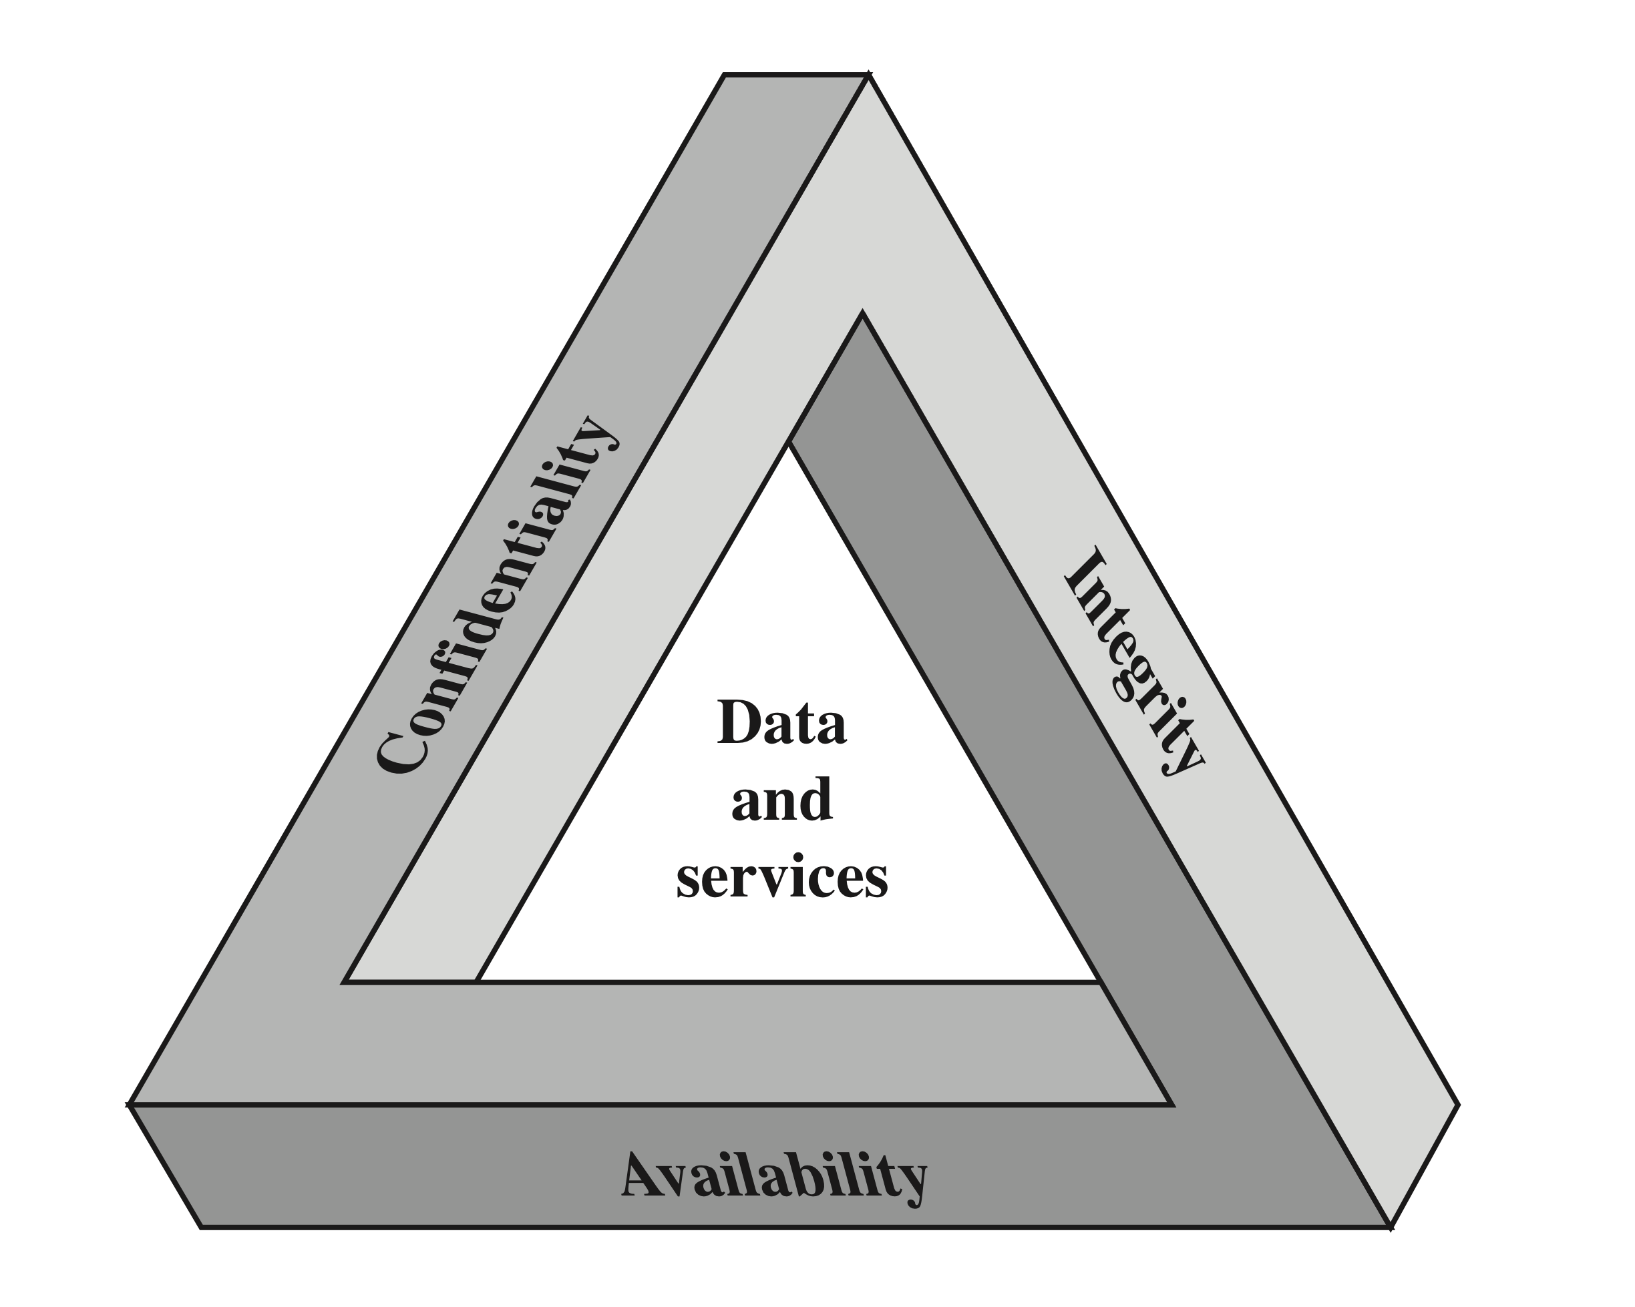
CIA Triad
Notes:
These three concepts form what is often referred to as the CIA triad . The
three concepts embody the fundamental security objectives for both data and for
information and computing services. For example, the NIST Standards for Security
Categorization of Federal Information and Information Systems (FIPS 199) lists
confidentiality, integrity, and availability as the three security objectives for information
and for information systems. FIPS 199 provides a useful characterization
of these three objectives in terms of requirements and the definition of a loss of
security in each category.
• Confidentiality: Preserving authorized restrictions on information access
and disclosure, including means for protecting personal privacy and proprietary
information. A loss of confidentiality is the unauthorized disclosure of
information.
• Integrity: Guarding against improper information modification or destruction,
including ensuring information nonrepudiation and authenticity. A loss of
integrity is the unauthorized modification or destruction of information.
• Availability: Ensuring timely and reliable access to and use of information.
A loss of availability is the disruption of access to or use of information or an
information system.

Slide 9
Possible additional concepts:
Authenticity
Verifying that users are who they say they are and that each input arriving at the system came from a trusted source
Accountability
The security goal that generates the requirement for actions of an entity to be traced uniquely to that entity
Notes:
Although the use of the CIA triad to define security objectives is well established,
some in the security field feel that additional concepts are needed to present
a complete picture. Two of the most commonly mentioned are as follows:
• Authenticity: The property of being genuine and being able to be verified and
trusted; confidence in the validity of a transmission, a message, or message
originator. This means verifying that users are who they say they are and that
each input arriving at the system came from a trusted source.
• Accountability: The security goal that generates the requirement for actions
of an entity to be traced uniquely to that entity. This supports nonrepudiation,
deterrence, fault isolation, intrusion detection and prevention, and after action
recovery and legal action. Because truly secure systems are not yet an
achievable goal, we must be able to trace a security breach to a responsible
party. Systems must keep records of their activities to permit later forensic
analysis to trace security breaches or to aid in transaction disputes.

Slide 10
Breach of Security Levels of Impact
High
The loss could be expected to have a severe or catastrophic adverse effect on organizational operations, organizational assets, or individuals
Moderate
The loss could be expected to have a serious adverse effect on organizational operations, organizational assets, or individuals
Low
The loss could be expected to have a limited adverse effect on organizational operations, organizational assets, or individuals
Notes:
We use three levels of impact on organizations or
individuals should there be a breach of security (i.e., a loss of confidentiality, integrity,
or availability). These levels are defined in FIPS PUB 199:
• Low: The loss could be expected to have a limited adverse effect on organizational
operations, organizational assets, or individuals. A limited adverse
effect means that, for example, the loss of confidentiality, integrity, or availability
might (i) cause a degradation in mission capability to an extent and
duration that the organization is able to perform its primary functions, but the
effectiveness of the functions is noticeably reduced; (ii) result in minor damage
to organizational assets; (iii) result in minor financial loss; or (iv) result in
minor harm to individuals.
• Moderate: The loss could be expected to have a serious adverse effect on
organizational operations, organizational assets, or individuals. A serious
adverse effect means that, for example, the loss might (i) cause a significant
degradation in mission capability to an extent and duration that the
organization is able to perform its primary functions, but the effectiveness
of the functions is significantly reduced; (ii) result in significant damage to
organizational assets; (iii) result in significant financial loss; or (iv) result in
significant harm to individuals that does not involve loss of life or serious,
life-threatening injuries.
• High: The loss could be expected to have a severe or catastrophic adverse
effect on organizational operations, organizational assets, or individuals.
A severe or catastrophic adverse effect means that, for example, the loss might
(i) cause a severe degradation in or loss of mission capability to an extent and
duration that the organization is not able to perform one or more of its primary
functions; (ii) result in major damage to organizational assets; (iii) result
in major financial loss; or (iv) result in severe or catastrophic harm to individuals
involving loss of life or serious, life-threatening injuries.

Slide 11
Examples of Security Requirements
Confidentiality
Student grade information is an asset whose confidentiality is considered to be highly important by students
Regulated by the Family Educational Rights and Privacy Act (FERPA)
Integrity
Patient information stored in a database – inaccurate information could result in serious harm or death to a patient and expose the hospital to massive liability
A Web site that offers a forum to registered users to discuss some specific topic would be assigned a moderate level of integrity
An example of a low-integrity requirement is an anonymous online poll
Availability
The more critical a component or service, the higher the level of availability required
A moderate availability requirement is a public Web site for a university
An online telephone directory lookup application would be classified as a low-availability requirement
Notes:
Confidentiality
Student grade information is an asset whose confidentiality is
considered to be highly important by students. In the United States, the release of
such information is regulated by the Family Educational Rights and Privacy Act
(FERPA). Grade information should only be available to students, their parents,
and employees that require the information to do their job. Student enrollment
information may have a moderate confidentiality rating. While still covered by
FERPA, this information is seen by more people on a daily basis, is less likely to be
targeted than grade information, and results in less damage if disclosed. Directory
information (such as lists of students, faculty, or departmental lists) may be assigned
a low confidentiality rating or indeed no rating. This information is typically freely
available to the public and published on a school’s Web site.
Integrity
Several aspects of integrity are illustrated by the example of a hospital
patient’s allergy information stored in a database. The doctor should be able to
trust that the information is correct and current. Now suppose that an employee
(e.g., a nurse) who is authorized to view and update this information deliberately
falsifies the data to cause harm to the hospital. The database needs to be restored
to a trusted basis quickly, and it should be possible to trace the error back to the
person responsible. Patient allergy information is an example of an asset with a high
requirement for integrity. Inaccurate information could result in serious harm or
death to a patient and expose the hospital to massive liability.
An example of an asset that may be assigned a moderate level of integrity
requirement is a Web site that offers a forum to registered users to discuss some
specific topic. Either a registered user or a hacker could falsify some entries or deface
the Web site. If the forum exists only for the enjoyment of the users, brings
in little or no advertising revenue, and is not used for something important such
as research, then potential damage is not severe. The Web master may experience
some data, financial, and time loss.
An example of a low-integrity requirement is an anonymous online poll. Many
Web sites, such as news organizations, offer these polls to their users with very few
safeguards. However, the inaccuracy and unscientific nature of such polls are well
understood.
Availability
The more critical a component or service, the higher is the level of
availability required. Consider a system that provides authentication services for
critical systems, applications, and devices. An interruption of service results in the
inability for customers to access computing resources and for the staff to access
the resources they need to perform critical tasks. The loss of the service translates
into a large financial loss due to lost employee productivity and potential
customer loss.
An example of an asset that typically would be rated as having a moderate
availability requirement is a public Web site for a university; the Web site provides
information for current and prospective students and donors. Such a site is not a
critical component of the university’s information system, but its unavailability will
cause some embarrassment.
An online telephone directory lookup application would be classified as a low availability
requirement. Although the temporary loss of the application may be
an annoyance, there are other ways to access the information, such as a hardcopy
directory or the operator.

Slide 12

Computer Security Challenges
Security is not simple
Potential attacks on the security features need to be considered
Procedures used to provide particular services are often counter-intuitive
It is necessary to decide where to use the various security mechanisms
Requires constant monitoring
Is too often an afterthought
Security mechanisms typically involve more than a particular algorithm or protocol
Security is essentially a battle of wits between a perpetrator and the designer
Little benefit from security investment is perceived until a security failure occurs
Strong security is often viewed as an impediment to efficient and user-friendly operation
Notes:
Computer and network security is both fascinating and complex. Some of the reasons
include:
1. Security is not as simple as it might first appear to the novice. The requirements
seem to be straightforward; indeed, most of the major requirements for
security services can be given self-explanatory, one-word labels: confidentiality,
authentication, nonrepudiation, and integrity. But the mechanisms used to
meet those requirements can be quite complex, and understanding them may
involve rather subtle reasoning.
2. In developing a particular security mechanism or algorithm, one must always
consider potential attacks on those security features. In many cases, successful
attacks are designed by looking at the problem in a completely different way,
therefore exploiting an unexpected weakness in the mechanism.
3. Because of point 2, the procedures used to provide particular services are
often counterintuitive. Typically, a security mechanism is complex, and it is not
obvious from the statement of a particular requirement that such elaborate
measures are needed. It is only when the various aspects of the threat are considered
that elaborate security mechanisms make sense.
4. Having designed various security mechanisms, it is necessary to decide where
to use them. This is true both in terms of physical placement (e.g., at what points
in a network are certain security mechanisms needed) and in a logical sense
[e.g., at what layer or layers of an architecture such as TCP/IP (Transmission
Control Protocol/Internet Protocol) should mechanisms be placed].
5. Security mechanisms typically involve more than a particular algorithm or
protocol. They also require that participants be in possession of some secret information
(e.g., an encryption key), which raises questions about the creation,
distribution, and protection of that secret information. There also may be a reliance
on communications protocols whose behavior may complicate the task
of developing the security mechanism. For example, if the proper functioning
of the security mechanism requires setting time limits on the transit time of a
message from sender to receiver, then any protocol or network that introduces
variable, unpredictable delays may render such time limits meaningless.
6. Computer and network security is essentially a battle of wits between a perpetrator
who tries to find holes and the designer or administrator who tries to
close them. The great advantage that the attacker has is that he or she need
only find a single weakness, while the designer must find and eliminate all
weaknesses to achieve perfect security.
7. There is a natural tendency on the part of users and system managers to
perceive little benefit from security investment until a security failure occurs.
8. Security requires regular, even constant, monitoring, and this is difficult in
today’s short-term, overloaded environment.
9. Security is still too often an afterthought to be incorporated into a system after
the design is complete rather than being an integral part of the design process.
10. Many users (and even security administrators) view strong security as an
impediment to efficient and user-friendly operation of an information
system or use of information.
The difficulties just enumerated will be encountered in numerous ways as we
examine the various security threats and mechanisms throughout this book.

Slide 13
OSI Security Architecture
Security attack
Any action that compromises the security of information owned by an organization
Security mechanism
A process (or a device incorporating such a process) that is designed to detect, prevent, or recover from a security attack
Security service
A processing or communication service that enhances the security of the data processing systems and the information transfers of an organization
Intended to counter security attacks, and they make use of one or more security mechanisms to provide the service
Notes:
To assess effectively the security needs of an organization and to evaluate and
choose various security products and policies, the manager responsible for computer
and network security needs some systematic way of defining the requirements
for security and characterizing the approaches to satisfying those requirements.
This is difficult enough in a centralized data processing environment; with the use of
local and wide area networks, the problems are compounded.
ITU-T Recommendation X.800, Security Architecture for OSI , defines such a
systematic approach. The OSI security architecture is useful to managers as a way
of organizing the task of providing security. Furthermore, because this architecture
was developed as an international standard, computer and communications vendors
have developed security features for their products and services that relate to this
structured definition of services and mechanisms.
For our purposes, the OSI security architecture provides a useful, if abstract,
overview of many of the concepts that this book deals with. The OSI security architecture
focuses on security attacks, mechanisms, and services. These can be defined
briefly as
• Security attack: Any action that compromises the security of information
owned by an organization.
• Security mechanism: A process (or a device incorporating such a process) that
is designed to detect, prevent, or recover from a security attack.
• Security service: A processing or communication service that enhances the
security of the data processing systems and the information transfers of an
organization. The services are intended to counter security attacks, and they
make use of one or more security mechanisms to provide the service.

Slide 14
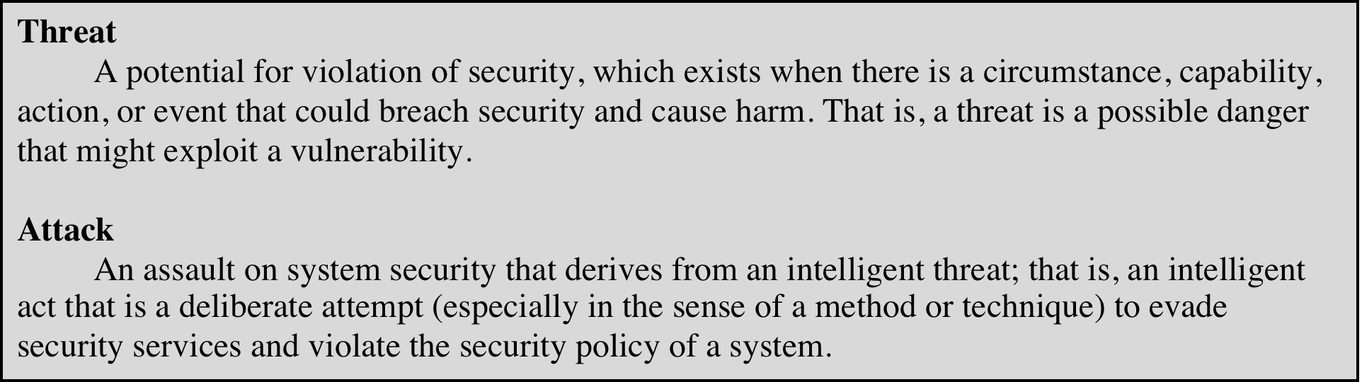
Table 1.1 Threats and Attacks (RFC 4949)
Notes:
In the literature, the terms threat and attack are commonly used to mean more
or less the same thing. Table 1.1 provides definitions taken from RFC 4949, Internet
Security Glossary.

Slide 15
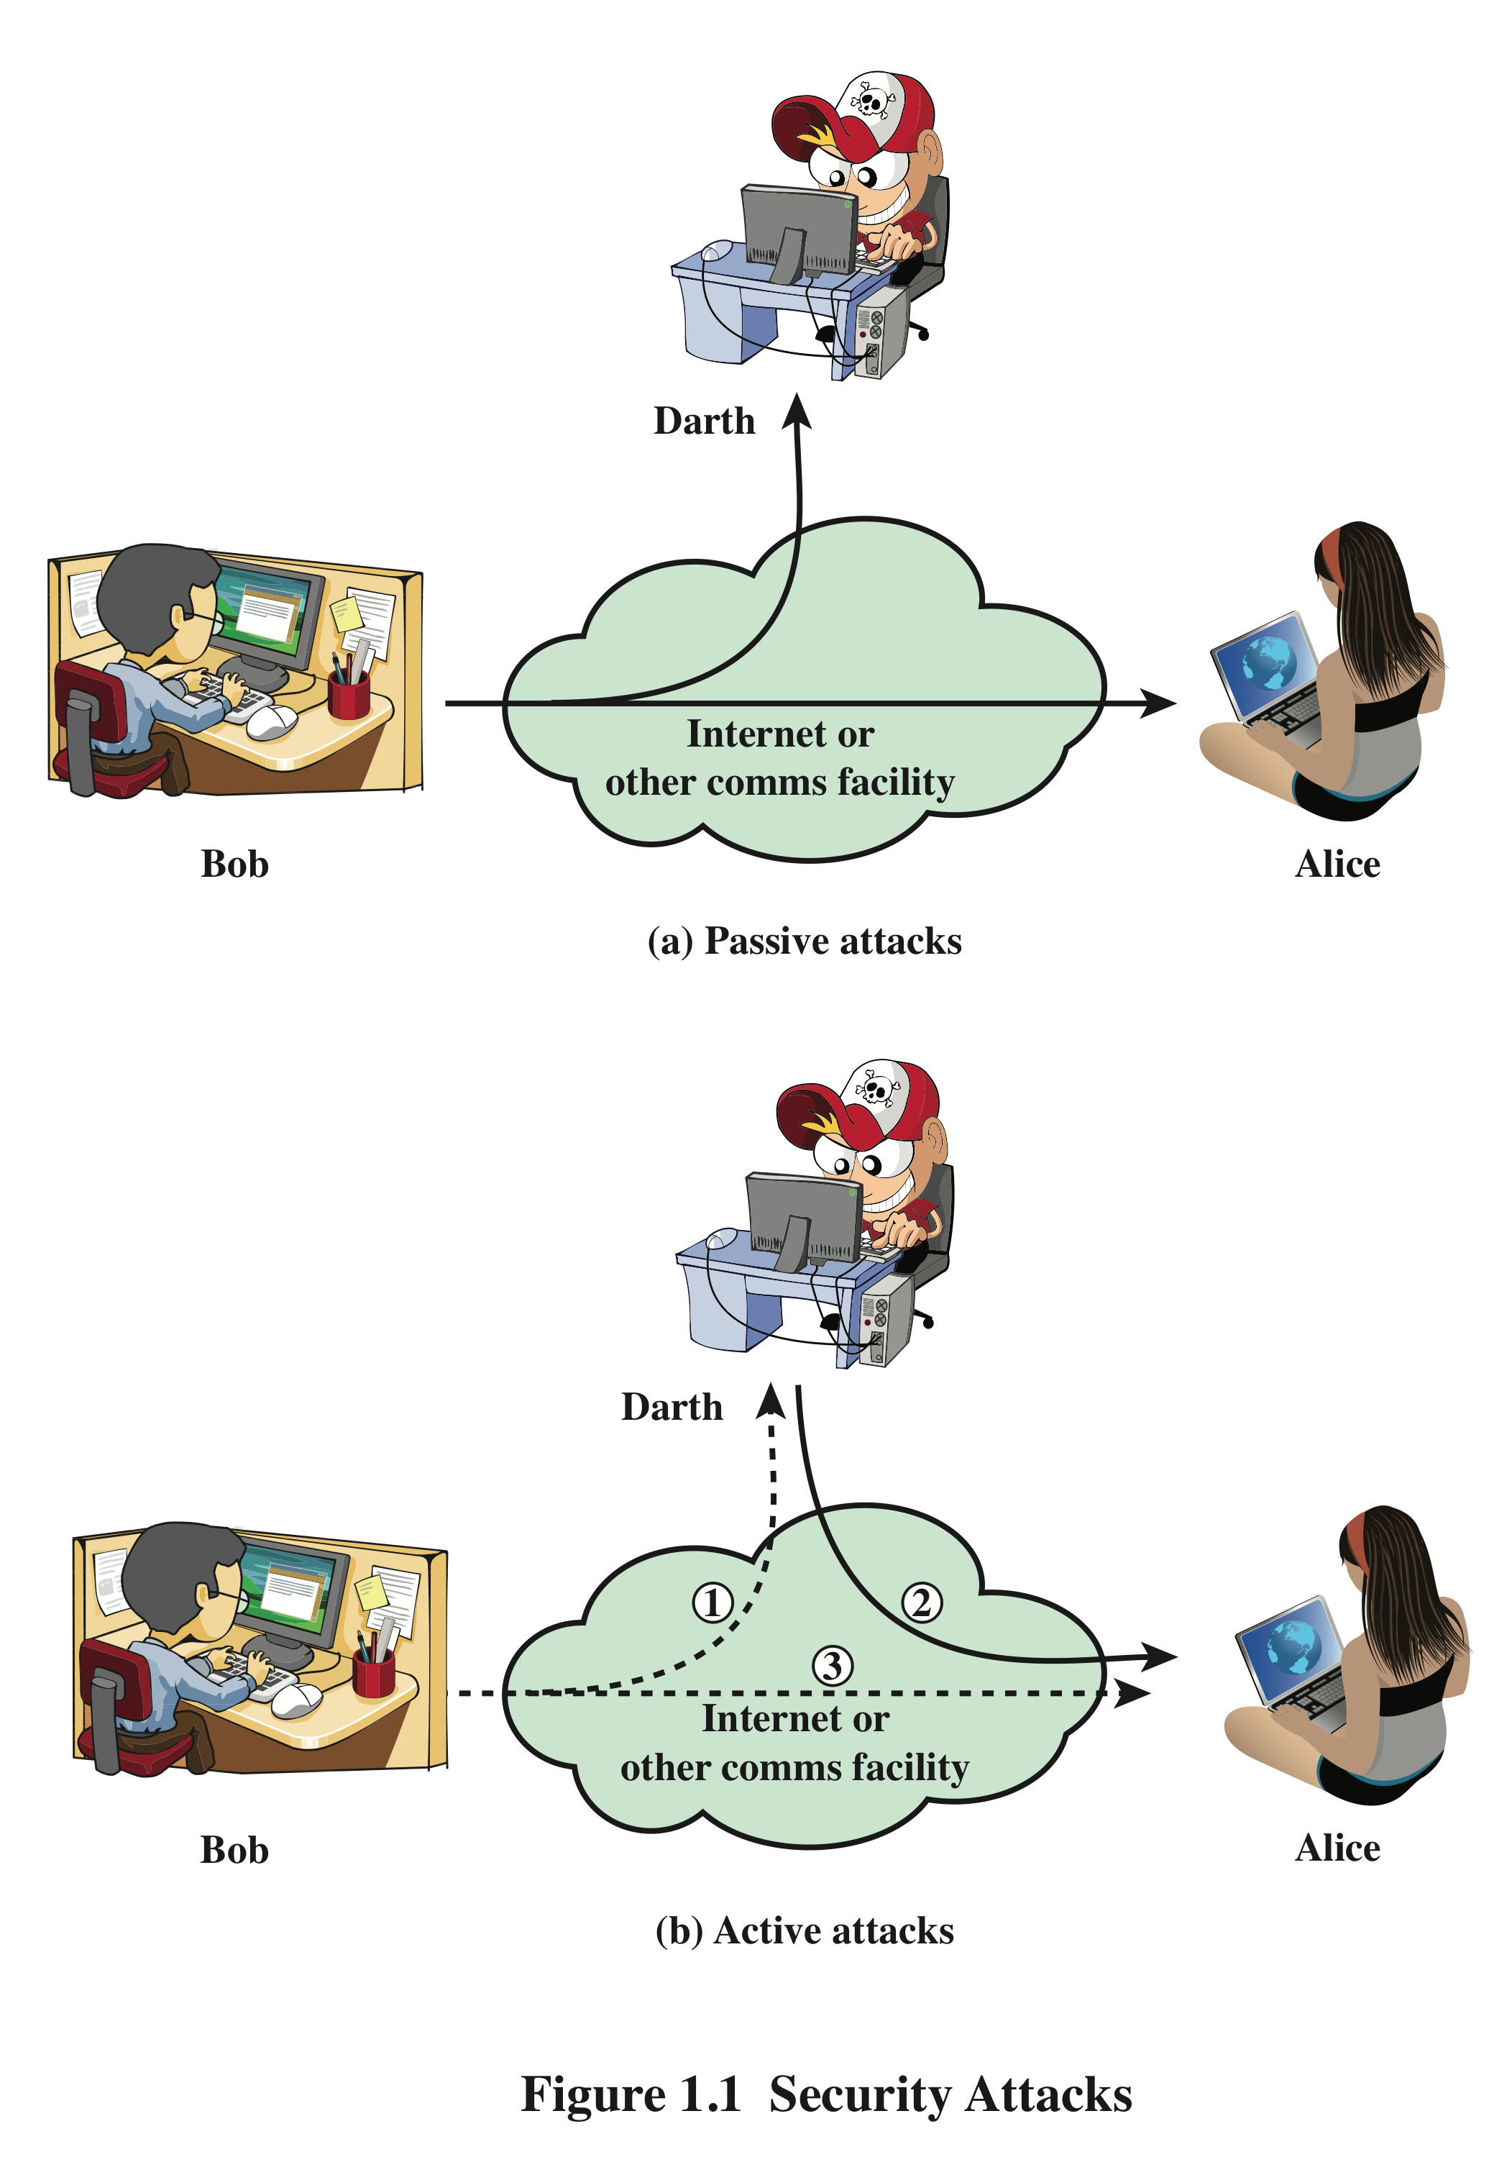
Security Attacks
A means of classifying security attacks, used both in X.800 and RFC 4949, is in terms of passive attacks and active attacks
A passive attack attempts to learn or make use of information from the system but does not affect system resources
An active attack attempts to alter system resources or affect their operation
Notes:
A useful means of classifying security attacks, used both in X.800 and RFC 4949, is in
terms of passive attacks and active attacks (Figure 1.1). A passive attack attempts to
learn or make use of information from the system but does not affect system resources.
An active attack attempts to alter system resources or affect their operation.

Slide 16
Passive Attacks
Are in the nature of eavesdropping on, or monitoring of, transmissions
Goal of the opponent is to obtain information that is being transmitted
Two types of passive attacks are:
The release of message contents
Traffic analysis
Notes:
Passive attacks (Figure 1.1) are in the nature of eavesdropping on, or monitoring
of, transmissions. The goal of the opponent is to obtain information that is being
transmitted. Two types of passive attacks are the release of message contents and
traffic analysis.
The release of message contents is easily understood. A telephone conversation,
an electronic mail message, and a transferred file may contain sensitive or
confidential information. We would like to prevent an opponent from learning the
contents of these transmissions.
A second type of passive attack, traffic analysis , is subtler. Suppose that we
had a way of masking the contents of messages or other information traffic so that
opponents, even if they captured the message, could not extract the information
from the message. The common technique for masking contents is encryption. If we
had encryption protection in place, an opponent might still be able to observe the
pattern of these messages. The opponent could determine the location and identity
of communicating hosts and could observe the frequency and length of messages
being exchanged. This information might be useful in guessing the nature of the
communication that was taking place.
Passive attacks are very difficult to detect, because they do not involve any
alteration of the data. Typically, the message traffic is sent and received in an apparently
normal fashion, and neither the sender nor receiver is aware that a third party
has read the messages or observed the traffic pattern. However, it is feasible to prevent
the success of these attacks, usually by means of encryption. Thus, the emphasis
in dealing with passive attacks is on prevention rather than detection.

Slide 17
Active Attacks
Involve some modification of the data stream or the creation of a false stream
Difficult to prevent because of the wide variety of potential physical, software, and network vulnerabilities
Goal is to detect attacks and to recover from any disruption or delays caused by them
Masquerade
Takes place when one entity pretends to be a different entity
Usually includes one of the other forms of active attack
Replay
Involves the passive capture of a data unit and its subsequent retransmission to produce an unauthorized effect
Modification of messages
Some portion of a legitimate message is altered, or messages are delayed or reordered to produce an unauthorized effect
Denial of service
Prevents or inhibits the normal use or management of communications facilities
Notes:
Active attacks (Figure 1.1b) involve some modification of the data stream or the
creation of a false stream and can be subdivided into four categories: masquerade,
replay, modification of messages, and denial of service.
A masquerade takes place when one entity pretends to be a different entity
(path 2 of Figure 1.1b is active). A masquerade attack usually includes one of the
other forms of active attack. For example, authentication sequences can be captured
and replayed after a valid authentication sequence has taken place, thus enabling an
authorized entity with few privileges to obtain extra privileges by impersonating an
entity that has those privileges.
Replay involves the passive capture of a data unit and its subsequent retransmission
to produce an unauthorized effect (paths 1, 2, and 3 active).
Modification of messages simply means that some portion of a legitimate
message is altered, or that messages are delayed or reordered, to produce an
unauthorized effect (paths 1 and 2 active). For example, a message meaning “Allow
John Smith to read confidential file accounts ” is modified to mean “Allow Fred
Brown to read confidential file accounts. ”
The denial of service prevents or inhibits the normal use or management of
communications facilities (path 3 active). This attack may have a specific target; for
example, an entity may suppress all messages directed to a particular destination
(e.g., the security audit service). Another form of service denial is the disruption
of an entire network, either by disabling the network or by overloading it with
messages so as to degrade performance.
Active attacks present the opposite characteristics of passive attacks. Whereas
passive attacks are difficult to detect, measures are available to prevent their success.
On the other hand, it is quite difficult to prevent active attacks absolutely
because of the wide variety of potential physical, software, and network vulnerabilities.
Instead, the goal is to detect active attacks and to recover from any disruption
or delays caused by them. If the detection has a deterrent effect, it may also
contribute to prevention.

Slide 18
Security Services
Defined by X.800 as:
A service provided by a protocol layer of communicating open systems and that ensures adequate security of the systems or of data transfers
Defined by RFC 4949 as:
A processing or communication service provided by a system to give a specific kind of protection to system resources
Notes:
X.800 defines a security service as a service that is provided by a protocol layer of
communicating open systems and that ensures adequate security of the systems
or of data transfers. Perhaps a clearer definition is found in RFC 4949, which
provides the following definition: a processing or communication service that is
provided by a system to give a specific kind of protection to system resources;
security services implement security policies and are implemented by security
mechanisms.

Slide 19
X.800 Service Categories
Authentication
Access control
Data confidentiality
Data integrity
Nonrepudiation
Notes:
X.800 divides these services into five categories.

Slide 20
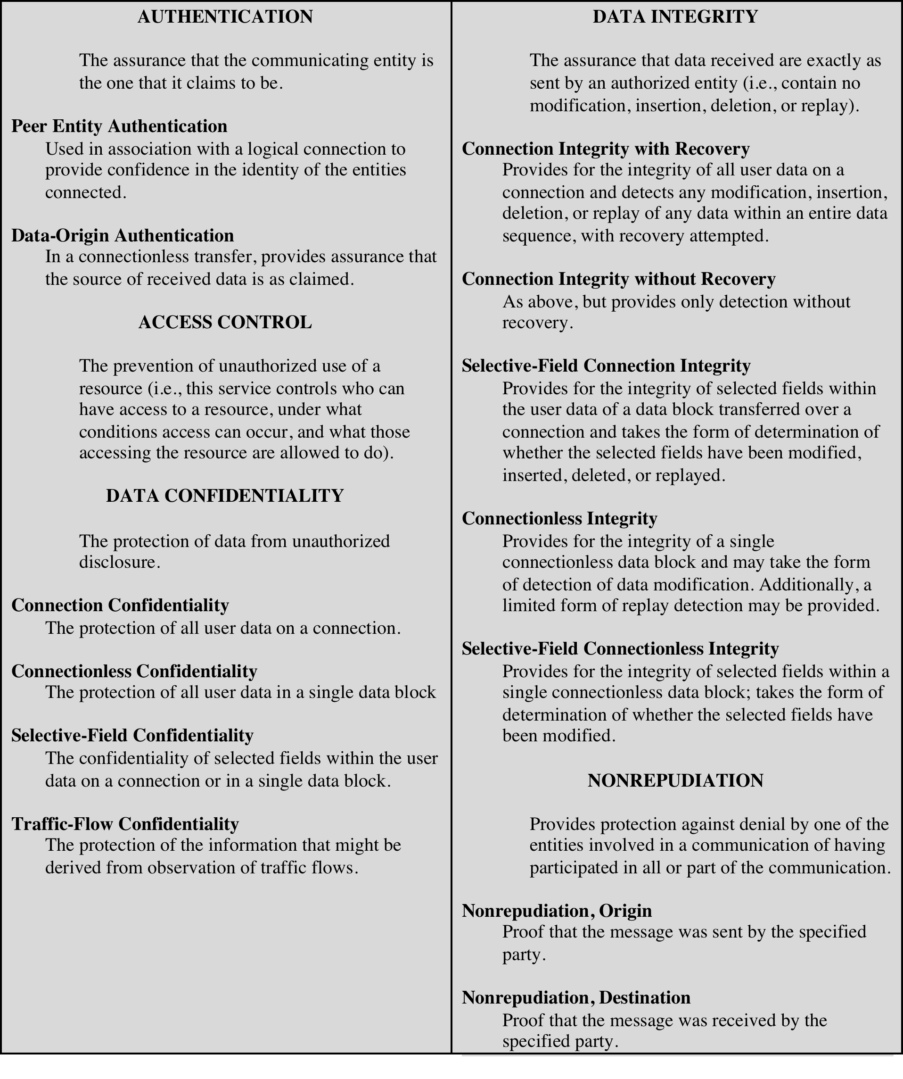
Table 1.2
Security Services
(X.800)
(This table is found on page 12 in the textbook)
Notes:
X.800 divides these services into five categories and fourteen specific services
(Table 1.2).

Slide 21
Authentication
Concerned with assuring that a communication is authentic
In the case of a single message, assures the recipient that the message is from the source that it claims to be from
In the case of ongoing interaction, assures the two entities are authentic and that the connection is not interfered with in such a way that a third party can masquerade as one of the two legitimate parties
Two specific authentication services are defined in X.800:
Peer entity authentication
Data origin authentication
Notes:
The authentication service is concerned with assuring that a communication is
authentic. In the case of a single message, such as a warning or alarm signal, the
function of the authentication service is to assure the recipient that the message
is from the source that it claims to be from. In the case of an ongoing interaction,
such as the connection of a terminal to a host, two aspects are involved. First,
at the time of connection initiation, the service assures that the two entities are
authentic, that is, that each is the entity that it claims to be. Second, the service
must assure that the connection is not interfered with in such a way that a third
party can masquerade as one of the two legitimate parties for the purposes of
unauthorized transmission or reception.
Two specific authentication services are defined in X.800:
• Peer entity authentication: Provides for the corroboration of the identity
of a peer entity in an association. Two entities are considered peers if they
implement to same protocol in different systems; for example two TCP modules
in two communicating systems. Peer entity authentication is provided for
use at the establishment of, or at times during the data transfer phase of, a
connection. It attempts to provide confidence that an entity is not performing
either a masquerade or an unauthorized replay of a previous connection.
• Data origin authentication: Provides for the corroboration of the source of a
data unit. It does not provide protection against the duplication or modification
of data units. This type of service supports applications like electronic mail,
where there are no prior interactions between the communicating entities.

Slide 22
Access Control
The ability to limit and control the access to host systems and applications via communications links
To achieve this, each entity trying to gain access must first be indentified, or authenticated, so that access rights can be tailored to the individual
Notes:
In the context of network security, access control is the ability to limit and control
the access to host systems and applications via communications links. To achieve
this, each entity trying to gain access must first be identified, or authenticated, so
that access rights can be tailored to the individual.

Slide 23

Data Confidentiality
The protection of transmitted data from passive attacks
Broadest service protects all user data transmitted between two users over a period of time
Narrower forms of service include the protection of a single message or even specific fields within a message
The protection of traffic flow from analysis
This requires that an attacker not be able to observe the source and destination, frequency, length, or other characteristics of the traffic on a communications facility
Notes:
Confidentiality is the protection of transmitted data from passive attacks. With
respect to the content of a data transmission, several levels of protection can be
identified. The broadest service protects all user data transmitted between two
users over a period of time. For example, when a TCP connection is set up between
two systems, this broad protection prevents the release of any user data transmitted
over the TCP connection. Narrower forms of this service can also be defined,
including the protection of a single message or even specific fields within a message.
These refinements are less useful than the broad approach and may even be more
complex and expensive to implement.
The other aspect of confidentiality is the protection of traffic flow from analysis.
This requires that an attacker not be able to observe the source and destination, frequency,
length, or other characteristics of the traffic on a communications facility.

Slide 24
Data Integrity
Can apply to a stream of messages, a single message, or selected fields within a message
Connection-oriented integrity service deals with a stream of messages and assures that messages are received as sent with no duplication, insertion, modification, reordering, or replays
A connectionless integrity service deals with individual messages without regard to any larger context and generally provides protection against message modification only
Notes:
As with confidentiality, integrity can apply to a stream of messages, a single message,
or selected fields within a message. Again, the most useful and straightforward
approach is total stream protection.
A connection-oriented integrity service, one that deals with a stream of messages,
assures that messages are received as sent with no duplication, insertion,
modification, reordering, or replays. The destruction of data is also covered under
this service. Thus, the connection-oriented integrity service addresses both message
stream modification and denial of service. On the other hand, a connectionless integrity
service, one that deals with individual messages without regard to any larger
context, generally provides protection against message modification only.
We can make a distinction between service with and without recovery.
Because the integrity service relates to active attacks, we are concerned with detection
rather than prevention. If a violation of integrity is detected, then the service
may simply report this violation, and some other portion of software or human
intervention is required to recover from the violation. Alternatively, there are
mechanisms available to recover from the loss of integrity of data, as we will review
subsequently. The incorporation of automated recovery mechanisms is, in general,
the more attractive alternative.

Slide 25

Nonrepudiation
Prevents either sender or receiver from denying a transmitted message
When a message is sent, the receiver can prove that the alleged sender in fact sent the message
When a message is received, the sender can prove that the alleged receiver in fact received the message
Notes:
Nonrepudiation prevents either sender or receiver from denying a transmitted message.
Thus, when a message is sent, the receiver can prove that the alleged sender in
fact sent the message. Similarly, when a message is received, the sender can prove
that the alleged receiver in fact received the message.

Slide 26
Availability service
Availability
The property of a system or a system resource being accessible and usable upon demand by an authorized system entity, according to performance specifications for the system
Availability service
One that protects a system to ensure its availability
Addresses the security concerns raised by denial-of-service attacks
Depends on proper management and control of system resources
Notes:
Both X.800 and RFC 4949 define availability to be the property of a system or
a system resource being accessible and usable upon demand by an authorized
system entity, according to performance specifications for the system (i.e., a system
is available if it provides services according to the system design whenever
users request them). A variety of attacks can result in the loss of or reduction
in availability. Some of these attacks are amenable to automated countermeasures,
such as authentication and encryption, whereas others require some sort
of physical action to prevent or recover from loss of availability of elements of a
distributed system.
X.800 treats availability as a property to be associated with various security
services. However, it makes sense to call out specifically an availability service. An
availability service is one that protects a system to ensure its availability. This service
addresses the security concerns raised by denial-of-service attacks. It depends
on proper management and control of system resources and thus depends on access
control service and other security services.

Slide 27
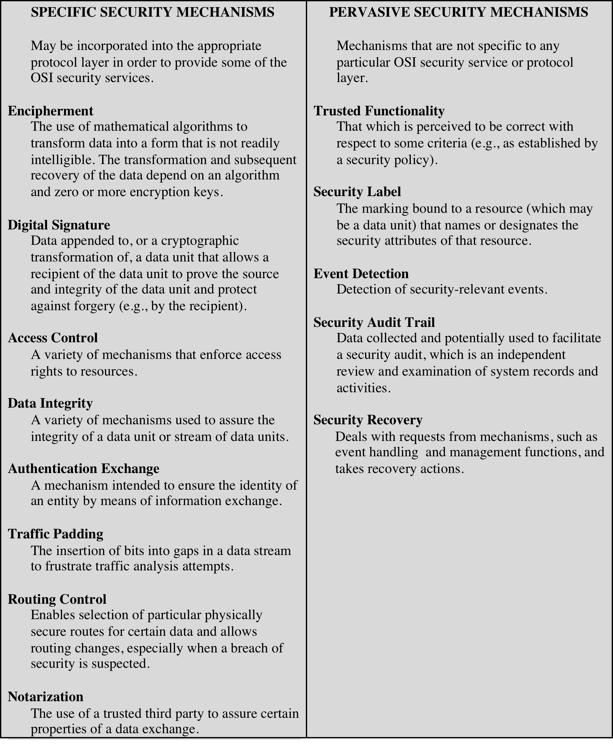
Table 1.3
Security Mechanisms
(X.800)
(This table is found on page 15 in the textbook)
Notes:
Table 1.3 lists the security mechanisms defined in X.800. The mechanisms are
divided into those that are implemented in a specific protocol layer, such as TCP
or an application-layer protocol, and those that are not specific to any particular
protocol layer or security service. These mechanisms will be covered in the
appropriate places in the book, so we do not elaborate now except to comment
on the definition of encipherment. X.800 distinguishes between reversible
encipherment mechanisms and irreversible encipherment mechanisms. A reversible
encipherment mechanism is simply an encryption algorithm that allows data to
be encrypted and subsequently decrypted. Irreversible encipherment mechanisms
include hash algorithms and message authentication codes, which are used in digital
signature and message authentication applications.

Slide 28
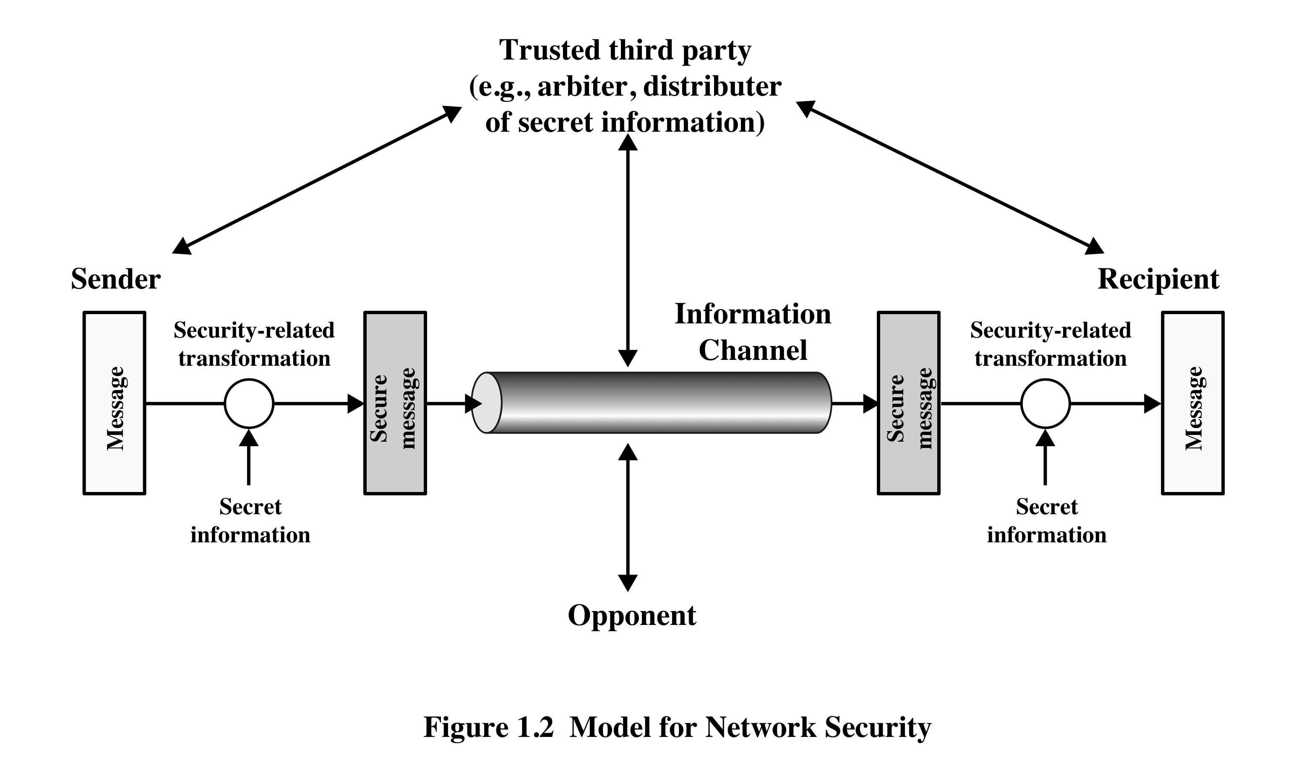
Model for Network Security
Notes:
A model for much of what we will be discussing is captured, in very general terms,
in Figure 1.2. A message is to be transferred from one party to another across some
sort of Internet service. The two parties, who are the principals in this transaction,
must cooperate for the exchange to take place. A logical information channel is
established by defining a route through the Internet from source to destination
and by the cooperative use of communication protocols (e.g., TCP/IP) by the two
principals.
Security aspects come into play when it is necessary or desirable to protect the
information transmission from an opponent who may present a threat to confidentiality,
authenticity, and so on. All of the techniques for providing security have two
components:
1. A security-related transformation on the information to be sent. Examples
include the encryption of the message, which scrambles the message so that it
is unreadable by the opponent, and the addition of a code based on the contents
of the message, which can be used to verify the identity of the sender.
2. Some secret information shared by the two principals and, it is hoped,
unknown to the opponent. An example is an encryption key used in conjunction
with the transformation to scramble the message before transmission and
unscramble it on reception.
A trusted third party may be needed to achieve secure transmission. For
example, a third party may be responsible for distributing the secret information
to the two principals while keeping it from any opponent. Or a third party may be
needed to arbitrate disputes between the two principals concerning the authenticity
of a message transmission.
This general model shows that there are four basic tasks in designing a
particular security service:
1. Design an algorithm for performing the security-related transformation. The
algorithm should be such that an opponent cannot defeat its purpose.
2. Generate the secret information to be used with the algorithm.
3. Develop methods for the distribution and sharing of the secret information.
4. Specify a protocol to be used by the two principals that make use of the security
algorithm and the secret information to achieve a particular security service.

Slide 29
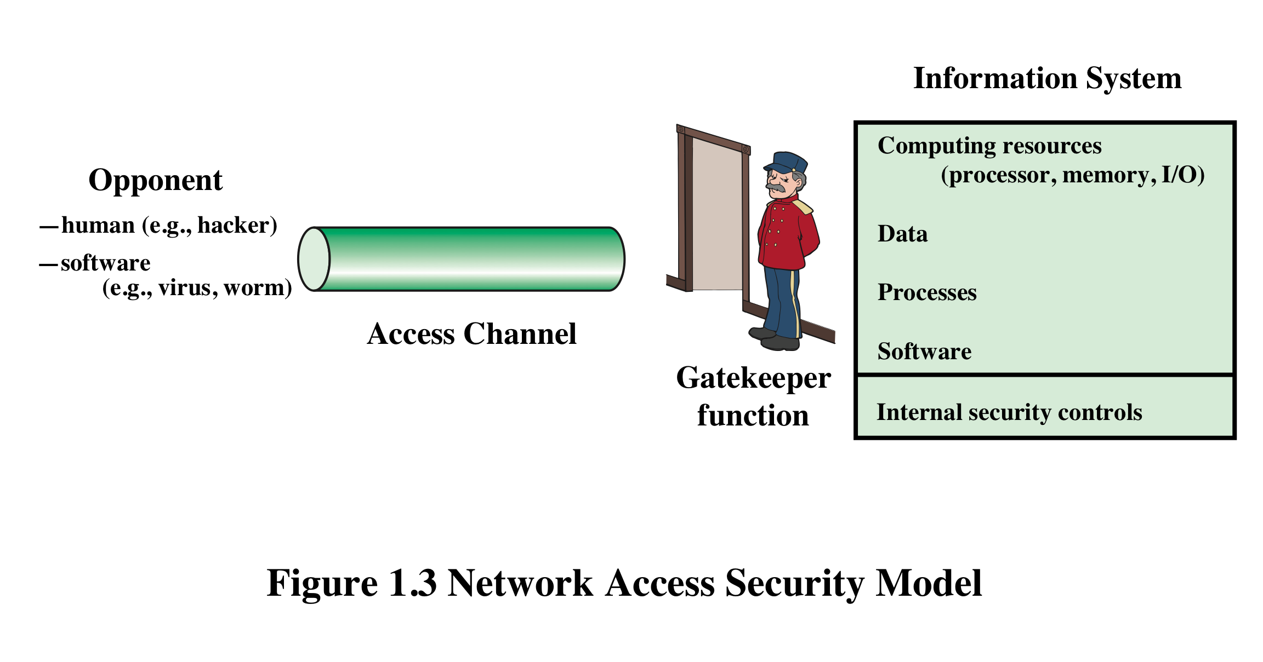
Network Access Security Model
Notes:
Parts One and Two of this book concentrate on the types of security mechanisms
and services that fit into the model shown in Figure 1.2. However, there are
other security-related situations of interest that do not neatly fit this model but are
considered in this book. A general model of these other situations is illustrated by
Figure 1.3, which reflects a concern for protecting an information system from unwanted
access. Most readers are familiar with the concerns caused by the existence
of hackers who attempt to penetrate systems that can be accessed over a network.
The hacker can be someone who, with no malign intent, simply gets satisfaction
from breaking and entering a computer system. The intruder can be a disgruntled
employee who wishes to do damage or a criminal who seeks to exploit computer
assets for financial gain (e.g., obtaining credit card numbers or performing illegal
money transfers).

Slide 30
Unwanted Access
Placement in a computer system of logic that exploits vulnerabilities in the system and that can affect application programs as well as utility programs
Programs can present two kinds of threats:
Information access threats
Intercept or modify data on behalf of users who should not have access to that data
Service threats
Exploit service flaws in computers to inhibit use by legitimate users
Notes:
Another type of unwanted access is the placement in a computer system
of logic that exploits vulnerabilities in the system and that can affect application
programs as well as utility programs, such as editors and compilers. Programs can
present two kinds of threats:
1. Information access threats: Intercept or modify data on behalf of users who
should not have access to that data.
2. Service threats: Exploit service flaws in computers to inhibit use by legitimate
users.
Viruses and worms are two examples of software attacks. Such attacks can be
introduced into a system by means of a disk that contains the unwanted logic concealed
in otherwise useful software. They also can be inserted into a system across a
network; this latter mechanism is of more concern in network security.
The security mechanisms needed to cope with unwanted access fall into two
broad categories (see Figure 1.3). The first category might be termed a gatekeeper
function. It includes password-based login procedures that are designed to deny
access to all but authorized users and screening logic that is designed to detect
and reject worms, viruses, and other similar attacks. Once either an unwanted user
or unwanted software gains access, the second line of defense consists of a variety
of internal controls that monitor activity and analyze stored information in an
attempt to detect the presence of unwanted intruders. These issues are explored in
Part Three.

Slide 31
standards
NIST
ISOC
National Institute of Standards and Technology
U.S. federal agency that deals with measurement science, standards, and technology related to U.S. government use and to the promotion of U.S. private-sector innovation
NIST Federal Information Processing Standards (FIPS) and Special Publications (SP) have a worldwide impact
Internet Society
Professional membership society with worldwide organizational and individual membership
Provides leadership in addressing issues that confront the future of the Internet
Is the organization home for the groups responsible for Internet infrastructure standards, including the Internet Engineering Task Force (IETF) and the Internet Architecture Board (IAB)
Internet standards and related specifications are published as Requests for Comments (RFCs)
Notes:
Many of the security techniques and applications described in this book have been
specified as standards. Additionally, standards have been developed to cover
management practices and the overall architecture of security mechanisms and
services. Throughout this book, we describe the most important standards in use
or being developed for various aspects of cryptography and network security.
Various organizations have been involved in the development or promotion of
these standards. The most important (in the current context) of these organizations
are as follows.
• National Institute of Standards and Technology: NIST is a U.S. federal agency
that deals with measurement science, standards, and technology related to
U.S. government use and to the promotion of U.S. private-sector innovation.
Despite its national scope, NIST Federal Information Processing Standards
(FIPS) and Special Publications (SP) have a worldwide impact.
• Internet Society: ISOC is a professional membership society with worldwide
organizational and individual membership. It provides leadership in addressing
issues that confront the future of the Internet and is the organization
home for the groups responsible for Internet infrastructure standards,
including the Internet Engineering Task Force (IETF) and the Internet
Architecture Board (IAB). These organizations develop Internet standards
and related specifications, all of which are published as Requests for
Comments (RFCs) .
A more detailed discussion of these organizations is contained in Appendix C.

Slide 32
Summary
Computer security concepts
Definition
Examples
Challenges
The OSI security architecture
Security attacks
Passive attacks
Active attacks
Security services
Authentication
Access control
Data confidentiality
Data integrity
Nonrepudiation
Availability service
Security mechanisms
Model for network security
Standards
Notes:
Chapter 1 summary.

Slide 33
Network Security Essentials
Fifth Edition
by William Stallings
Notes:
Lecture slides prepared for “Network Security Essentials”, 5/e, by William Stallings, Chapter 2 – “Symmetric Encryption and Message Confidentiality”.

Slide 34
Chapter 2
Symmetric Encryption and
Message Confidentiality
(block cipher slide no.41, 46, 210)
Notes:
This chapter begins with a look at a general model for the symmetric encryption
process; this will enable us to understand the context within which the algorithms are
used. Then we look at three important block encryption algorithms: DES, triple DES,
and AES. This is followed by a discussion of random and pseudorandom number generation.
Next, the chapter introduces symmetric stream encryption and describes the
widely used stream cipher RC4. Finally, we look at the important topic of block cipher
modes of operation.

Slide 35
“I have solved other ciphers of an abstruseness ten thousand times greater. Circumstances, and a certain bias of mind, have led me to take interest in such riddles, and it may well be doubted whether human ingenuity can construct an enigma of the kind which human ingenuity may not, by proper application, resolve.”
—The Gold Bug, Edgar Allen Poe
Notes:
Opening quote.

Slide 36
Amongst the tribes of Central Australia every man, woman, and child has a secret or sacred name which is bestowed by the older men upon him or her soon after birth, and which is known to none but the fully initiated members of the group. This secret name is never mentioned except upon the most solemn occasions; to utter it in the hearing of men of another group would be a most serious breach of tribal custom. When mentioned at all, the name is spoken only in a whisper, and not until the most elaborate precautions have been taken that it shall be heard by no one but members of the group. The native thinks that a stranger knowing his secret name would have special power to work him ill by means of magic.
—The Golden Bough, Sir James George Frazer
Notes:
Symmetric encryption, also referred to as conventional encryption, secret-key, or
single-key encryption, was the only type of encryption in use prior to the development
of public-key encryption in the late 1970s. It remains by far the most widely
used of the two types of encryption.

Slide 37
Some Basic Terminology
Plaintext - original message
Ciphertext - coded message
Cipher - algorithm for transforming plaintext to ciphertext
Key - info used in cipher known only to sender/receiver
Encipher (encrypt) - converting plaintext to ciphertext
Decipher (decrypt) - recovering ciphertext from plaintext
Cryptography - study of encryption principles/methods
Cryptanalysis (code breaking) - study of principles/methods of deciphering ciphertext without knowing key
Cryptology - field of both cryptography and cryptanalysis
Notes:
Briefly review some terminology used throughout the course.

Slide 38
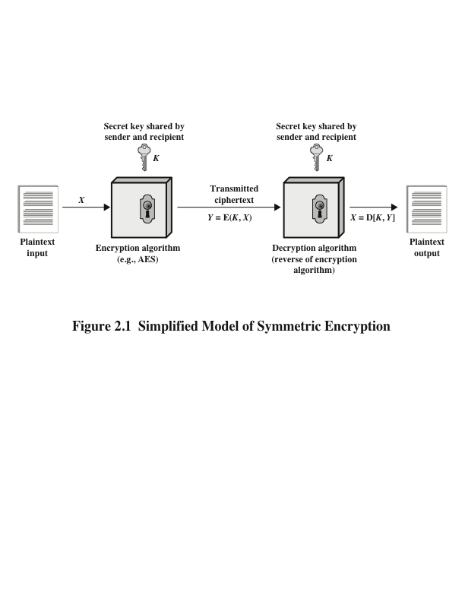
Notes:
A symmetric encryption scheme has five ingredients (Figure 2.1):
• Plaintext: This is the original message or data that is fed into the algorithm
as input.
• Encryption algorithm: The encryption algorithm performs various substitutions
and transformations on the plaintext.
• Secret key: The secret key is also input to the algorithm. The exact substitutions
and transformations performed by the algorithm depend on the key.
• Ciphertext: This is the scrambled message produced as output. It depends on
the plaintext and the secret key. For a given message, two different keys will
produce two different ciphertexts.
• Decryption algorithm: This is essentially the encryption algorithm run in
reverse. It takes the ciphertext and the same secret key and produces the
original plaintext.

Slide 39
Requirements
There are two requirements for secure use of symmetric encryption:
A strong encryption algorithm
Sender and receiver must have obtained copies of the secret key in a secure fashion and must keep the key secure
The security of symmetric encryption depends on the secrecy of the key, not the secrecy of the algorithm
This makes it feasible for widespread use
Manufacturers can and have developed low-cost chip implementations of data encryption algorithms
These chips are widely available and incorporated into a number of products
Notes:
There are two requirements for secure use of symmetric encryption:
1. We need a strong encryption algorithm. At a minimum, we would like the
algorithm to be such that an opponent who knows the algorithm and has
access to one or more ciphertexts would be unable to decipher the ciphertext
or figure out the key. This requirement is usually stated in a stronger form:
The opponent should be unable to decrypt ciphertext or discover the key even
if he or she is in possession of a number of ciphertexts together with the plaintext
that produced each ciphertext.
2. Sender and receiver must have obtained copies of the secret key in a secure
fashion and must keep the key secure. If someone can discover the key and
knows the algorithm, all communication using this key is readable.
It is important to note that the security of symmetric encryption depends on
the secrecy of the key, not the secrecy of the algorithm. That is, it is assumed that
it is impractical to decrypt a message on the basis of the ciphertext plus knowledge
of the encryption/decryption algorithm. In other words, we do not need to keep the
algorithm secret; we need to keep only the key secret.
This feature of symmetric encryption is what makes it feasible for widespread
use. The fact that the algorithm need not be kept secret means that manufacturers
can and have developed low-cost chip implementations of data encryption
algorithms. These chips are widely available and incorporated into a number of
products. With the use of symmetric encryption, the principal security problem is
maintaining the secrecy of the key.

Slide 40
Cryptography
Cryptographic systems are generically classified along three independent dimensions:
The type of operations used for transforming plaintext to ciphertext
Substitution
Each element in the plaintext is mapped into another element
Transposition
Elements in the plaintext are rearranged
Fundamental requirement is that no information be lost
Product systems
Involve multiple stages of substitutions and transpositions
The number of keys used
Referred to as symmetric, single-key, secret-key, or conventional encryption if both sender and receiver use the same key
Referred to as asymmetric, two-key, or public-key encryption if the sender and receiver each use a different key
The way in which the plaintext is processed
Block cipher processes the input one block of elements at a time, producing an output block for each input block
Stream cipher processes the input elements continuously, producing output one element at a time, as it goes along
Notes:
Cryptographic systems are generically classified along three independent
dimensions:
1. The type of operations used for transforming plaintext to ciphertext. All
encryption algorithms are based on two general principles: substitution, in
which each element in the plaintext (bit, letter, group of bits or letters) is
mapped into another element, and transposition, in which elements in the
plaintext are rearranged. The fundamental requirement is that no information
be lost (i.e., that all operations be reversible). Most systems, referred to as
product systems, involve multiple stages of substitutions and transpositions.
2. The number of keys used. If both sender and receiver use the same key, the
system is referred to as symmetric, single-key, secret-key, or conventional
encryption.
If the sender and receiver each use a different key, the system is
referred to as asymmetric, two-key, or public-key encryption.
3. The way in which the plaintext is processed. A block cipher processes the
input one block of elements at a time, producing an output block for each
input block. A stream cipher processes the input elements continuously, producing
output one element at a time, as it goes along.

Slide 41
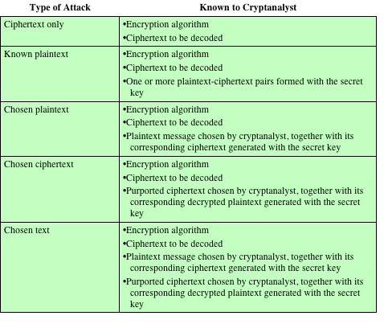
Table 2.1
Types of Attacks on Encrypted Messages
Notes:
The process of attempting to discover the plaintext or key is known as cryptanalysis .
The strategy used by the cryptanalyst depends on the nature of the encryption scheme
and the information available to the cryptanalyst.
Table 2.1 summarizes the various types of cryptanalytic attacks based on the
amount of information known to the cryptanalyst. The most difficult problem is
presented when all that is available is the ciphertext only . In some cases, not even
the encryption algorithm is known, but in general, we can assume that the opponent
does know the algorithm used for encryption. One possible attack under these circumstances
is the brute-force approach of trying all possible keys. If the key space
is very large, this becomes impractical. Thus, the opponent must rely on an analysis
of the ciphertext itself, generally applying various statistical tests to it. To use this
approach, the opponent must have some general idea of the type of plaintext that
is concealed, such as English or French text, an EXE file, a Java source listing, an
accounting file, and so on.
The ciphertext-only attack is the easiest to defend against because the
opponent has the least amount of information to work with. In many cases, however,
the analyst has more information. The analyst may be able to capture one
or more plaintext messages as well as their encryptions. Or the analyst may know
that certain plaintext patterns will appear in a message. For example, a file that is
encoded in the Postscript format always begins with the same pattern, or there may
be a standardized header or banner to an electronic funds transfer message, and so
on. All of these are examples of known plaintext . With this knowledge, the analyst
may be able to deduce the key on the basis of the way in which the known plaintext
is transformed.
Closely related to the known-plaintext attack is what might be referred to as a
probable-word attack. If the opponent is working with the encryption of some general
prose message, he or she may have little knowledge of what is in the message.
However, if the opponent is after some very specific information, then parts of the
message may be known. For example, if an entire accounting file is being transmitted,
the opponent may know the placement of certain key words in the header of
the file. As another example, the source code for a program developed by a corporation
might include a copyright statement in some standardized position.
If the analyst is able somehow to get the source system to insert into the system
a message chosen by the analyst, then a chosen-plaintext attack is possible. In
general, if the analyst is able to choose the messages to encrypt, the analyst may
deliberately pick patterns that can be expected to reveal the structure of the key.
Table 2.1 lists two other types of attack: chosen ciphertext and chosen text.
These are less commonly employed as cryptanalytic techniques but are nevertheless
possible avenues of attack.

Slide 42
cryptanalysis
An encryption scheme is computationally secure if the ciphertext generated by the scheme meets one or both of the following criteria:
The cost of breaking the cipher exceeds the value of the encrypted information
The time required to break the cipher exceeds the useful lifetime of the information
Notes:
Only relatively weak algorithms fail to withstand a ciphertext-only attack.
Generally, an encryption algorithm is designed to withstand a known-plaintext
attack.
An encryption scheme is computationally secure if the ciphertext generated
by the scheme meets one or both of the following criteria:
• The cost of breaking the cipher exceeds the value of the encrypted information.
• The time required to break the cipher exceeds the useful lifetime of the
information.

Slide 43
Brute Force attack
Involves trying every possible key until an intelligible translation of the ciphertext into plaintext is obtained
On average, half of all possible keys must be tried to achieve success
Unless known plaintext is provided, the analyst must be able to recognize plaintext as plaintext
To supplement the brute-force approach
Some degree of knowledge about the expected plaintext is needed
Some means of automatically distinguishing plaintext from garble is also needed
Notes:
Unfortunately, it is very difficult to estimate the amount of effort required
to cryptanalyze ciphertext successfully. However, assuming there are no inherent
mathematical weaknesses in the algorithm, then a brute-force approach is indicated.
A brute-force attack involves trying every possible key until an intelligible
translation of the ciphertext into plaintext is obtained. On average, half of all possible
keys must be tried to achieve success. That is, if there are x different keys, on
average an attacker would discover the actual key after x /2 tries. It is important
to note that there is more to a brute-force attack than simply running through all
possible keys. Unless known plaintext is provided, the analyst must be able to recognize
plaintext as plaintext. If the message is just plaintext in English, then the
result pops out easily, although the task of recognizing English would have to be
automated. If the text message has been compressed before encryption, then recognition
is more difficult. And if the message is some more general type of data,
such as a numerical file, and this has been compressed, the problem becomes even
more difficult to automate. Thus, to supplement the brute-force approach, some
degree of knowledge about the expected plaintext is needed, and some means of
automatically distinguishing plaintext from garble is also needed.

Slide 44
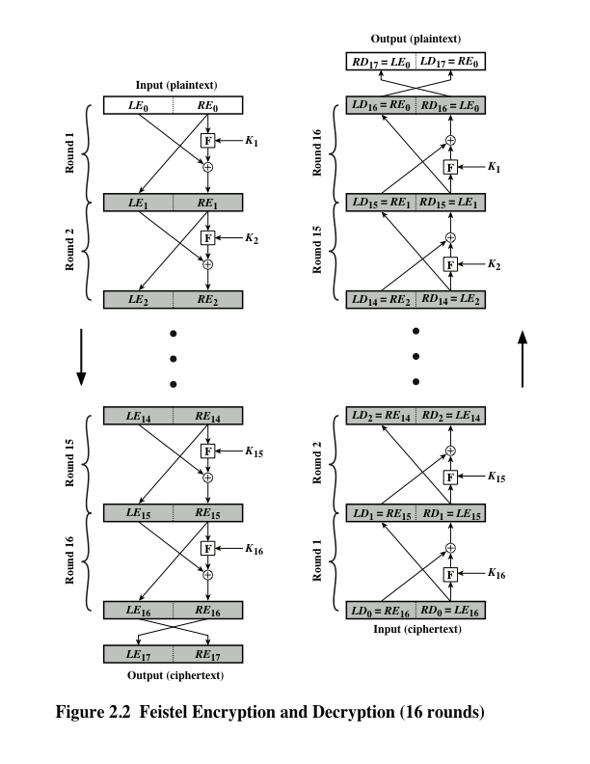
Notes:
Many symmetric block encryption algorithms, including DES, have a structure first
described by Horst Feistel of IBM in 1973 [FEIS73] and shown in Figure 2.2. The
inputs to the encryption algorithm are a plaintext block of length 2w bits and a key
K . The plaintext block is divided into two halves, LE₀ and RE₀ . The two halves
of the data pass through n rounds of processing and then combine to produce the
ciphertext block. Each round i has as inputs LE_{i-1} and RE_{i-1} derived from the previous
round, as well as a subkey K_{i} derived from the overall K . In general, the subkeys
K_{i} are different from K and from each other and are generated from the key
by a subkey generation algorithm. In Figure 2.2, 16 rounds are used, although any
number of rounds could be implemented. The right-hand side of Figure 2.2 shows
the decryption process.
All rounds have the same structure. A substitution is performed on the left half
of the data. This is done by applying a round function F to the right half of the data
and then taking the exclusive-OR (XOR) of the output of that function and the left
half of the data. The round function has the same general structure for each round
but is parameterized by the round subkey K_{i} . Following this substitution, a permutation
is performed that consists of the interchange of the two halves of the data.

Slide 45
Feistel Cipher Design Elements
Block size
Larger block sizes mean greater security but reduced encryption/decryption speed
Key size
Larger key size means greater security but may decrease encryption/decryption speed
Number of rounds
The essence of a symmetric block cipher is that a single round offers inadequate security but that multiple rounds offer increasing security
Subkey generation algorithm
Greater complexity in this algorithm should lead to greater difficulty of cryptanalysis
Round function
Greater complexity generally means greater resistance to cryptanalysis
Fast software encryption/decryption
In many cases, encryption is embedded in applications or utility functions in such a way as to preclude a hardware implementation; accordingly, the seed of execution of the algorithm becomes a concern
Ease of analysis
If the algorithm can be concisely and clearly explained, it is easier to analyze that algorithm for cryptanalytic vulnerabilities and therefore develop a higher level of assurance as to its strength
Notes:
The Feistel structure is a particular example of the more general structure
used by all symmetric block ciphers. In general, a symmetric block cipher consists of
a sequence of rounds, with each round performing substitutions and permutations
conditioned by a secret key value. The exact realization of a symmetric block cipher
depends on the choice of the following parameters and design features.
• Block size: Larger block sizes mean greater security (all other things being
equal) but reduced encryption/decryption speed. A block size of 128 bits is a
reasonable trade-off and is nearly universal among recent block cipher designs.
• Key size: Larger key size means greater security but may decrease encryption/
decryption speed. The most common key length in modern algorithms is 128 bits.
• Number of rounds: The essence of a symmetric block cipher is that a single
round offers inadequate security but that multiple rounds offer increasing
security. A typical size is from 10 to 16 rounds.
• Subkey generation algorithm: Greater complexity in this algorithm should
lead to greater difficulty of cryptanalysis.
• Round function: Again, greater complexity generally means greater resistance
to cryptanalysis.
There are two other considerations in the design of a symmetric block cipher:
• Fast software encryption/decryption: In many cases, encryption is embedded
in applications or utility functions in such a way as to preclude a hardware
implementation. Accordingly, the speed of execution of the algorithm
becomes a concern.
• Ease of analysis: Although we would like to make our algorithm as difficult as
possible to cryptanalyze, there is great benefit in making the algorithm easy to
analyze. That is, if the algorithm can be concisely and clearly explained, it is
easier to analyze that algorithm for cryptanalytic vulnerabilities and therefore
develop a higher level of assurance as to its strength. DES, for example, does
not have an easily analyzed functionality.

Slide 46
Symmetric Block encryption algorithms
The three most important symmetric block ciphers
Data Encryption Standard (DES)
Triple DES (3DES)
Advanced Encryption Standard (AES)
Block cipher
The most commonly used symmetric encryption algorithms
Processes the plaintext input in fixed-sized blocks and produces a block of ciphertext of equal size for each plaintext block
Notes:
The most commonly used symmetric encryption algorithms are block ciphers.
A block cipher processes the plaintext input in fixed-sized blocks and produces a
block of ciphertext of equal size for each plaintext block. This section focuses on
the three most important symmetric block ciphers: the Data Encryption Standard
(DES), triple DES (3DES), and the Advanced Encryption Standard (AES).

Slide 47

Data Encryption Standard (DES)
Most widely used encryption scheme
Issued in 1977 as Federal Information Processing Standard 46 (FIPS 46) by the National Institute of Standards and Technology (NIST)
The algorithm itself is referred to as the Data Encryption Algorithm (DEA)
Notes:
The most widely used encryption scheme is based on the Data Encryption Standard
(DES) issued in 1977, as Federal Information Processing Standard 46 (FIPS 46) by
the National Bureau of Standards, now known as the National Institute of Standards
and Technology (NIST). The algorithm itself is referred to as the Data Encryption
Algorithm (DEA).

Slide 48
DES algorithm
Description of the algorithm:
Plaintext is 64 bits in length
Key is 56 bits in length
Structure is a minor variation of the Feistel network
There are 16 rounds of processing
Process of decryption is essentially the same as the encryption process
The strength of DES:
Concerns fall into two categories
The algorithm itself
Refers to the possibility that cryptanalysis is possible by exploiting the characteristics of the algorithm
The use of a 56-bit key
Speed of commercial, off-the-shelf processors threatens the security
Notes:
The plaintext is 64 bits in length and the key is
56 bits in length; longer plaintext amounts are processed in 64-bit blocks. The DES
structure is a minor variation of the Feistel network shown in Figure 2.2. There are
16 rounds of processing. From the original 56-bit key, 16 subkeys are generated, one
of which is used for each round.
The process of decryption with DES is essentially the same as the encryption
process. The rule is as follows: Use the ciphertext as input to the DES algorithm, but
use the subkeys K_{i} in reverse order. That is, use K₁₆ on the first iteration, K₁₅ on the
second iteration, and so on until K₁ is used on the 16th and last iteration.
Concerns about the strength of DES fall into two categories:
concerns about the algorithm itself and concerns about the use of a 56-bit key.
The first concern refers to the possibility that cryptanalysis is possible by exploiting
the characteristics of the DES algorithm. Over the years, there have been numerous
attempts to find and exploit weaknesses in the algorithm, making DES the most studied
encryption algorithm in existence. Despite numerous approaches, no one
has so far succeeded in discovering a fatal weakness in DES.
A more serious concern is key length. With a key length of 56 bits, there are
2⁵⁶ possible keys, which is approximately 7.2 * 10¹⁶ keys. Thus, on the face of it,
a brute-force attack appears impractical. Assuming that on average half the key
space has to be searched, a single machine performing one DES encryption per
microsecond would take more than a thousand years to break the cipher.
However, the assumption of one encryption per microsecond is overly
conservative. DES finally and definitively proved insecure in July 1998, when the
Electronic Frontier Foundation (EFF) announced that it had broken a DES encryption
using a special-purpose “DES cracker” machine that was built for less than
$250,000. The attack took less than three days. The EFF has published a detailed
description of the machine, enabling others to build their own cracker [EFF98].
And, of course, hardware prices will continue to drop as speeds increase, making
DES virtually worthless.
With current technology, it is not even necessary to use special, purpose-built
hardware. Rather, the speed of commercial, off-the-shelf processors threaten the
security of DES. A paper from Seagate Technology [SEAG08] suggests that a rate
of one billion (10⁹ ) key combinations per second is reasonable for today’s multicore
computers. Recent offerings confirm this. Both Intel and AMD now offer hardware based
instructions to accelerate the use of AES. Tests run on a contemporary multicore
Intel machine resulted in an encryption rate of about half a billion [BASU12].
Another recent analysis suggests that with contemporary supercomputer technology,
a rate of 10¹³ encryptions/s is reasonable [AROR12].

Slide 49
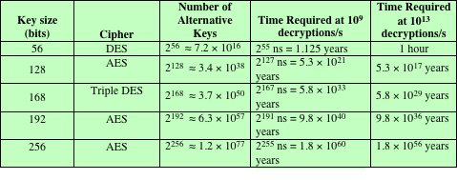
Table 2.2 Average Time Required for Exhaustive Key Search
Notes:
Considering these results, Table 2.2 shows how much time is required for a
brute-force attack for various key sizes. As can be seen, a single PC can break DES
in about a year; if multiple PCs work in parallel, the time is drastically shortened.
And today’s supercomputers should be able to find a key in about an hour. Key
sizes of 128 bits or greater are effectively unbreakable using simply a brute-force
approach. Even if we managed to speed up the attacking system by a factor of 1 trillion
(10¹² ), it would still take over 100,000 years to break a code using a 128-bit key.

Slide 50
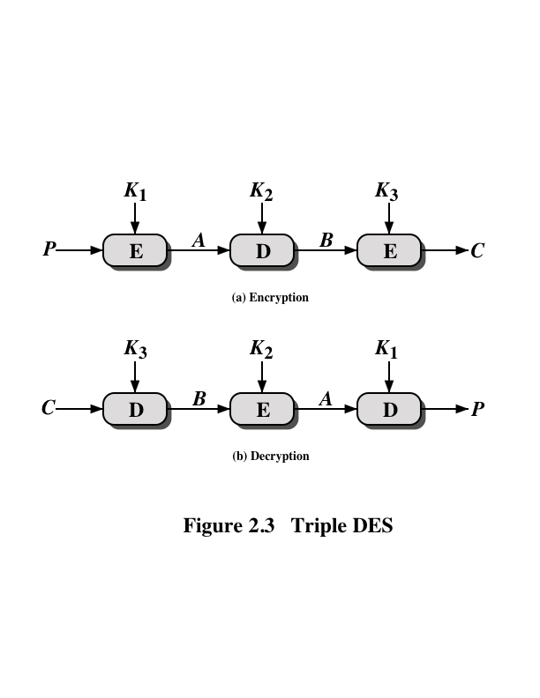
Notes:
Triple DES (3DES) was first standardized for use in financial applications in ANSI
standard X9.17 in 1985. 3DES was incorporated as part of the Data Encryption
Standard in 1999 with the publication of FIPS 46-3.
3DES uses three keys and three executions of the DES algorithm. The function
follows an encrypt-decrypt-encrypt (EDE) sequence (Figure 2.3a).
There is no cryptographic significance to the use of decryption for the second
stage of 3DES encryption. Its only advantage is that it allows users of 3DES to
decrypt data encrypted by users of the older single DES.
With three distinct keys, 3DES has an effective key length of 168 bits.

Slide 51
3DES guidelines
FIPS 46-3 includes the following guidelines for 3DES:
3DES is the FIPS-approved symmetric encryption algorithm of choice
The original DES, which uses a single 56-bit key, is permitted under the standard for legacy systems only; new procurements should support 3DES
Government organizations with legacy DES systems are encouraged to transition to 3DES
It is anticipated that 3DES and the Advanced Encryption Standard (AES) will coexist as FIPS-approved algorithms, allowing for a gradual transition to AES
Notes:
FIPS 46-3 includes the following guidelines for 3DES.
• 3DES is the FIPS-approved symmetric encryption algorithm of choice.
• The original DES, which uses a single 56-bit key, is permitted under the standard
for legacy systems only. New procurements should support 3DES.
• Government organizations with legacy DES systems are encouraged to transition
to 3DES.
• It is anticipated that 3DES and the Advanced Encryption Standard (AES) will
coexist as FIPS-approved algorithms, allowing for a gradual transition to AES.
It is easy to see that 3DES is a formidable algorithm. Because the underlying
cryptographic algorithm is DEA, 3DES can claim the same resistance to cryptanalysis
based on the algorithm as is claimed for DEA. Furthermore, with a 168-bit key
length, brute-force attacks are effectively impossible.
Ultimately, AES is intended to replace 3DES, but this process will take a
number of years. NIST anticipates that 3DES will remain an approved algorithm
(for U.S. government use) for the foreseeable future.

Slide 52
Advanced encryption standard (AES)
In 1997 NIST issued a call for proposals for a new AES:
Should have a security strength equal to or better than 3DES and significantly improved efficiency
Must be a symmetric block cipher with a block length of 128 bits and support for key lengths of 128, 192, and 256 bits
Evaluation criteria included security, computational efficiency, memory requirements, hardware and software suitability, and flexibility
NIST selected Rijndael as the proposed AES algorithm
FIPS PUB 197
Developers were two cryptographers from Belgium: Dr. Joan Daemen and Dr. Vincent Rijmen
Notes:
The principal drawback of 3DES is that the algorithm is relatively sluggish
in software. The original DEA was designed for mid-1970s hardware implementation
and does not produce efficient software code. 3DES, which has three times
as many rounds as DEA, is correspondingly slower. A secondary drawback is that
both DEA and 3DES use a 64-bit block size. For reasons of both efficiency and
security, a larger block size is desirable.
Because of these drawbacks, 3DES is not a reasonable candidate for long term
use. As a replacement, NIST in 1997 issued a call for proposals for a new
Advanced Encryption Standard (AES) , which should have a security strength equal
to or better than 3DES and significantly improved efficiency. In addition to these
general requirements, NIST specified that AES must be a symmetric block cipher
with a block length of 128 bits and support for key lengths of 128, 192, and 256 bits.
Evaluation criteria included security, computational efficiency, memory requirements,
hardware and software suitability, and flexibility.
In a first round of evaluation, 15 proposed algorithms were accepted. A second
round narrowed the field to five algorithms. NIST completed its evaluation process
and published a final standard (FIPS PUB 197) in November of 2001. NIST selected
Rijndael as the proposed AES algorithm. The two researchers who developed and
submitted Rijndael for the AES are both cryptographers from Belgium: Dr. Joan
Daemen and Dr. Vincent Rijmen.
AES uses a block length of 128 bits and a key length
that can be 128, 192, or 256 bits. In the description of this section, we assume a key
length of 128 bits, which is likely to be the one most commonly implemented.
The input to the encryption and decryption algorithms is a single 128-bit
block. In FIPS PUB 197, this block is depicted as a square matrix of bytes. This
block is copied into the State array, which is modified at each stage of encryption or
decryption. After the final stage, State is copied to an output matrix. Similarly, the
128-bit key is depicted as a square matrix of bytes. This key is then expanded into an
array of key schedule words: Each word is four bytes and the total key schedule is
44 words for the 128-bit key. The ordering of bytes within a matrix is by column. So,
for example, the first four bytes of a 128-bit plaintext input to the encryption cipher
occupy the first column of the in matrix, the second four bytes occupy the second
column, and so on. Similarly, the first four bytes of the expanded key, which form a
word, occupy the first column of the w matrix.

Slide 53
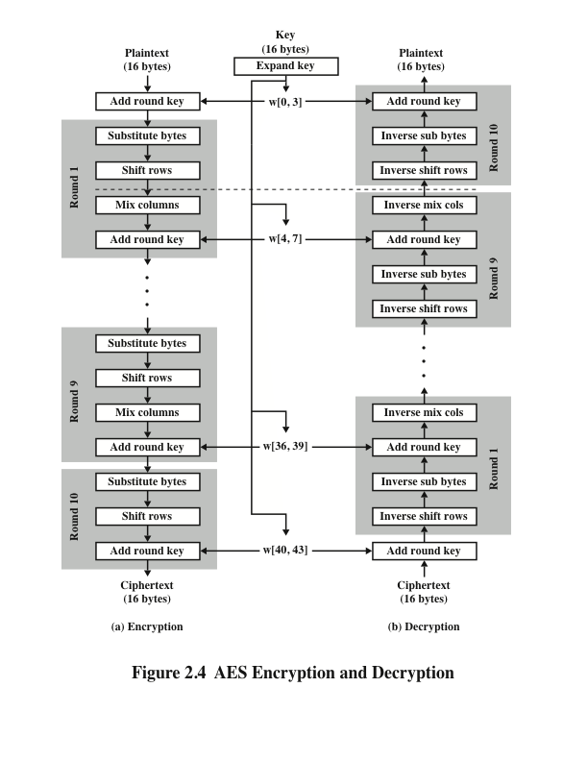
Notes:
Four different stages are used, one of permutation and three of substitution
(Figure 2.4):
• Substitute bytes: Uses a table, referred to as an S-box, to perform a byte-by-
byte substitution of the block.
• Shift rows: A simple permutation that is performed row by row.
• Mix columns: A substitution that alters each byte in a column as a function
of all of the bytes in the column.
• Add round key: A simple bitwise XOR of the current block with a portion
of the expanded key.

Slide 54
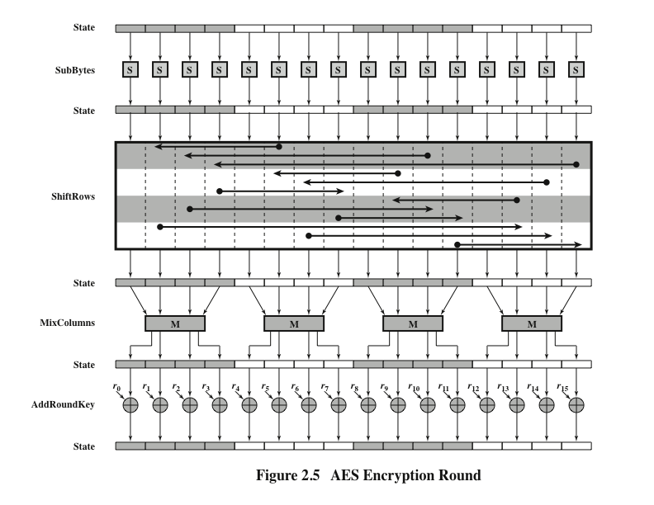
Notes:
Figure 2.5
depicts the structure of a full encryption round.

Slide 55
Random and pseudorandom Numbers
A number of network security algorithms based on cryptography make use of random numbers
Examples:
Generation of keys for the RSA public-key encryption algorithm and other public-key algorithms
Generation of a symmetric key for use as a temporary session key; used in a number of networking applications such as Transport Layer Security, Wi-Fi, e-mail security, and IP security
In a number of key distribution scenarios, such as Kerberos, random numbers are used for handshaking to prevent replay attacks
Two distinct and not necessarily compatible requirements for a sequence of random numbers are:
Randomness
Unpredictability
Notes:
Random numbers play an important role in the use of encryption for various
network security applications. We provide an overview in this section. The topic is
examined in more detail in Appendix E.
A number of network security algorithms based on cryptography make use of
random numbers. For example,
• Generation of keys for the RSA public-key encryption algorithm (described
in Chapter 3) and other public-key algorithms.
• Generation of a stream key for symmetric stream cipher (discussed in the
following section).
• Generation of a symmetric key for use as a temporary session key. This function
is used in a number of networking applications, such as Transport Layer
Security (Chapter 5), Wi-Fi (Chapter 6), e-mail security (Chapter 7), and IP
security (Chapter 8).
• In a number of key distribution scenarios, such as Kerberos (Chapter 4),
random numbers are used for handshaking to prevent replay attacks.
These applications give rise to two distinct and not necessarily compatible
requirements for a sequence of random numbers: randomness and
unpredictability.

Slide 56
Randomness
The following criteria are used to validate that a sequence of numbers is random:
Uniform distribution
The distribution of bits in the sequence should be uniform
Frequency of occurrence of ones and zeros should be approximately the same
Independence
No one subsequence in the sequence can be inferred from the others
There is no test to “prove” independence
The general strategy is to apply a number of tests until the confidence that independence exists is sufficiently strong
Notes:
Traditionally, the concern in the generation of a sequence of allegedly
random numbers has been that the sequence of numbers be random in some well defined
statistical sense. The following criteria are used to validate that a sequence
of numbers is random.
• Uniform distribution: The distribution of bits in the sequence should be
uniform; that is, the frequency of occurrence of ones and zeros should
be approximately the same.
• Independence: No one subsequence in the sequence can be inferred from the
others.
Although there are well-defined tests for determining that a sequence of numbers
matches a particular distribution, such as the uniform distribution, there is no
such test to “prove” independence. Rather, a number of tests can be applied to
demonstrate if a sequence does not exhibit independence. The general strategy is
to apply a number of such tests until the confidence that independence exists is sufficiently
strong.

Slide 57
unpredictability
In applications such as reciprocal authentication and session key generation, the requirement is not so much that the sequence of numbers be statistically random but that the successive members of the sequence are unpredictable
With “true” random sequences, each number is statistically independent of other numbers in the sequence and therefore unpredictable
Care must be taken that an opponent not be able to predict future elements of the sequence on the basis of earlier elements
Notes:
In applications such as reciprocal authentication and session key
generation, the requirement is not so much that the sequence of numbers be statistically
random but that the successive members of the sequence are unpredictable.
With “true” random sequences, each number is statistically independent of other
numbers in the sequence and therefore unpredictable. However, as is discussed
shortly, true random numbers are not always used; rather, sequences of numbers
that appear to be random are generated by some algorithm. In this latter case, care
must be taken that an opponent not be able to predict future elements of the sequence
on the basis of earlier elements.

Slide 58
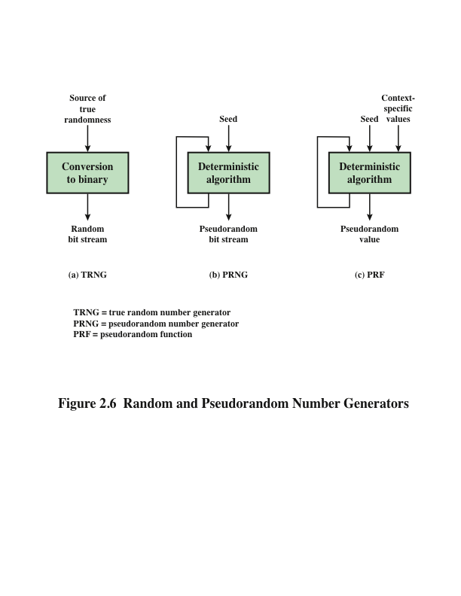
Notes:
Cryptographic applications typically make use of algorithmic techniques for random
number generation. These algorithms are deterministic and therefore produce
sequences of numbers that are not statistically random. However, if the algorithm is
good, the resulting sequences will pass many reasonable tests of randomness. Such
numbers are referred to as pseudorandom numbers .
You may be somewhat uneasy about the concept of using numbers generated
by a deterministic algorithm as if they were random numbers. Despite what might be
called philosophical objections to such a practice, it generally works. That is, under
most circumstances, pseudorandom numbers will perform as well as if they were random
for a given use. The phrase “as well as” is unfortunately subjective, but the use
of pseudorandom numbers is widely accepted. The same principle applies in statistical
application, in which a statistician takes a sample of a population and assumes that
the results will be approximately the same as if the whole population were measured.
Figure 2.6 contrasts a true random number generator (TRNG) with two
forms of pseudorandom number generators. A TRNG takes as input a source
that is effectively random; the source is often referred to as an entropy source . In
essence, the entropy source is drawn from the physical environment of the computer
and could include things such as keystroke timing patterns, disk electrical
activity, mouse movements, and instantaneous values of the system clock. The
source, or combination of sources, serves as input to an algorithm that produces
random binary output. The TRNG may simply involve conversion of an analog
source to a binary output. The TRNG may involve additional processing to overcome
any bias in the source.
In contrast, a PRNG takes as input a fixed value, called the seed , and produces
a sequence of output bits using a deterministic algorithm. Typically, as shown in
Figure 2.6, there is some feedback path by which some of the results of the algorithm
are fed back as input as additional output bits are produced. The important
thing to note is that the output bit stream is determined solely by the input value or
values, so that an adversary who knows the algorithm and the seed can reproduce
the entire bit stream.
Figure 2.6 shows two different forms of PRNGs, based on application.
• Pseudorandom number generator: An algorithm that is used to produce an
open-ended sequence of bits is referred to as a PRNG. A common application
for an open-ended sequence of bits is as input to a symmetric stream cipher, as
discussed in the following section.
• Pseudorandom function (PRF): A PRF is used to produce a pseudorandom
string of bits of some fixed length. Examples are symmetric encryption
keys and nonces. Typically, the PRF takes as input a seed plus some context
specific values, such as a user ID or an application ID. A number of examples
of PRFs will be seen throughout this book.
Other than the number of bits produced, there is no difference between a
PRNG and a PRF. The same algorithms can be used in both applications. Both
require a seed and both must exhibit randomness and unpredictability. Furthermore,
a PRNG application may also employ context-specific input.

Slide 59
Algorithm design
Purpose-built algorithms
Designed specifically and solely for the purpose of generating pseudorandom bit streams
Algorithms based on existing cryptographic algorithms
Cryptographic algorithms have the effect of randomizing input
Can serve as the core of PRNGs
Three broad categories of cryptographic algorithms are commonly used to create PRNGs:
Symmetric block ciphers
Asymmetric ciphers
Hash functions and message authentication codes
Notes:
Cryptographic PRNGs have been the subject of much research over the years,
and a wide variety of algorithms have been developed. These fall roughly into two
categories:
• Purpose-built algorithms: These are algorithms designed specifically and
solely for the purpose of generating pseudorandom bit streams. Some of these
algorithms are used for a variety of PRNG applications; several of these are
described in the next section. Others are designed specifically for use in a
stream cipher. The most important example of the latter is RC4, described in
the next section.
• Algorithms based on existing cryptographic algorithms: Cryptographic algorithms
have the effect of randomizing input. Indeed, this is a requirement of
such algorithms. For example, if a symmetric block cipher produced ciphertext
that had certain regular patterns in it, it would aid in the process of cryptanalysis.
Thus, cryptographic algorithms can serve as the core of PRNGs.
Three broad categories of cryptographic algorithms are commonly used to
create PRNGs:
—Symmetric block ciphers
—Asymmetric ciphers
—Hash functions and message authentication codes
Any of these approaches can yield a cryptographically strong PRNG. A
purpose-built algorithm may be provided by an operating system for general use.
For applications that already use certain cryptographic algorithms for encryption or
authentication, it makes sense to re-use the same code for the PRNG. Thus, all of
these approaches are in common use.

Slide 60
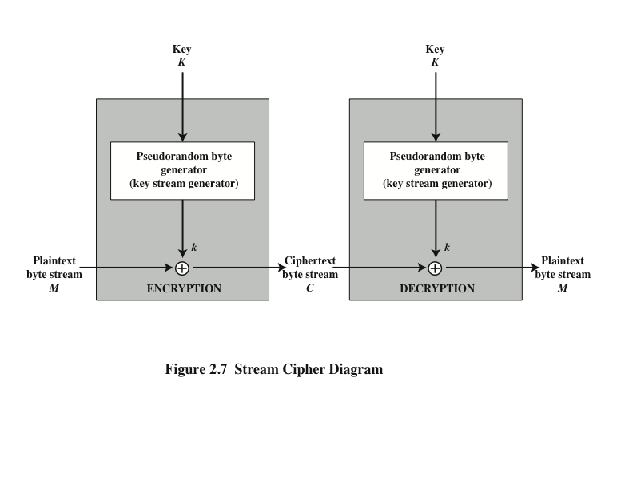
Notes:
A typical stream cipher encrypts plaintext one byte at a time, although a stream
cipher may be designed to operate on one bit at a time or on units larger than a
byte at a time. Figure 2.7 is a representative diagram of stream cipher structure.
In this structure, a key is input to a pseudorandom bit generator that produces a
stream of 8-bit numbers that are apparently random. The pseudorandom stream is
unpredictable without knowledge of the input key and has an apparently random
character. The output of the generator, called a keystream , is combined one byte at
a time with the plaintext stream using the bitwise exclusive-OR (XOR) operation.

Slide 61
Stream Cipher design considerations
The encryption sequence should have a large period
The longer the period of repeat, the more difficult it will be to do cryptanalysis
The keystream should approximate the properties of a true random number stream as close as possible
The more random-appearing the keystream is, the more randomized the ciphertext is, making cryptanalysis more difficult
The pseudorandom number generator is conditioned on the value of the input key
To guard against brute-force attacks, the key needs to be sufficiently long
With current technology, a key length of at least 128 bits is desirable
Notes:
[KUMA97] lists the following important design considerations for a stream
cipher.
1. The encryption sequence should have a large period. A pseudorandom number
generator uses a function that produces a deterministic stream of bits that
eventually repeats. The longer the period of repeat, the more difficult it will
be to do cryptanalysis.
2. The keystream should approximate the properties of a true random number
stream as close as possible. For example, there should be an approximately
equal number of 1s and 0s. If the keystream is treated as a stream of bytes,
then all of the 256 possible byte values should appear approximately equally
often. The more random-appearing the keystream is, the more randomized the
ciphertext is, making cryptanalysis more difficult.
3. Note from Figure 2.7 that the output of the pseudorandom number generator
is conditioned on the value of the input key. To guard against brute-force
attacks, the key needs to be sufficiently long. The same considerations as apply
for block ciphers are valid here. Thus, with current technology, a key length of
at least 128 bits is desirable.

Slide 62
RC4 algorithm
A stream cipher designed in 1987 by Ron Rivest for RSA Security
It is a variable key-size stream cipher with byte-oriented operations
The algorithm is based on the use of a random permutation
Is used in the Secure Sockets Layer/Transport Layer Security (SSL/TLS) standards that have been defined for communication between Web browsers and servers
Also used in the Wired Equivalent Privacy (WEP) protocol and the newer WiFi Protected Access (WPA) protocol that are part of the IEEE 802.11 wireless LAN standard
Notes:
RC4 is a stream cipher designed in 1987 by Ron Rivest for RSA Security. It is
a variable key-size stream cipher with byte-oriented operations. The algorithm
is based on the use of a random permutation. Analysis shows that the period of
the cipher is overwhelmingly likely to be greater than 10100 [ROBS95a]. Eight
to sixteen machine operations are required per output byte, and the cipher can
be expected to run very quickly in software. RC4 is used in the Secure Sockets
Layer/Transport Layer Security (SSL/TLS) standards that have been defined
for communication between Web browsers and servers. It is also used in the
Wired Equivalent Privacy (WEP) protocol and the newer WiFi Protected Access
(WPA) protocol that are part of the IEEE 802.11 wireless LAN standard. RC4
was kept as a trade secret by RSA Security. In September 1994, the RC4 algorithm
was anonymously posted on the Internet on the Cypherpunks anonymous
remailers list.
The RC4 algorithm is remarkably simple and quite easy to explain. A
variable-length key of from 1 to 256 bytes (8 to 2048 bits) is used to initialize a
256-byte state vector S, with elements S[0], S[1], . . . , S[255]. At all times, S contains
a permutation of all 8-bit numbers from 0 through 255. For encryption and decryption,
a byte k (see Figure 2.7) is generated from S by selecting one of the 255 entries
in a systematic fashion. As each value of k is generated, the entries in S are once
again permuted.
A number of papers have been published analyzing methods
of attacking RC4 (e.g., [KNUD98], [FLUH00], [MANT01]). None of these
approaches is practical against RC4 with a reasonable key length, such as 128 bits.
A more serious problem is reported in [FLUH01]. The authors demonstrate that
the WEP protocol, intended to provide confidentiality on 802.11 wireless LAN
networks, is vulnerable to a particular attack approach. In essence, the problem is
not with RC4 itself but the way in which keys are generated for use as input to RC4.
This particular problem does not appear to be relevant to other applications using
RC4 and can be remedied in WEP by changing the way in which keys are generated.
This problem points out the difficulty in designing a secure system that involves
both cryptographic functions and protocols that make use of them.

Slide 63
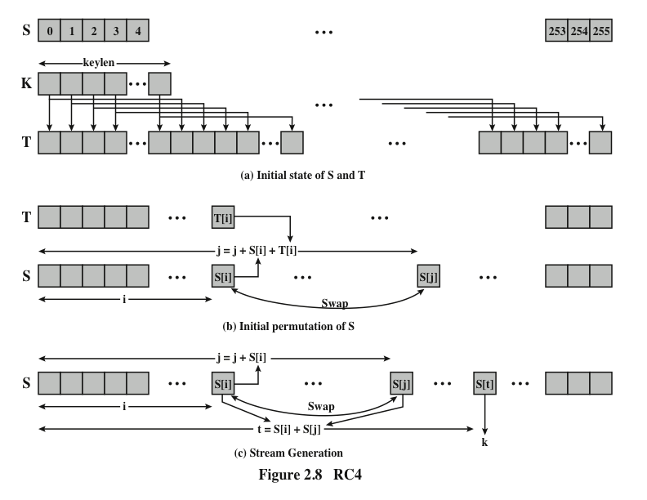
Notes:
Figure 2.8 illustrates the RC4 logic.

Slide 64
Cipher block Modes of Operation
A symmetric block cipher processes one block of data at a time
In the case of DES and 3DES, the block length is b=64 bits
For AES, the block length is b=128
For longer amounts of plaintext, it is necessary to break the plaintext into b-bit blocks, padding the last block if necessary
Five modes of operation have been defined by NIST
Intended to cover virtually all of the possible applications of encryption for which a block cipher could be used
Intended for use with any symmetric block cipher, including triple DES and AES
Notes:
A symmetric block cipher processes one block of data at a time. In the case of
DES and 3DES, the block length is b = 64 bits; for AES, the block length is
b = 128 bits. For longer amounts of plaintext, it is necessary to break the plaintext
into b -bit blocks (padding the last block if necessary). To apply a block cipher in a
variety of applications, five modes of operation have been defined by NIST
(Special Publication 800-38A). The five modes are intended to cover virtually all
of the possible applications of encryption for which a block cipher could be used.
These modes are intended for use with any symmetric block cipher, including triple
DES and AES. The most important modes are described briefly in the remainder
of this section.

Slide 65
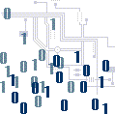
Electronic Codebook Mode (ECB)
Plaintext is handled b bits at a time and each block of plaintext is encrypted using the same key
The term “codebook” is used because, for a given key, there is a unique ciphertext for every b-bit block of plaintext
One can imagine a gigantic codebook in which there is an entry for every possible b-bit plaintext pattern showing its corresponding ciphertext
With ECB, if the same b-bit block of plaintext appears more than once in the message, it always produces the same ciphertext
Because of this, for lengthy messages, the ECB mode may not be secure
If the message is highly structured, it may be possible for a cryptanalyst to exploit these regularities
Notes:
The simplest way to proceed is using what is known as electronic codebook (ECB)
mode , in which plaintext is handled b bits at a time and each block of plaintext is
encrypted using the same key. The term codebook is used because, for a given key,
there is a unique ciphertext for every b -bit block of plaintext. Therefore, one can
imagine a gigantic codebook in which there is an entry for every possible b -bit plaintext
pattern showing its corresponding ciphertext.
With ECB, if the same b -bit block of plaintext appears more than once in
the message, it always produces the same ciphertext. Because of this, for lengthy
messages, the ECB mode may not be secure. If the message is highly structured,
it may be possible for a cryptanalyst to exploit these regularities. For example,
if it is known that the message always starts out with certain predefined fields,
then the cryptanalyst may have a number of known plaintext–ciphertext pairs to
work with. If the message has repetitive elements with a period of repetition a
multiple of b bits, then these elements can be identified by the analyst. This may
help in the analysis or may provide an opportunity for substituting or rearranging
blocks.
To overcome the security deficiencies of ECB, we would like a technique in
which the same plaintext block, if repeated, produces different ciphertext blocks.

Slide 66
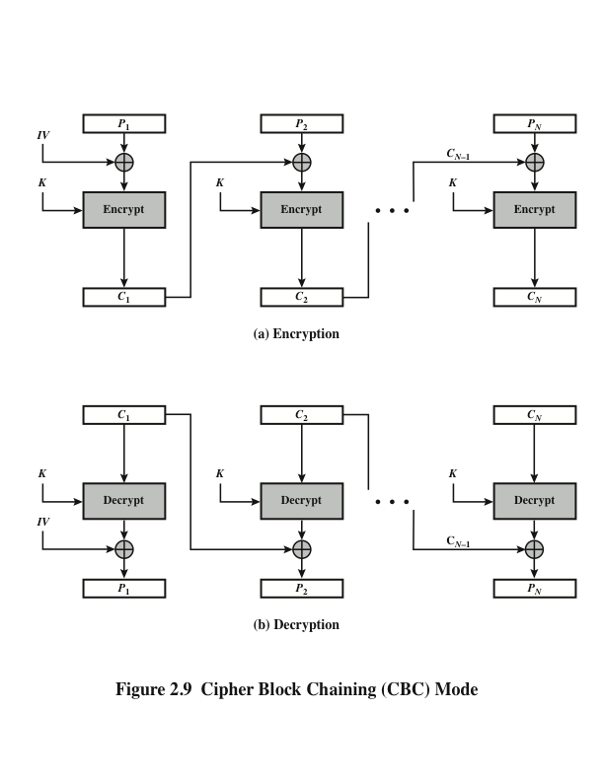
Notes:
In the cipher block chaining (CBC) mode (Figure 2.9), the input to the encryption
algorithm is the XOR of the current plaintext block and the preceding ciphertext
block; the same key is used for each block. In effect, we have chained together the
processing of the sequence of plaintext blocks. The input to the encryption function
for each plaintext block bears no fixed relationship to the plaintext block. Therefore,
repeating patterns of b bits are not exposed.
For decryption, each cipher block is passed through the decryption algorithm.
The result is XORed with the preceding ciphertext block to produce the plaintext
block.
To produce the first block of ciphertext, an initialization vector (IV) is XORed
with the first block of plaintext. On decryption, the IV is XORed with the output of
the decryption algorithm to recover the first block of plaintext.
The IV must be known to both the sender and receiver. For maximum security,
the IV should be protected as well as the key. This could be done by sending
the IV using ECB encryption. One reason for protecting the IV is as follows: If an
opponent is able to fool the receiver into using a different value for IV, then the
opponent is able to invert selected bits in the first block of plaintext.

Slide 67
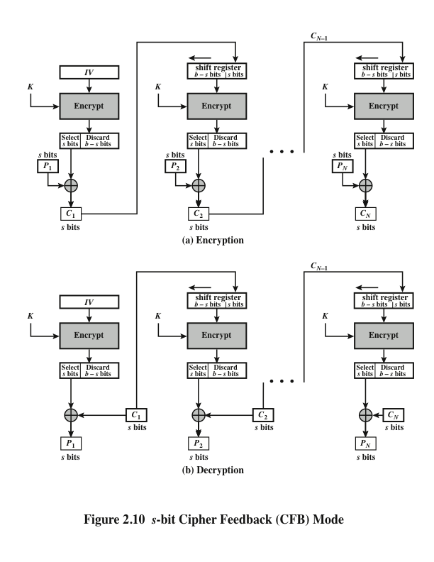
Notes:
It is possible to convert any block cipher into a stream cipher by using the cipher
feedback (CFB) mode . A stream cipher eliminates the need to pad a message to
be an integral number of blocks. It also can operate in real time. Thus, if a character
stream is being transmitted, each character can be encrypted and transmitted
immediately using a character-oriented stream cipher.
One desirable property of a stream cipher is that the ciphertext be of the same
length as the plaintext. Thus, if 8-bit characters are being transmitted, each character
should be encrypted using 8 bits. If more than 8 bits are used, transmission
capacity is wasted.
Figure 2.10 depicts the CFB scheme. In the figure, it is assumed that the unit
of transmission is s bits; a common value is s = 8. As with CBC, the units of plaintext
are chained together, so that the ciphertext of any plaintext unit is a function of
all the preceding plaintext.

Slide 68
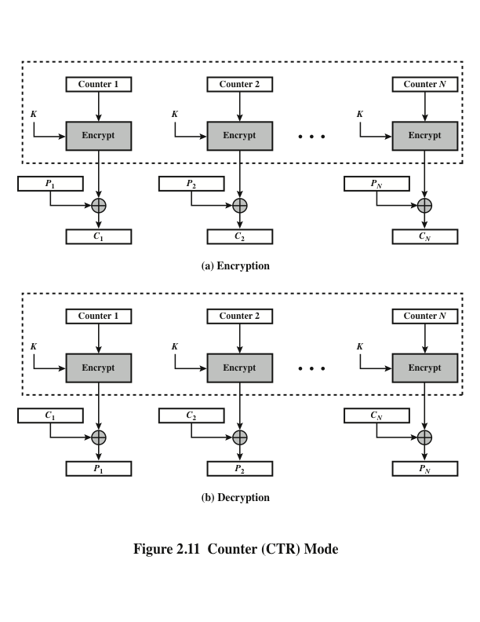
Notes:
Although interest in the counter mode (CTR) has increased recently, with applications
to ATM (asynchronous transfer mode) network security and IPSec (IP security),
this mode was proposed early on (e.g., [DIFF79]).
Figure 2.11 depicts the CTR mode. A counter equal to the plaintext block
size is used. The only requirement stated in SP 800-38A is that the counter value
must be different for each plaintext block that is encrypted. Typically, the counter
is initialized to some value and then incremented by 1 for each subsequent block
(modulo 2b , where b is the block size). For encryption, the counter is encrypted and
then XORed with the plaintext block to produce the ciphertext block; there is no
chaining. For decryption, the same sequence of counter values is used, with each
encrypted counter XORed with a ciphertext block to recover the corresponding
plaintext block.

Slide 69
Advantages of CTR mode
Hardware efficiency
Encryption/decryption can be done in parallel on multiple blocks of plaintext or ciphertext
Throughput is only limited by the amount of parallelism that is achieved
Software efficiency
Because of the opportunities for parallel execution, processors that support parallel features can be effectively utilized
Preprocessing
The execution of the underlying encryption algorithm does not depend on input of the plaintext or ciphertext --- when the plaintext or ciphertext input is presented, the only computation is a series of XORs, greatly enhancing throughput
Random access
The ith block of plaintext or ciphertext can be processed in random-access fashion
Provable security
It can be shown that CTR is at least as secure as the other modes discussed in this section
Simplicity
Requires only the implementation of the encryption algorithm and not the decryption algorithm
Notes:
[LIPM00] lists the following advantages of CTR mode.
• Hardware efficiency: Unlike the chaining modes, encryption (or decryption)
in CTR mode can be done in parallel on multiple blocks of plaintext or
ciphertext. For the chaining modes, the algorithm must complete the computation
on one block before beginning on the next block. This limits the maximum
throughput of the algorithm to the reciprocal of the time for one execution of
block encryption or decryption. In CTR mode, the throughput is only limited
by the amount of parallelism that is achieved.
• Software efficiency: Similarly, because of the opportunities for parallel execution
in CTR mode, processors that support parallel features (such as aggressive
pipelining, multiple instruction dispatch per clock cycle, a large number of
registers, and SIMD instructions) can be effectively utilized.
• Preprocessing: The execution of the underlying encryption algorithm does not
depend on input of the plaintext or ciphertext. Therefore, if sufficient memory
is available and security is maintained, preprocessing can be used to prepare the
output of the encryption boxes that feed into the XOR functions in Figure 2.11.
When the plaintext or ciphertext input is presented, then the only computation
is a series of XORs. Such a strategy greatly enhances throughput.
• Random access: The ith block of plaintext or ciphertext can be processed in
random-access fashion. With the chaining modes, block Ci cannot be computed
until the i- 1 prior block are computed. There may be applications in
which a ciphertext is stored, and it is desired to decrypt just one block; for such
applications, the random access feature is attractive.
• Provable security: It can be shown that CTR is at least as secure as the other
modes discussed in this section.
• Simplicity: Unlike ECB and CBC modes, CTR mode requires only the
implementation of the encryption algorithm and not the decryption algorithm.
This matters most when the decryption algorithm differs substantially
from the encryption algorithm, as it does for AES. In addition, the decryption
key scheduling need not be implemented.

Slide 70
summary
Symmetric encryption principles
Cryptography
Cryptanalysis
Feistel cipher structure
Symmetric block encryption algorithms
Data encryption standard
Triple DES
Advanced encryption standard
Random and pseudorandom numbers
The use of random numbers
TRNGs, PRNGs, PRFs
Algorithm design
Stream ciphers and RC4
Stream cipher structure
RC4 algorithm
Cipher block modes of operation
ECB
CBC
CFB
CTR
Notes:
Chapter 2 summary.

Slide 71
Network Security Essentials
Fifth Edition
by William Stallings
Notes:
Lecture slides prepared for “Network Security Essentials”, 5/e, by William Stallings, Chapter 3 – “Public Key Cryptography and Message Authentication”.

Slide 72
Chapter 3
Public Key Cryptography and Message Authentication
Notes:
In addition to message confidentiality, message authentication is an important network
security function. This chapter examines three aspects of message authentication.
First, we look at the use of message authentication codes and hash functions to
provide message authentication. Then we look at public-key encryption principles
and two specific public-key algorithms. These algorithms are useful in the exchange
of conventional encryption keys. Then we look at the use of public-key encryption
to produce digital signatures, which provides an enhanced form of message
authentication.

Slide 73
Every Egyptian received two names, which were known respectively as the true name and the good name, or the great name and the little name; and while the good or little name was made public, the true or great name appears to have been carefully concealed.
—The Golden Bough, Sir James George Frazer
To guard against the baneful influence exerted by strangers is therefore an elementary dictate of savage prudence. Hence before strangers are allowed to enter a district, or at least before they are permitted to mingle freely with the inhabitants, certain ceremonies are often performed by the natives of the country for the purpose of disarming the strangers of their magical powers, or of disinfecting, so to speak, the tainted atmosphere by which they are supposed to be surrounded.
—The Golden Bough, Sir James George Frazer
Notes:
Encryption protects against passive attack (eavesdropping). A different requirement
is to protect against active attack (falsification of data and transactions).
Protection against such attacks is known as message authentication.
A message, file, document, or other collection of data is said to be authentic
when it is genuine and comes from its alleged source. Message authentication is a
procedure that allows communicating parties to verify that received messages are
authentic. The two important aspects are to verify that the contents of the message
have not been altered and that the source is authentic. We may also wish to
verify a message’s timeliness (it has not been artificially delayed and replayed) and
sequence relative to other messages flowing between two parties. All of these concerns
come under the category of data integrity as described in Chapter 1.

Slide 74
Approaches to Message Authentication
Using conventional encryption
Without message encryption
Symmetric encryption alone is not a suitable tool for data authentication
We assume that only the sender and receiver share a key, so only the genuine sender would be able to encrypt a message successfully
The receiver assumes that no alterations have been made and that sequencing is proper if the message includes an error detection code and a sequence number
If the message includes a timestamp, the receiver assumes that the message has not been delayed beyond that normally expected for network transit
An authentication tag is generated and appended to each message for transmission
The message itself is not encrypted and can be read at the destination independent of the authentication function at the destination
Because the message is not encrypted, message confidentiality is not provided
Notes:
It would seem possible to perform authentication simply by the use of symmetric
encryption. If we assume that only the sender and receiver share a key (which
is as it should be), then only the genuine sender would be able to encrypt a message
successfully for the other participant, provided the receiver can recognize a
valid message. Furthermore, if the message includes an error-detection code and a
sequence number, the receiver is assured that no alterations have been made and
that sequencing is proper. If the message also includes a timestamp, the receiver is
assured that the message has not been delayed beyond that normally expected for
network transit. In fact, symmetric encryption alone is not a suitable tool for data authentication.
To give one simple example, in the ECB mode of encryption, if an attacker
reorders the blocks of ciphertext, then each block will still decrypt successfully.
However, the reordering may alter the meaning of the overall data sequence.
Although sequence numbers may be used at some level (e.g., each IP packet), it is
typically not the case that a separate sequence number will be associated with each
b -bit block of plaintext. Thus, block reordering is a threat.
In this section, we examine several approaches to message authentication that do
not rely on encryption. In all of these approaches, an authentication tag is generated
and appended to each message for transmission. The message itself is not encrypted
and can be read at the destination independent of the authentication function at the
destination.
Because the approaches discussed in this section do not encrypt the message,
message confidentiality is not provided. As was mentioned, message encryption by
itself does not provide a secure form of authentication. However, it is possible to
combine authentication and confidentiality in a single algorithm by encrypting a
message plus its authentication tag. Typically, however, message authentication is
provided as a separate function from message encryption.
There is a place for both authentication and encryption in meeting security
requirements.

Slide 75
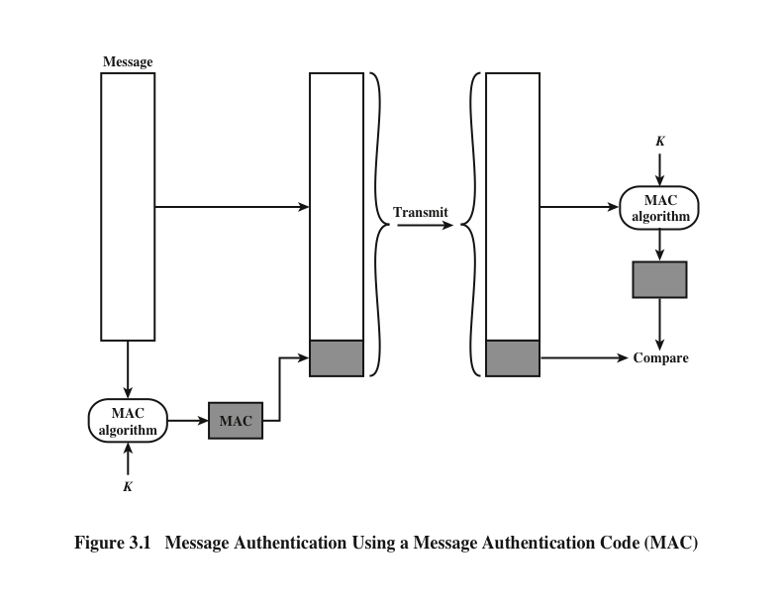
Notes:
One authentication technique involves the use
of a secret key to generate a small block of data, known as a message authentication
code (MAC) , that is appended to the message.
This technique assumes that
two communicating parties, say A and B, share a common secret key K_{AB}. When
A has a message to send to B, it calculates the message authentication code as a
function of the message and the key: MAC_{M} = F(K_{AB} , M ). The message plus code
are transmitted to the intended recipient. The recipient performs the same calculation
on the received message, using the same secret key, to generate a new message
authentication code. The received code is compared to the calculated code
(Figure 3.1).
If we assume that only the receiver and the sender know the identity
of the secret key, and if the received code matches the calculated code, then the following
statements apply:
1. The receiver is assured that the message has not been altered. If an attacker
alters the message but does not alter the code, then the receiver’s calculation
of the code will differ from the received code. Because the attacker is assumed
not to know the secret key, the attacker cannot alter the code to correspond to
the alterations in the message.
2. The receiver is assured that the message is from the alleged sender. Because
no one else knows the secret key, no one else could prepare a message with a
proper code.
3. If the message includes a sequence number (such as is used with HDLC and
TCP), then the receiver can be assured of the proper sequence, because an
attacker cannot successfully alter the sequence number.
A number of algorithms could be used to generate the code. The NIST specification,
FIPS PUB 113, recommends the use of DES. DES is used to generate an
encrypted version of the message, and the last number of bits of ciphertext are used
as the code. A 16- or 32-bit code is typical.
The process just described is similar to encryption. One difference is that the
authentication algorithm need not be reversible, as it must for decryption. Because
of the mathematical properties of the authentication function, it is less vulnerable to
being broken than encryption.

Slide 76
One-way Hash Functions
Accepts a variable-size message M as input and produces a fixed-size message digest H(M) as output
Does not take a secret key as input
To authenticate a message, the message digest is sent with the message in such a way that the message digest is authentic
Notes:
An alternative to the message authentication code is
the one-way hash function. As with the message authentication code, a hash function
accepts a variable-size message M as input and produces a fixed-size message
digest H(M ) as output. Unlike the MAC, a hash function does not take a secret key
as input. To authenticate a message, the message digest is sent with the message in
such a way that the message digest is authentic.

Slide 77
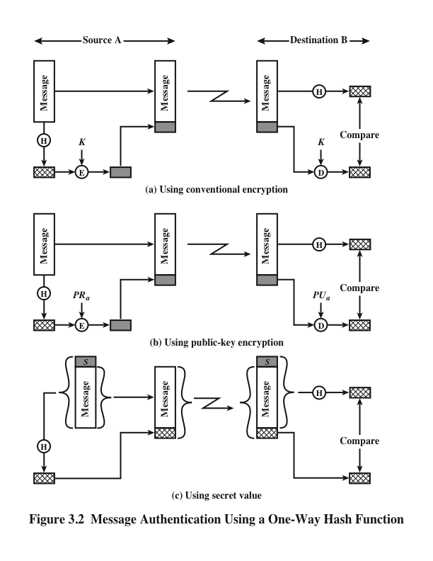
Figure 3.2 illustrates three ways in which the message can be authenticated.
The message digest can be encrypted using conventional encryption (part a); if
it is assumed that only the sender and receiver share the encryption key, then
authenticity is assured. The message digest can be encrypted using public-key
encryption (part b); this is explained in Section 3.5. The public-key approach
has two advantages: (1) It provides a digital signature as well as message
authentication. (2) It does not require the distribution of keys to communicating
parties.
These two approaches also have an advantage over approaches that encrypt the entire message in that less computation is required. Nevertheless, there has been interest in developing a technique that avoids encryption altogether. Figure 3.2c shows a technique that uses a hash function but no encryption for
message authentication. Because the secret value itself is not sent, it is not possible for an attacker to modify an intercepted message. As long as the secret value remains secret, it is also not possible for an attacker to generate
a false message. A variation on the third technique, called HMAC, is the one adopted for IP security (described in Chapter 9); it also has been specified for SNMPv3
(Chapter 13).
Notes:
Figure 3.2 illustrates three ways in which the message can be authenticated.
The message digest can be encrypted using conventional encryption (part a); if
it is assumed that only the sender and receiver share the encryption key, then
authenticity is assured. The message digest can be encrypted using public-key
encryption (part b); this is explained in Section 3.5. The public-key approach
has two advantages: (1) It provides a digital signature as well as message
authentication. (2) It does not require the distribution of keys to communicating
parties.
These two approaches also have an advantage over approaches that encrypt
the entire message in that less computation is required. Nevertheless, there has
been interest in developing a technique that avoids encryption altogether.
Figure 3.2c shows a technique that uses a hash function but no encryption for
message authentication. Because the secret value itself is
not sent, it is not possible for an attacker to modify an intercepted message. As long
as the secret value remains secret, it is also not possible for an attacker to generate
a false message.
A variation on the third technique, called HMAC, is the one adopted for
IP security (described in Chapter 9); it also has been specified for SNMPv3
(Chapter 13).

Slide 78
Secure Hash Functions
1.
2.
3.
4.
5.
6.
A hash function with this property is referred to as collision resistant. This is sometimes referred to as strong collision resistant.
H can be applied to a block of data of any size.
H produces a fixed-length output.
H(x) is relatively easy to compute for any given x, making both hardware and software implementations practical.
For any given code h, it is computationally infeasible to find x such that H(x) = h. A hash function with this property is referred to as one-way or preimage resistant.
For any given block x, it is computationally infeasible to find y x with H(y) = H(x). A hash function with this property is referred to as second preimage resistant. This is sometimes referred to as weak collision resistant.
It is computationally infeasible to find any pair (x, y) such that H(x) = H(y).
Is important not only in message authentication but in digital signatures
Purpose is to produce a “fingerprint” of a file, message, or other block of data
To be useful for message authentication, a hash function H must have the following properties:
Notes:
The purpose of a hash function is to produce a “fingerprint” of a file, message, or
other block of data. To be useful for message authentication, a hash function H
must have the following properties:
1. H can be applied to a block of data of any size.
2. H produces a fixed-length output.
3. H(x ) is relatively easy to compute for any given x , making both hardware and
software implementations practical.
4. For any given code h , it is computationally infeasible to find x such that
H(x ) = h. A hash function with this property is referred to as one-way or
preimage resistant .
5. For any given block x, it is computationally infeasible to find y x with
H(y) = H(x). A hash function with this property is referred to as second preimage
resistant. This is sometimes referred to as weak collision resistant.
6. It is computationally infeasible to find any pair (x, y) such that H(x) = H(y).
A hash function with this property is referred to as collision resistant. This is
sometimes referred to as strong collision resistant.
A hash function that satisfies the first five properties in the preceding list is
referred to as a weak hash function. If the sixth property is also satisfied, then it is
referred to as a strong hash function. The sixth property, collision resistant, protects
against a sophisticated class of attack known as the birthday attack.

Slide 79
Security of Hash Functions
There are two approaches to attacking a secure hash function:
Cryptanalysis
Involves exploiting logical weaknesses in the algorithm
Brute-force attack
The strength of a hash function against this attack depends solely on the length of the hash code produced by the algorithm
Notes:
As with symmetric encryption, there are two approaches to attacking a secure hash
function: cryptanalysis and brute-force attack. As with symmetric encryption algorithms,
cryptanalysis of a hash function involves exploiting logical weaknesses in the
algorithm.
The strength of a hash function against brute-force attacks depends solely on
the length of the hash code produced by the algorithm.
If collision resistance is required (and this is desirable for a general-purpose
secure hash code), then the value 2^{n/2} determines the strength of the hash code
against brute-force attacks. Van Oorschot and Wiener [VANO94] presented a
design for a $10 million collision search machine for MD5, which has a 128-bit
hash length, that could find a collision in 24 days. Thus, a 128-bit code may be
viewed as inadequate. The next step up, if a hash code is treated as a sequence
of 32 bits, is a 160-bit hash length. With a hash length of 160 bits, the same
search machine would require over four thousand years to find a collision. With
today’s technology, the time would be much shorter, so that 160 bits now
appears suspect.

Slide 80
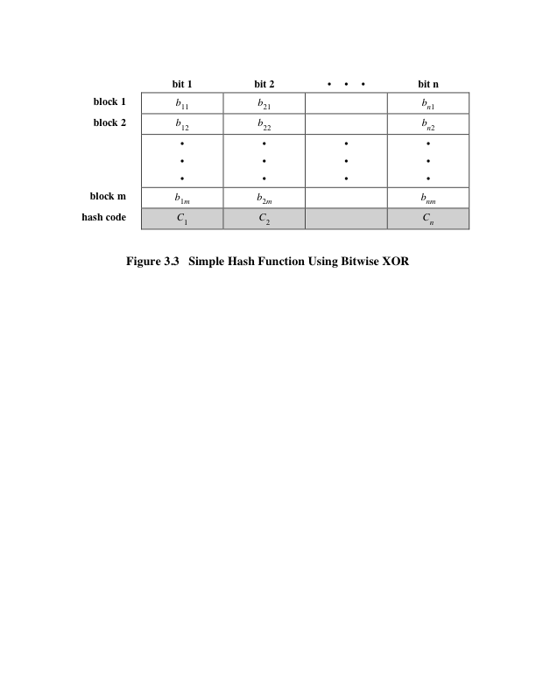
Notes:
All hash functions operate using the following general principles. The input (message,
file, etc.) is viewed as a sequence of n -bit blocks. The input is processed one
block at a time in an iterative fashion to produce an n -bit hash function.
One of the simplest hash functions is the bit-by-bit exclusive-OR (XOR) of
every block.
Figure 3.3 illustrates this operation; it produces a simple parity for each bit
position and is known as a longitudinal redundancy check.

Slide 81
The sha Secure Hash function
SHA was developed by NIST and published as a federal information processing standard (FIPS 180) in 1993
Was revised in 1995 as SHA-1 and published as FIPS 180-1
The actual standards document is entitled “Secure Hash Standard”
Based on the hash function MD4 and its design closely models MD4
Produces 160-bit hash values
In 2005 NIST announced the intention to phase out approval of SHA-1 and move to a reliance on SHA-2 by 2010
Notes:
In recent years, the most widely used hash function has been the Secure Hash
Algorithm (SHA). Indeed, because virtually every other widely used hash function
had been found to have substantial cryptanalytic weaknesses, SHA was more or
less the last remaining standardized hash algorithm by 2005. SHA was developed
by the National Institute of Standards and Technology (NIST) and published as a
federal information processing standard (FIPS 180) in 1993. When weaknesses were
discovered in SHA (now known as SHA-0), a revised version was issued as FIPS
180-1 in 1995 and is referred to as SHA-1 . The actual standards document is entitled
“Secure Hash Standard.” SHA is based on the hash function MD4, and its design
closely models MD4.
SHA-1 produces a hash value of 160 bits.
In 2005, NIST announced the intention to phase out approval of SHA-1 and
move to a reliance on SHA-2 by 2010.

Slide 82
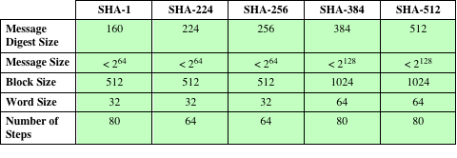
Table 3.1 Comparison of SHA Parameters
Note: All sizes are measured in bits.
Notes:
In 2002, NIST produced a revised
version of the standard, FIPS 180-2, that defined three new versions of SHA with
hash value lengths of 256, 384, and 512 bits known as SHA-256, SHA-384, and
SHA-512, respectively. Collectively, these hash algorithms are known as SHA-2 .
These new versions have the same underlying structure and use the same types of
modular arithmetic and logical binary operations as SHA-1. A revised document
was issued as FIP PUB 180-3 in 2008, which added a 224-bit version (Table 3.1).
SHA-1 and SHA-2 are also specified in RFC 6234, which essentially duplicates the
material in FIPS 180-3 but adds a C code implementation.

Slide 83
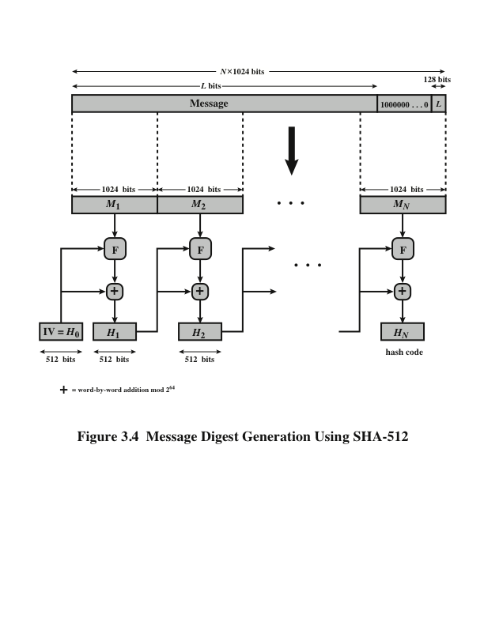
Notes:
The algorithm takes as input a message with a maximum length of less than
2¹²⁸ bits and produces as output a 512-bit message digest. The input is processed in
1024-bit blocks. Figure 3.4 depicts the overall processing of a message to produce a
digest. See F block details in Figure 3.5.

Slide 84
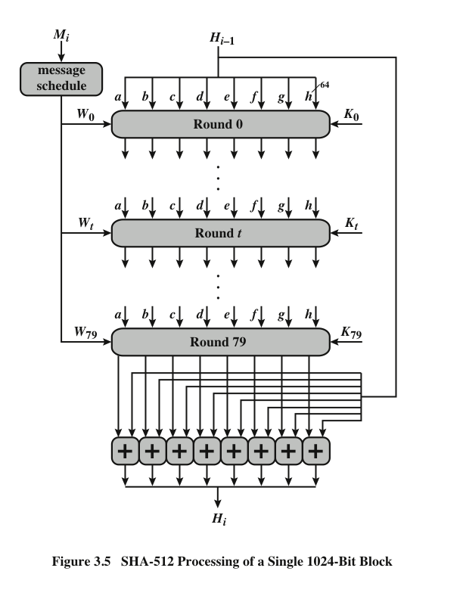
Notes:
The heart of the algorithm
is a module that consists of 80 rounds; this module is labeled F in Figure 3.4.
The logic is illustrated in Figure 3.5.

Slide 85
Sha-3
Basic requirements that must be satisfied by any candidate for SHA-3
1. It must be possible to replace SHA-2 with SHA-3 in any application by a simple drop-in substitution. Therefore, SHA-3 must support hash value lengths of 224, 256, 384, and 512 bits.
2. SHA-3 must preserve the online nature of SHA-2. That is, the algorithm must process comparatively small blocks (512 or 1024 bits) at a time instead of requiring that the entire message be buffered in memory before processing it.
Notes:
SHA-2, particularly the 512-bit version, would appear to provide unassailable security.
However, SHA-2 shares the same structure and mathematical operations
as its
predecessors, and this is a cause for concern. Because it would take years to find a
suitable replacement for SHA-2, should it become vulnerable, NIST announced in
2007 a competition to produce the next-generation NIST hash function, which is to
be called SHA-3. Following are the basic requirements that must be satisfied by any
candidate for SHA-3:
1. It must be possible to replace SHA-2 with SHA-3 in any application by a simple
drop-in substitution. Therefore, SHA-3 must support hash value lengths of
224, 256, 384, and 512 bits.
2. SHA-3 must preserve the online nature of SHA-2. That is, the algorithm must
process comparatively small blocks (512 or 1024 bits) at a time instead of
requiring that the entire message be buffered in memory before processing it.
In 2012, NIST selected a winning submission and formally published SHA-3.
A detailed presentation of SHA-3 is provided in Chapter 15.

Slide 86
HMAC
There has been an increased interest in developing a MAC derived from a cryptographic hash code, such as SHA-1
Cryptographic hash functions generally execute faster in software than conventional encryption algorithms such as DES
Library code for cryptographic hash functions is widely available
A hash function such as SHA-1 was not designed for use as a MAC and cannot be used directly for that purpose because it does not rely on a secret key
There have been a number of proposals for the incorporation of a secret key into an existing hash algorithm
The approach that has received the most support is HMAC
HMAC
Has been issued as RFC 2104
Has been chosen as the mandatory-to-implement MAC for IP Security
Is used in other Internet protocols, such as Transport Layer Security (TLS) and Secure Electronic Transaction (SET)
Notes:
In recent years, there has been increased interest in developing a MAC derived
from a cryptographic hash code, such as SHA-1. The motivations for this interest
are as follows: (hash message authentication code=HMAC)
• Cryptographic hash functions generally execute faster in software than conventional
encryption algorithms such as DES.
• Library code for cryptographic hash functions is widely available.
A hash function such as SHA-1 was not designed for use as a MAC and cannot
be used directly for that purpose because it does not rely on a secret key. There have
been a number of proposals for the incorporation of a secret key into an existing hash
algorithm. The approach that has received the most support is HMAC [BELL96a,
BELL96b]. HMAC has been issued as RFC 2104, has been chosen as the mandatory-to-
implement MAC for IP Security, and is used in other Internet protocols, such as
Transport Layer Security (TLS) and Secure Electronic Transaction (SET).

Slide 87
HMAC Design Objectives
To use, without modifications, available hash functions --- in particular, hash functions that perform well in software, and for which code is freely and widely available
To allow for easy replaceability of the embedded hash function in case faster or more secure hash functions are found or required
To preserve the original performance of the hash function without incurring a significant degradation
To use and handle keys in a simple way
To have a well understood cryptographic analysis of the strength of the authentication mechanism based on reasonable assumptions on the embedded hash function
Notes:
RFC 2104 lists the following design objectives for
HMAC.
• To use, without modifications, available hash functions. In particular, hash
functions that perform well in software, and for which code is freely and
widely available
• To allow for easy replaceability of the embedded hash function in case faster
or more secure hash functions are found or required
• To preserve the original performance of the hash function without incurring a
significant degradation
• To use and handle keys in a simple way
• To have a well-understood cryptographic analysis of the strength of the
authentication mechanism based on reasonable assumptions on the embedded
hash function. The first two objectives are important to the acceptability of HMAC. HMAC
treats the hash function as a “black box.” This has two benefits. First, an existing
implementation of a hash function can be used as a module in implementing
HMAC. In this way, the bulk of the HMAC code is prepackaged and ready to use
without modification. Second, if it is ever desired to replace a given hash function
in an HMAC implementation, all that is required is to remove the existing hash
function module and drop in the new module. This could be done if a faster hash
function were desired. More important, if the security of the embedded hash function
were compromised, the security of HMAC could be retained simply by replacing
the embedded hash function with a more secure one.
The last design objective in the preceding list is, in fact, the main advantage
of HMAC over other proposed hash-based schemes. HMAC can be proven secure
provided that the embedded hash function has some reasonable cryptographic
strengths. We return to this point later in this section, but first we examine the structure
of HMAC.

Slide 88
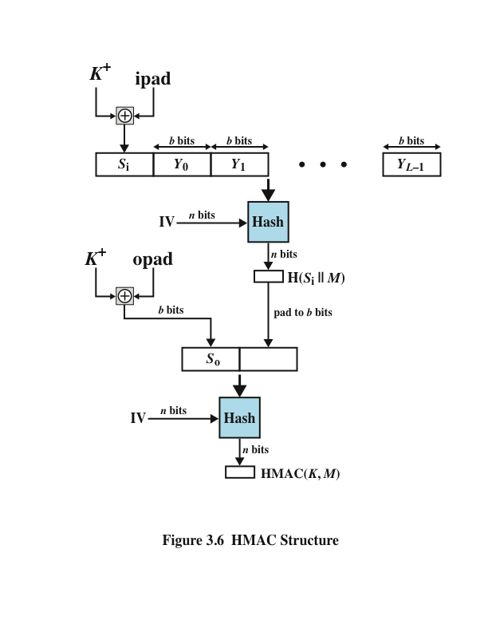
Notes:
Figure 3.6 illustrates the overall operation of HMAC.

Slide 89
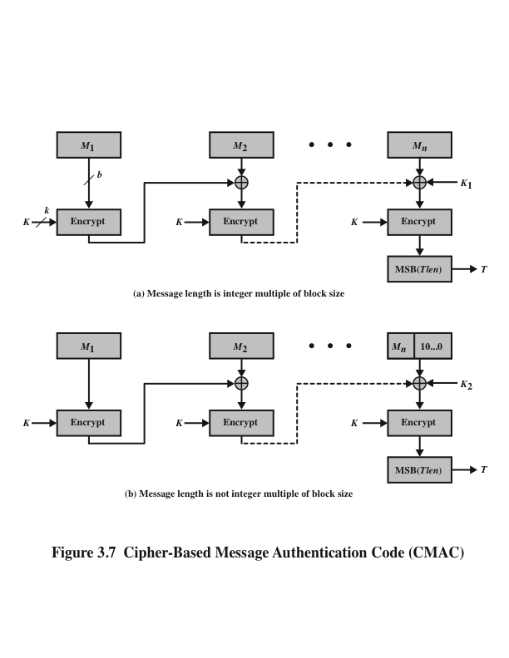
Notes:
The Cipher-based
Message Authentication Code mode of operation is for use with AES and triple
DES. It is specified in NIST Special Publication 800-38B.

Slide 90
Counter with Cipher Block Chaining-Message Authentication Code (CCM)
Key algorithmic ingredients
AES encryption algorithm
CTR mode of operation
CMAC authentication algorithm
NIST standard SP 800-38C
Referred to as an authenticated encryption mode
“Authenticated encryption” is a term used to describe encryption systems that simultaneously protect confidentiality and authenticity of communications
A single key is used for both encryption and MAC algorithms
Notes:
The
Counter with Cipher Block Chaining-Message Authentication Code (CCM)
mode of operation, defined in NIST SP 800-38C, is referred to as an authenticated
encryption
mode. “Authenticated encryption” is a term used to describe encryption
systems that simultaneously protect confidentiality and authenticity (integrity) of
communications. Many applications and protocols require both forms of security,
but until recently the two services have been designed separately.
The key algorithmic ingredients of CCM are the AES encryption algorithm
(Section 2.2), the CTR mode of operation (Section 2.5), and the CMAC authentication
algorithm. A single key K is used for both encryption and MAC algorithms.

Slide 91
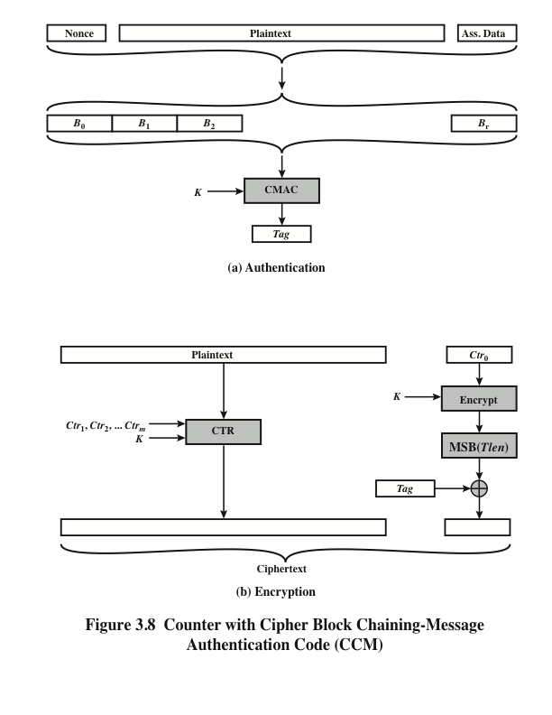
Notes:
Figure 3.8 illustrates the operation of CCM. For authentication, the input
includes the nonce, the associated data, and the plaintext. This input is formatted as
a sequence of blocks B₀ through B_{r} . The first block contains the nonce plus some
formatting bits that indicate the lengths of the N , A , and P elements. This is followed
by zero or more blocks that contain A , followed by zero of more blocks that
contain P. The resulting sequence of blocks serves as input to the CMAC algorithm,
which produces a MAC value with length Tlen , which is less than or equal to the
block length (Figure 3.8a).
For encryption, a sequence of counters is generated that must be independent
of the nonce. The authentication tag is encrypted in CTR mode using the single
counter Ctr₀ . The Tlen most significant bits of the output are XORed with the tag
to produce an encrypted tag. The remaining counters are used for the CTR mode
encryption of the plaintext (Figure 2.11). The encrypted plaintext is concatenated
with the encrypted tag to form the ciphertext output (Figure 3.8b).

Slide 92
Public-Key encryption structure
First publicly proposed by Diffie and Hellman in 1976
Based on mathematical functions rather than on simple operations on bit patterns
Is asymmetric, involving the use of two separate keys
Misconceptions:
Public-key encryption is more secure from cryptanalysis than conventional encryption
Public-key encryption is a general-purpose technique that has made conventional encryption obsolete
There is a feeling that key distribution is trivial when using public-key encryption, compared to the rather cumbersome handshaking involved with key distribution centers for conventional encryption
Notes:
Public-key encryption, first publicly proposed by Diffie and Hellman in 1976
[DIFF76], is the first truly revolutionary advance in encryption in literally thousands
of years. Public-key algorithms are based on mathematical functions rather
than on simple operations on bit patterns, such as are used in symmetric encryption
algorithms. More important, public-key cryptography is asymmetric, involving the
use of two separate keys—in contrast to the symmetric conventional encryption,
which uses only one key. The use of two keys has profound consequences in the
areas of confidentiality, key distribution, and authentication.
Before proceeding, we should first mention several common misconceptions
concerning public-key encryption. One is that public-key encryption is more
secure from cryptanalysis than conventional encryption. In fact, the security of any
encryption scheme depends on (1) the length of the key and (2) the computational
work involved in breaking a cipher. There is nothing in principle about either conventional
or public-key encryption that makes one superior to another from the
point of view of resisting cryptanalysis. A second misconception is that public-key
encryption is a general-purpose technique that has made conventional encryption
obsolete. On the contrary, because of the computational overhead of current public-
key encryption schemes, there seems no foreseeable likelihood that conventional
encryption will be abandoned. Finally, there is a feeling that key distribution
is trivial when using public-key encryption, compared to the rather cumbersome
handshaking involved with key distribution centers for conventional encryption.
In fact, some form of protocol is needed, often involving a central agent, and the
procedures involved are no simpler or any more efficient than those required for
conventional encryption.

Slide 93
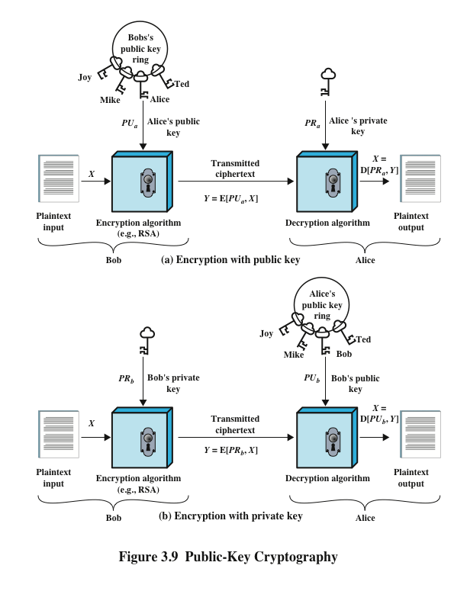
Notes:
A public-key encryption scheme has six ingredients (Figure 3.9a).
• Plaintext: This is the readable message or data that is fed into the algorithm as
input.
• Encryption algorithm: The encryption algorithm performs various transformations
on the plaintext.
• Public and private key: This is a pair of keys that have been selected so that if
one is used for encryption, the other is used for decryption. The exact transformations
performed by the encryption algorithm depend on the public or
private key that is provided as input.
• Ciphertext: This is the scrambled message produced as output. It depends on
the plaintext and the key. For a given message, two different keys will produce
two different ciphertexts.
• Decryption algorithm: This algorithm accepts the ciphertext and the matching
key and produces the original plaintext.
The key used in conventional encryption is typically referred to as a secret
key . The two keys used for public-key encryption are referred to as the public key
and the private key. Invariably, the private key is kept secret, but it is referred
to as a private key rather than a secret key to avoid confusion with conventional
encryption.

Slide 94
Applications for public-key cryptosystems
Public-key systems are characterized by the use of a cryptographic type of algorithm with two keys, one held private and one available publicly
Depending on the application, the sender uses either the sender’s private key, the receiver’s public key, or both to perform some type of cryptographic function
The use of public-key cryptosystems can be classified into three categories:
Encryption/decryption
The sender encrypts a message with the recipient’s public key
Digital signature
The sender “signs” a message with its private key
Key exchange
Two sides cooperate to exchange a session key
Notes:
Before proceeding, we need to clarify one aspect of public-key cryptosystems that
is otherwise likely to lead to confusion. Public-key systems are characterized by
the use of a cryptographic type of algorithm with two keys, one held private and
one available publicly. Depending on the application, the sender uses either the
sender’s private key, the receiver’s public key, or both to perform some type of
cryptographic function. In broad terms, we can classify the use of public-key cryptosystems
into three categories:
• Encryption/decryption: The sender encrypts a message with the recipient’s
public key.
• Digital signature: The sender “signs” a message with its private key. Signing
is achieved by a cryptographic algorithm applied to the message or to a small
block of data that is a function of the message.
• Key exchange: Two sides cooperate to exchange a session key. Several different
approaches are possible, involving the private key(s) of one or both
parties.

Slide 95
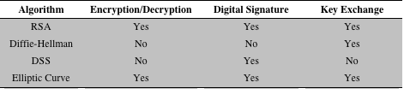
Table 3.2 applications for public-key cryptosystems
Notes:
Some algorithms are suitable for all three applications, whereas others can be
used only for one or two of these applications. Table 3.2 indicates the applications
supported by the algorithms discussed in this chapter: RSA and Diffie–Hellman.
This table also includes the Digital Signature Standard (DSS) and elliptic-curve
cryptography, also mentioned later in this chapter.

Slide 96
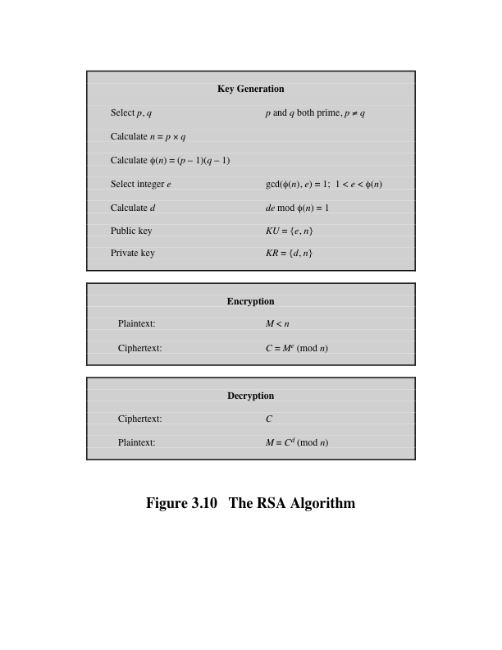
Notes:
The two most widely used public-key algorithms are RSA and Diffie–Hellman.
We look at both of these in this section and then briefly introduce two other
algorithms.
One of the first public-key schemes was developed in 1977 by Ron Rivest, Adi
Shamir, and Len Adleman at MIT and first published in 1978 [RIVE78]. The
RSA scheme has since that time reigned supreme as the most widely accepted and
implemented approach to public-key encryption. RSA is a block cipher in which the
plaintext and ciphertext are integers between 0 and n - 1 for some n.
Figure 3.10 summarizes the RSA algorithm.

Slide 97
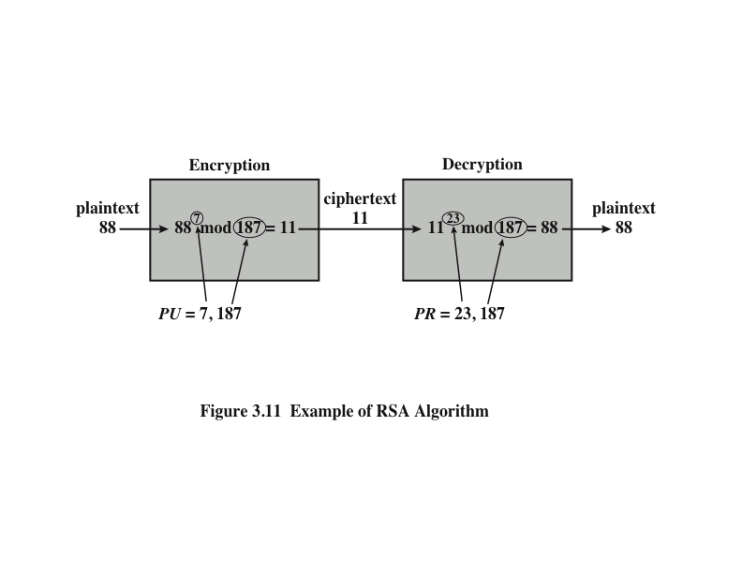
Notes:
An example, from [SING99], is shown in Figure 3.11.
What is a mod m?
Definition. On this page, a, b, k, and m are always integers. a≡b (mod m) is read as "a is congruent to b mod m". In a simple, but not wholly correct way, we can think of a≡b (mod m) to mean "a is the remainder when b is divided by m". For instance, 2≡12 (mod 10) means that 2 is the remainder when 12 is divided by 10.

Slide 98
Diffie-Hellman Key Exchange
First published public-key algorithm
A number of commercial products employ this key exchange technique
Purpose of the algorithm is to enable two users to exchange a secret key securely that then can be used for subsequent encryption of messages
The algorithm itself is limited to the exchange of the keys
Depends for its effectiveness on the difficulty of computing discrete logarithms
Notes:
The first published public-key algorithm appeared in the seminal paper by Diffie
and Hellman that defined public-key cryptography [DIFF76] and is generally
referred to as the Diffie–Hellman key exchange . A number of commercial products
employ this key exchange technique.
The purpose of the algorithm is to enable two users to exchange a secret key
securely that then can be used for subsequent encryption of messages. The algorithm
itself is limited to the exchange of the keys.
The Diffie–Hellman algorithm depends for its effectiveness on the difficulty
of computing discrete logarithms.

Slide 99
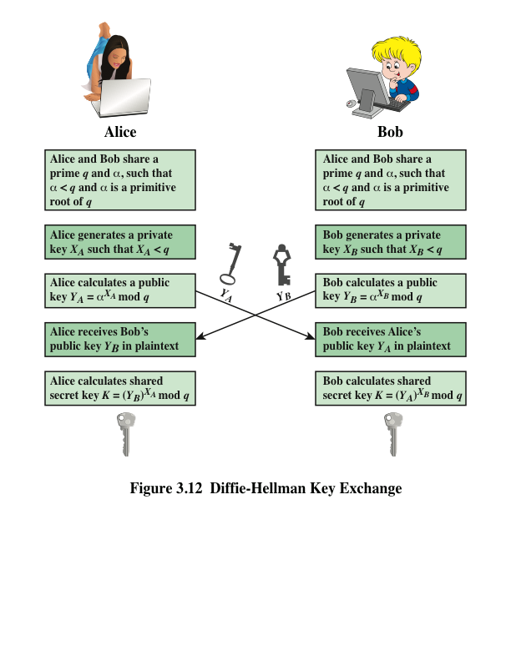
Notes:
The Diffie–Hellman key exchange is summarized in Figure 3.12.

Slide 100
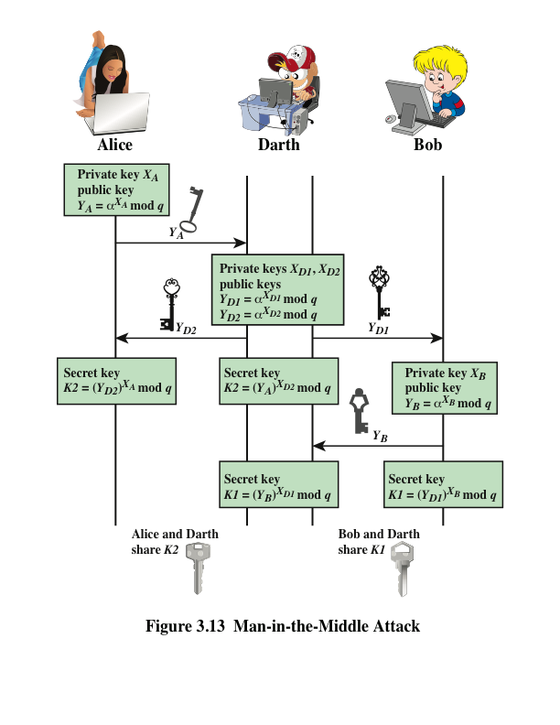
Notes:
The protocol depicted in Figure 3.12 is insecure
against a man-in-the-middle attack. Suppose Alice and Bob wish to exchange keys,
and Darth is the adversary. The attack proceeds as follows (Figure 3.13).

Slide 101
Digital Signature standard (DSS)
FIPS PUB 186
Makes use of the SHA-1 and presents a new digital signature technique, the Digital Signature Algorithm (DSA)
Originally proposed in 1991 and revised in 1993 and again in 1996
Uses an algorithm that is designed to provide only the digital signature function
Unlike RSA, it cannot be used for encryption or key exchange
Notes:
The National Institute of Standards and Technology
(NIST) has published Federal Information Processing Standard FIPS PUB 186,
known as the Digital Signature Standard (DSS) . The DSS makes use of the SHA-1
and presents a new digital signature technique, the Digital Signature Algorithm
(DSA). The DSS was originally proposed in 1991 and revised in 1993 in response to
public feedback concerning the security of the scheme. There was a further minor revision
in 1996. The DSS uses an algorithm that is designed to provide only the digital
signature function. Unlike RSA, it cannot be used for encryption or key exchange.

Slide 102
Elliptic-curve cryptology (ECC)
Technique is based on the use of a mathematical construct known as the elliptic curve
Principal attraction of ECC compared to RSA is that it appears to offer equal security for a far smaller bit size, thereby reducing processing overhead
The confidence level in ECC is not yet as high as that in RSA
Notes:
The vast majority of the products and standards
that use public-key cryptography for encryption and digital signatures use RSA.
The bit length for secure RSA use has increased over recent years, and this has
put a heavier processing load on applications using RSA. This burden has ramifications,
especially for electronic commerce sites that conduct large numbers of secure
transactions. Recently, a competing system has begun to challenge RSA: elliptic
curve cryptography (ECC) . Already, ECC is showing up in standardization efforts,
including the IEEE P1363 Standard for Public-Key Cryptography.
The principal attraction of ECC compared to RSA is that it appears to offer
equal security for a far smaller bit size, thereby reducing processing overhead. On
the other hand, although the theory of ECC has been around for some time, it is
only recently that products have begun to appear and that there has been sustained
cryptanalytic interest in probing for weaknesses. Thus, the confidence level in ECC
is not yet as high as that in RSA.
ECC is fundamentally more difficult to explain than either RSA or Diffie–
Hellman, and a full mathematical description is beyond the scope of this book.
The technique is based on the use of a mathematical construct known as the
elliptic curve.

Slide 103
Summary
Approaches to message authentication
Authentication using conventional encryption
Message authentication without message encryption
Secure hash functions
Hash function requirements
Security of hash functions
Simple hash functions
The SHA secure hash function SHA-3
Digital signatures
Message authentication codes
HMAC (Hash MAC)
MACs based on block ciphers
Public-key cryptography principles
Public-key encryption structure
Applications for public-key cryptosystems
Requirements for public-key cryptography
Public-key cryptography algorithms
The RSA public-key encryption algorithm
Diffie-Hellman key exchange
Other public-key cryptography algorithms
Notes:
Chapter 3 summary.

Slide 104
Network Security Essentials
Fifth Edition
by William Stallings
Notes:
Lecture slides prepared for “Network Security Essentials”, 5/e, by William Stallings, Chapter 4 – “Key Distribution and User Authentication”.

Slide 105
Chapter 4
Key Distribution and User Authentication
Notes:
This chapter covers two important related concepts. First is the complex topic of cryptographic
key distribution, involving cryptographic, protocol, and management considerations.
This chapter gives the reader a feel for the issues involved and provides a
broad survey of the various aspects of key management and distribution.
This chapter also examines some of the authentication functions that have been
developed to support network-based user authentication. The chapter includes a detail
discussion of one of the earliest and also one of the most widely used key distribution
and user authentication services: Kerberos. Next, the chapter looks at key distribution
schemes that rely on asymmetric encryption. This is followed by a discussion of X.509
certificates and public-key infrastructure. Finally, the concept of federated identity
management is introduced.

Slide 106
No Singhalese, whether man or woman, would venture out of the house without a bunch of keys in his hand, for without such a talisman he would fear that some devil might take advantage of his weak state to slip into his body.
—The Golden Bough, Sir James George Frazer
Notes:
Opening quote.

Slide 107
Symmetric Key Distribution using symmetric encryption
For symmetric encryption to work, the two parties to an exchange must share the same key, and that key must be protected from access by others
Frequent key changes are usually desirable to limit the amount of data compromised if an attacker learns the key
Key distribution technique
The means of delivering a key to two parties that wish to exchange data, without allowing others to see the key
Notes:
For symmetric encryption to work, the two parties to an exchange must share
the same key, and that key must be protected from access by others. Furthermore,
frequent key changes are usually desirable to limit the amount of data compromised
if an attacker learns the key. Therefore, the strength of any cryptographic
system rests with the “key distribution technique,” a term that refers to the means of
delivering a key to two parties that wish to exchange data, without allowing others
to see the key.

Slide 108
Key Distribution
For two parties A and B, there are the following options:
1
2
3
4
A key can be selected by A and physically delivered to B
A third party can select the key and physically deliver it to A and B
If A and B have previously and recently used a key, one party could transmit the new key to the other, using the old key to encrypt the new key
If A and B each have an encrypted connection to a third party C, C could deliver a key on the encrypted links to A and B
Notes:
Key distribution can be achieved in a number of ways. For two
parties A and B, there are the following options:
1. A key could be selected by A and physically delivered to B.
2. A third party could select the key and physically deliver it to A and B.
3. If A and B have previously and recently used a key, one party could transmit
the new key to the other, using the old key to encrypt the new key.
4. If A and B each have an encrypted connection to a third party C, C could
deliver a key on the encrypted links to A and B.
Options 1 and 2 call for manual delivery of a key. For link encryption, this is
a reasonable requirement, because each link encryption device is only going to be
exchanging data with its partner on the other end of the link. However, for end-to-end
encryption over a network, manual delivery is awkward. In a distributed system,
any given host or terminal may need to engage in exchanges with many other
hosts and terminals over time. Thus, each device needs a number of keys supplied
dynamically. The problem is especially difficult in a wide-area distributed system.
Option 3 is a possibility for either link encryption or end-to-end encryption,
but if an attacker ever succeeds in gaining access to one key, then all subsequent
keys are revealed. Even if frequent changes are made to the link encryption keys,
these should be done manually. To provide keys for end-to-end encryption, option
4 is preferable.
For option 4 , two kinds of keys are used:
• Session key: When two end systems (hosts,
terminals, etc.) wish to communicate,
they establish a logical connection (e.g., virtual circuit). For the duration
of that logical connection, called a session, all user data are encrypted with
a one-time session key. At the conclusion of the session the session key is
destroyed.
• Permanent key: A permanent key is a key used between entities for the purpose
of distributing session keys.
A necessary element of option 4 is a key distribution center (KDC) . The KDC
determines which systems are allowed to communicate with each other. When permission
is granted for two systems to establish a connection, the key distribution
center provides a one-time session key for that connection.
In general terms, the operation of a KDC proceeds as follows:
1. When host A wishes to set up a connection to host B, it transmits a connection request
packet to the KDC. The communication between A and the KDC is
encrypted using a master key shared only by A and the KDC.
2. If the KDC approves the connection request, it generates a unique one-time
session key. It encrypts the session key using the permanent key it shares with
A and delivers the encrypted session key to A. Similarly, it encrypts the session
key using the permanent key it shares with B and delivers the encrypted session
key to B.
3. A and B can now set up a logical connection and exchange messages and data,
all encrypted using the temporary session key.

Slide 109
Kerberos
Key distribution and user authentication service developed at MIT
Provides a centralized authentication server whose function is to authenticate users to servers and servers to users
Relies exclusively on symmetric encryption, making no use of public-key encryption
Two versions are in use
Version 4 implementations still exist, although this version is being phased out
Version 5 corrects some of the security deficiencies of version 4 and has been issued as a proposed Internet Standard (RFC 4120)
Notes:
Kerberos is a key distribution and user authentication service developed at MIT.
The problem that Kerberos addresses is this: Assume an open distributed environment
in which users at workstations wish to access services on servers distributed
throughout the network. We would like for servers to be able to restrict access to
authorized users and to be able to authenticate requests for service. In this environment,
a workstation cannot be trusted to identify its users correctly to network
services. In particular, the following three threats exist:
1. A user may gain access to a particular workstation and pretend to be another
user operating from that workstation.
2. A user may alter the network address of a workstation so that the requests
sent from the altered workstation appear to come from the impersonated
workstation.
3. A user may eavesdrop on exchanges and use a replay attack to gain entrance
to a server or to disrupt operations.
In any of these cases, an unauthorized user may be able to gain access to services
and data that he or she is not authorized to access. Rather than building elaborate
authentication protocols at each server, Kerberos provides a centralized authentication
server whose function is to authenticate users to servers and servers to users.
Kerberos relies exclusively on symmetric encryption, making no use of public-key
encryption.
Two versions of Kerberos are in use. Version 4 [MILL88, STEI88] implementations
still exist, although this version is being phased out. Version 5 [KOHL94]
corrects some of the security deficiencies of version 4 and has been issued as a proposed
Internet Standard (RFC 4120).
Because of the complexity of Kerberos, it is best to start with a description
of version 4. This enables us to see the essence of the Kerberos strategy without
considering some of the details required to handle subtle security threats. Then, we
examine version 5.

Slide 110
Kerberos version 4
A basic third-party authentication scheme
Authentication Server (AS)
Users initially negotiate with AS to identify self
AS provides a non-corruptible authentication credential (ticket granting ticket TGT)
Ticket Granting Server (TGS)
Users subsequently request access to other services from TGS on basis of users TGT
Complex protocol using DES
Notes:
Version 4 of Kerberos makes use of DES, in a rather elaborate protocol, to provide
the authentication service. Viewing the protocol as a whole, it is difficult to see the
need for the many elements contained therein. Therefore, we adopt a strategy used
by Bill Bryant [BRYA88] and build up to the full protocol by looking first at several
hypothetical dialogues. Each successive dialogue adds additional complexity to
counter security vulnerabilities revealed in the preceding dialogue.
In an unprotected network environment,
any client can apply to any server for service. The obvious security risk is that of
impersonation. An opponent can pretend to be another client and obtain unauthorized
privileges on server machines. To counter this threat, servers must be able to
confirm the identities of clients who request service. Each server can be required to
undertake this task for each client/server interaction, but in an open environment,
this places a substantial burden on each server.
An alternative is to use an authentication server (AS) that knows the passwords
of all users and stores these in a centralized database. In addition, the AS
shares a unique secret key with each server. These keys have been distributed
physically or in some other secure manner.
Although the foregoing scenario solves
some of the problems of authentication in an open network environment, problems
remain. Two in particular stand out. First, we would like to minimize the number
of times that a user has to enter a password. Suppose each ticket can be used only
once. If user C logs on to a workstation in the morning and wishes to check his or her
mail at a mail server, C must supply a password to get a ticket for the mail server.
If C wishes to check the mail several times during the day, each attempt requires
reentering the password. We can improve matters by saying that tickets are reusable.
For a single logon session, the workstation can store the mail-server ticket after it is
received and use it on behalf of the user for multiple accesses to the mail server.
However, under this scheme, it remains the case that a user would need a new
ticket for every different service. If a user wished to access a print server, a mail
server, a file server, and so on, the first instance of each access would require a new
ticket and hence require the user to enter the password.
The second problem is that the earlier scenario involved a plaintext transmission
of the password [message (1)]. An eavesdropper could capture the password
and use any service accessible to the victim.
To solve these additional problems, we introduce a scheme for avoiding plaintext
passwords and a new server, known as the ticket-granting server (TGS) .
The new service, TGS, issues tickets to users who have been authenticated to
AS. Each time the user requires
access to a new service, the client applies to the TGS, using the ticket to authenticate
itself. The TGS then grants a ticket for the particular service. The client saves
each service-granting ticket and uses it to authenticate its user to a server each time
a particular service is requested.

Slide 111
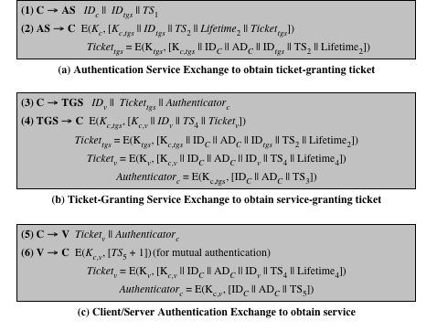
Table 4.1
Summary of Kerberos Version 4 Message Exchanges
Notes:
Table 4.1, shows the
actual Kerberos protocol.

Slide 112
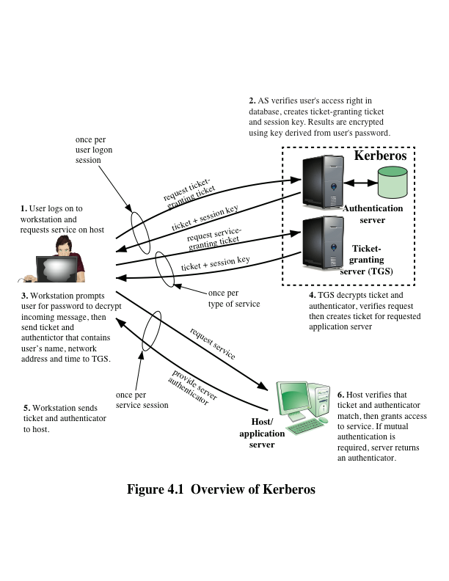
Notes:
Figure 4.1 provides simplified overview.

Slide 113
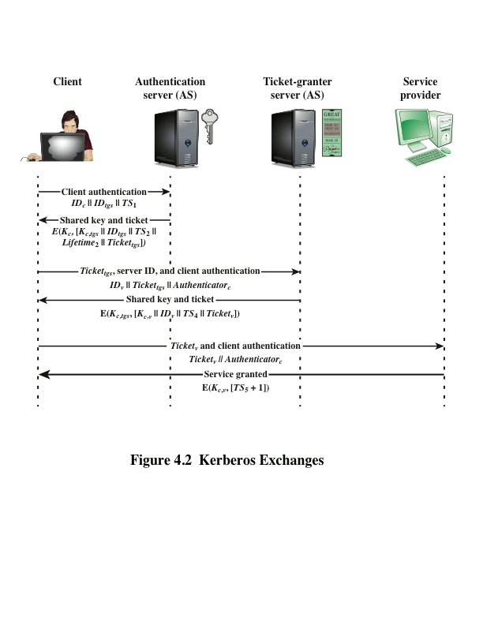
Notes:
Figure 4.2 illustrates the Kerberos exchanges among the parties.

Slide 114
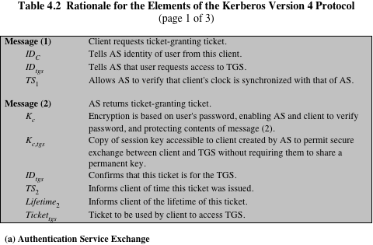
Notes:
Table 4.2
summarizes the justification for each of the elements in the Kerberos protocol.

Slide 115
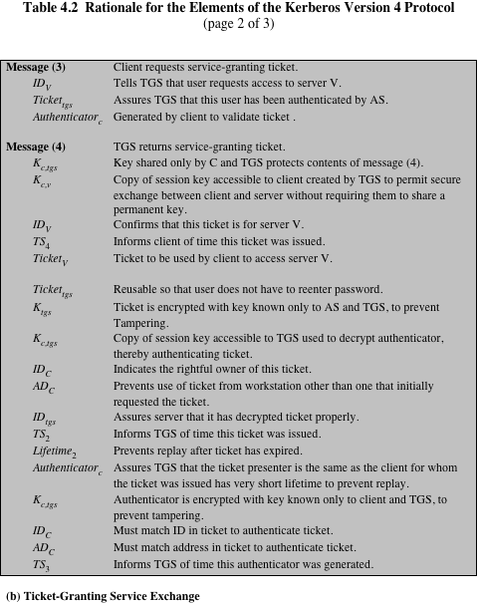
Notes:
Continuation of Table 4.2

Slide 116
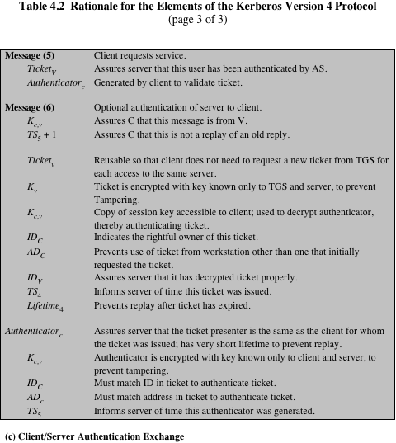
Notes:
Continuation of Table 4.2

Slide 117
Kerberos Realms
Kerberos realm
A set of managed nodes that share the same Kerberos database
The Kerberos database resides on the Kerberos master computer system, which should be kept in a physically secure room
A read-only copy of the Kerberos database might also reside on other Kerberos computer systems
All changes to the database must be made on the master computer system
Changing or accessing the contents of a Kerberos database requires the Kerberos master password
A Kerberos environment consists of:
A Kerberos server
A number of clients
A number of application servers
Notes:
A full-service Kerberos environment
consisting of a Kerberos server, a number of clients, and a number of application
servers requires the following:
1. The Kerberos server must have the user ID and hashed passwords of all participating
users in its database. All users are registered with the Kerberos
server.
2. The Kerberos server must share a secret key with each server. All servers are
registered with the Kerberos server.
Such an environment is referred to as a Kerberos realm . The concept of realm
can be explained as follows. A Kerberos realm is a set of managed nodes that share
the same Kerberos database. The Kerberos database resides on the Kerberos master
computer system, which should be kept in a physically secure room. A read-only
copy of the Kerberos database might also reside on other Kerberos computer systems.
However, all changes to the database must be made on the master computer
system. Changing or accessing the contents of a Kerberos database requires the
Kerberos master password.

Slide 118
Kerberos principal
A service or user that is known to the Kerberos system
Each Kerberos principal is identified by its principal name
A service or user name
An instance name
A realm name
Principal name
Principal names consist of three parts
Notes:
A related concept is that of a Kerberos principal , which
is a service or user that is known to the Kerberos system. Each Kerberos principal is
identified by its principal name. Principal names consist of three parts: a service or
user name, an instance name, and a realm name.
Networks of clients and servers under different administrative organizations
typically constitute different realms. That is, it generally is not practical or does not
conform to administrative policy to have users and servers in one administrative
domain registered with a Kerberos server elsewhere. However, users in one realm
may need access to servers in other realms, and some servers may be willing to provide
service to users from other realms, provided that those users are authenticated.

Slide 119
Differences between versions 4 and 5
Environmental shortcomings
Technical deficiencies
Encryption system dependence
Internet protocol dependence
Message byte ordering
Ticket lifetime
Authentication forwarding
Interrealm authentication
Double encryption
PCBC encryption
Session keys
Password attacks
Notes:
Version 5 is intended to address the
limitations of version 4 in two areas: environmental shortcomings and technical
deficiencies. We briefly summarize the improvements in each area. Kerberos version
4 did not fully address the need to be of general purpose. This led to the following
environmental shortcomings
Encryption system dependence
Internet protocol dependence
Message byte ordering
Ticket lifetime
Authentication forwarding
Interrealm authentication
Apart from these environmental limitations, there are technical deficiencies
in the version 4 protocol itself. Most of these deficiencies were documented in
[BELL90], and version 5 attempts to address these. The deficiencies are the
Following:
Double encryption
PCBC encryption
Session keys
Password attacks

Slide 120
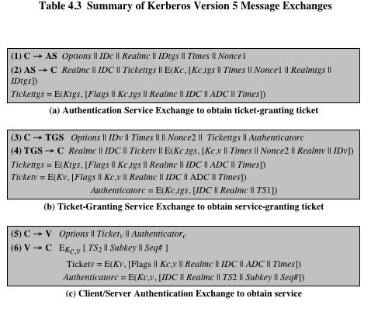
Notes:
Table 4.3 summarizes the basic version
5 dialogue. This is best explained by comparison with version 4 (Table 4.1).

Slide 121
Key distribution using asymmetric encryption
One of the major roles of public-key encryption is to address the problem of key distribution
There are two distinct aspects to the use of public-key encryption in this regard:
The distribution of public keys
The use of public-key encryption to distribute secret keys
Public-key certificate
Consists of a public key plus a user ID of the key owner, with the whole block signed by a trusted third party
Typically, the third party is a certificate authority (CA) that is trusted by the user community, such as a government agency or a financial institution
A user can present his or her public key to the authority in a secure manner and obtain a certificate
The user can then publish the certificate
Anyone needing this user’s public key can obtain the certificate and verify that it is valid by way of the attached trusted signature
Notes:
One of the major roles of public-key encryption is to address the problem of key
distribution. There are actually two distinct aspects to the use of public-key encryption
in this regard.
• The distribution of public keys.
• The use of public-key encryption to distribute secret keys.
On the face of it, the point of public-key encryption is that the public key is public.
Thus, if there is some broadly accepted public-key algorithm, such as RSA, any
participant can send his or her public key to any other participant or broadcast the
key to the community at large. Although this approach is convenient, it has a major
weakness. Anyone can forge such a public announcement. That is, some user could
pretend to be user A and send a public key to another participant or broadcast such
a public key. Until such time as user A discovers the forgery and alerts other participants,
the forger is able to read all encrypted messages intended for A and can use
the forged keys for authentication.
The solution to this problem is the public-key certificate . In essence, a certificate
consists of a public key plus a user ID of the key owner, with the whole block
signed by a trusted third party. Typically, the third party is a certificate authority
(CA) that is trusted by the user community, such as a government agency or a financial
institution. A user can present his or her public key to the authority in a secure
manner and obtain a certificate. The user can then publish the certificate. Anyone
needing this user’s public key can obtain the certificate and verify that it is valid by
way of the attached trusted signature. Figure 4.3 illustrates the process.
One scheme has become universally accepted for formatting public-key certificates:
the X.509 standard. X.509 certificates are used in most network security
applications, including IP security, secure sockets layer (SSL), and S/MIME—all of
which are discussed in subsequent chapters. X.509 is examined in detail in the next
section.

Slide 122
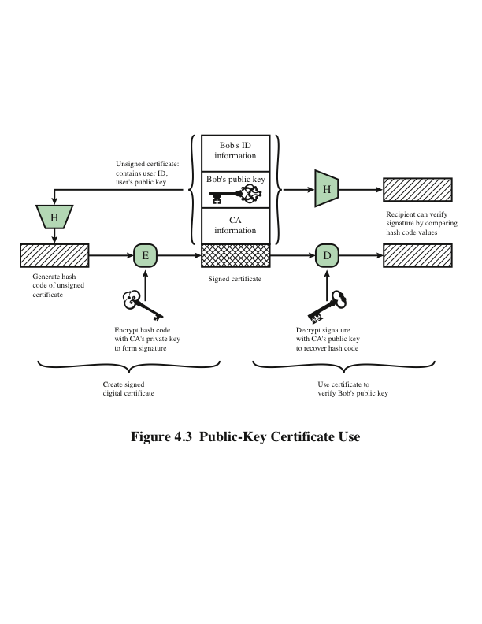
Notes:
Figure 4.3 illustrates the generation of a public-key certificate.

Slide 123
X.509 Certificates
ITU-T recommendation X.509 is part of the X.500 series of recommendations that define a directory service
Defines a framework for the provision of authentication services by the X.500 directory to its users
The directory may serve as a repository of public-key certificates
Defines alternative authentication protocols based on the use of public-key certificates
Was initially issued in 1988
Based on the use of public-key cryptography and digital signatures
The standard does not dictate the use of a specific algorithm but recommends RSA
Notes:
ITU-T recommendation X.509 is part of the X.500 series of recommendations that
define a directory service. The directory is, in effect, a server or distributed set
of servers that maintains a database of information about users. The information
includes a mapping from user name to network address, as well as other attributes
and information about the users.
X.509 defines a framework for the provision of authentication services by the
X.500 directory to its users. The directory may serve as a repository of public-key
certificates. Each certificate contains the public key of a user and is signed with the
private key of a trusted certification authority. In addition, X.509 defines alternative
authentication protocols based on the use of public-key certificates.
X.509 is an important standard because the certificate structure and authentication
protocols defined in X.509 are used in a variety of contexts. For example, the
X.509 certificate format is used in S/MIME (Chapter 8), IP Security (Chapter 9),
and SSL/TLS (Chapter 6).
X.509 was initially issued in 1988. The standard was subsequently revised to
address some of the security concerns documented in [IANS90] and [MITC90]; a
revised recommendation was issued in 1993. A third version was issued in 1995 and
revised in 2000.
X.509 is based on the use of public-key cryptography and digital signatures.
The standard does not dictate the use of a specific algorithm but recommends
RSA. The digital signature scheme is assumed to require the use of a hash function.
Again, the standard does not dictate a specific hash algorithm. The 1988 recommendation
included the description of a recommended hash algorithm; this algorithm
has since been shown to be insecure and was dropped from the 1993 recommendation.

Slide 124
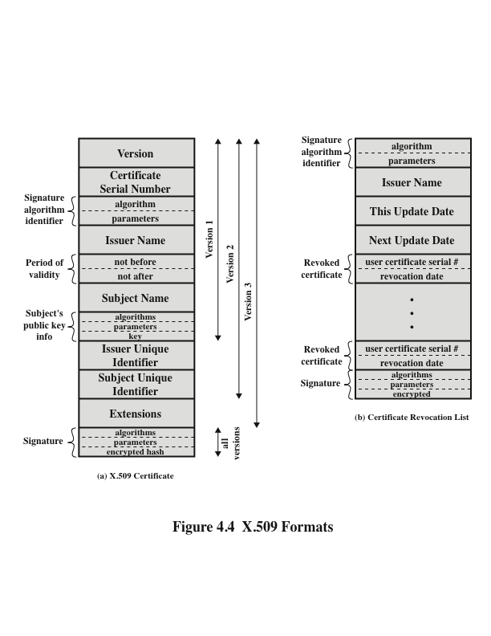
Notes:
Figure 4.4a shows the general format of a certificate.

Slide 125
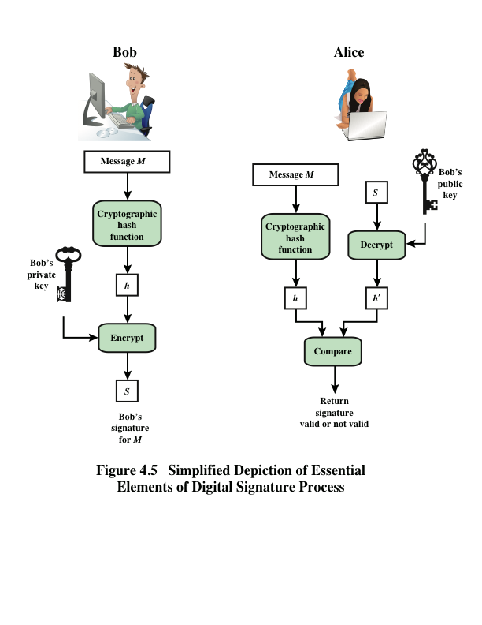
Notes:
The CA signs the certificate with its private key. If the corresponding public
key is known to a user, then that user can verify that a certificate signed by the CA
is valid. This is the typical digital signature approach, as illustrated in Figure 4.5.

Slide 126
Obtaining a user’s certificate
User certificates generated by a CA have the following characteristics:
Any user with access to the public key of the CA can verify the user public key that was certified
No party other than the certification authority can modify the certificate without this being detected
Because certificates are unforgeable, they can be placed in a directory without the need for the directory to make special efforts to protect them
Notes:
User certificates generated by a CA have the
following characteristics:
• Any user with access to the public key of the CA can verify the user public key
that was certified.
• No party other than the certification authority can modify the certificate without
this being detected.
Because certificates are unforgeable, they can be placed in a directory without the
need for the directory to make special efforts to protect them.
If all users subscribe to the same CA, then there is a common trust of that CA.
All user certificates can be placed in the directory for access by all users. In addition,
a user can transmit his or her certificate directly to other users. In either case,
once B is in possession of A’s certificate, B has confidence that messages it encrypts
with A’s public key will be secure from eavesdropping and that messages signed with
A’s private key are unforgeable.
If there is a large community of users, it may not be practical for all users to
subscribe to the same CA. Because it is the CA that signs certificates, each participating
user must have a copy of the CA’s own public key to verify signatures. This
public key must be provided to each user in an absolutely secure way (with respect
to integrity and authenticity) so that the user has confidence in the associated certificates.
Thus, with many users, it may be more practical for there to be a number
of CAs, each of which securely provides its public key to some fraction of the users.

Slide 127
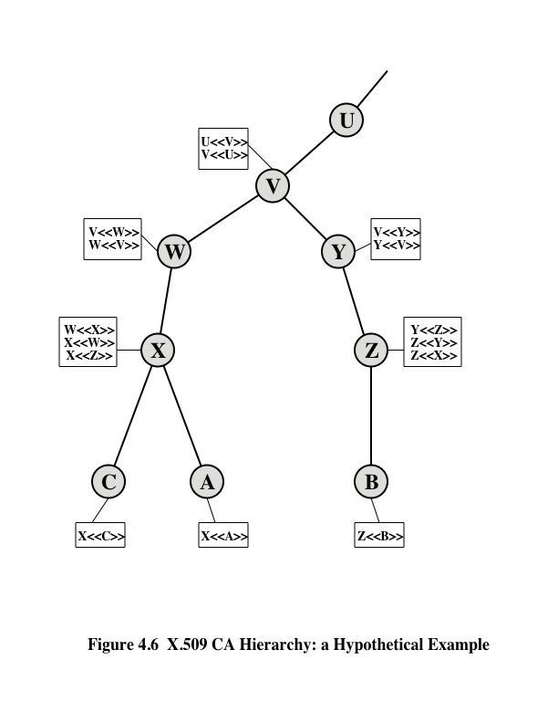
Notes:
Figure 4.6, taken from X.509, is an example of a hierarchy. The connected
circles indicate the hierarchical relationship among the CAs; the associated boxes
indicate certificates maintained in the directory for each CA entry. The directory
entry for each CA includes two types of certificates:
• Forward certificates: Certificates of X generated by other CAs
• Reverse certificates: Certificates generated by X that are the certificates of
other CAs

Slide 128
Revocation of certificates
Each certificate includes a period of validity
Typically a new certificate is issued just before the expiration of the old one
It may be desirable on occasion to revoke a certificate before it expires for one of the following reasons:
The user’s private key is assumed to be compromised
The user is no longer certified by this CA; reasons for this include subject’s name has changed, the certificate is superseded, or the certificate was not issued in conformance with the CA’s policies
The CA’s certificate is assumed to be compromised
Notes:
Recall from Figure 4.4 that each certificate includes
a period of validity, much like a credit card. Typically, a new certificate is issued just
before the expiration of the old one. In addition, it may be desirable on occasion to
revoke a certificate before it expires for one of the following reasons.
1. The user’s private key is assumed to be compromised.
2. The user is no longer certified by this CA. Reasons for this include subject’s
name has changed, the certificate is superseded, or the certificate was not
issued in conformance with the CA’s policies.
3. The CA’s certificate is assumed to be compromised.
Each CA must maintain a list consisting of all revoked but not expired certificates
issued by that CA, including both those issued to users and to other CAs.
These lists also should be posted on the directory.
Each certificate revocation list (CRL) posted to the directory is signed by the
issuer and includes (Figure 4.4b) the issuer’s name, the date the list was created, the
date the next CRL is scheduled to be issued, and an entry for each revoked certificate.
Each entry consists of the serial number of a certificate and revocation date for
that certificate. Because serial numbers are unique within a CA, the serial number
is sufficient to identify the certificate.
When a user receives a certificate in a message, the user must determine
whether the certificate has been revoked. The user could check the directory each
time a certificate is received. To avoid the delays (and possible costs) associated
with directory searches, it is likely that the user would maintain a local cache of certificates
and lists of revoked certificates.

Slide 129
X.509 Version 3
Includes a number of optional extensions that may be added to the version 2 format
Each extension consists of:
An extension identifier
A criticality indicator
An extension value
The certificate extensions fall into three main categories:
Key and policy information
Subject and issuer attributes
Certification path constraints
Notes:
The X.509 version 2 format does not convey all of the information that recent
design and implementation experience has shown to be needed. [FORD95] lists the
following requirements not satisfied by version 2:
1. The Subject field is inadequate to convey the identity of a-key owner to a
public-key user. X.509 names may be relatively short and lacking in obvious
identification details that may be needed by the user.
2. The Subject field is also inadequate for many applications, which typically recognize
entities by an Internet e-mail address, a URL, or some other Internet related
identification.
3. There is a need to indicate security policy information. This enables a security
application or function, such as IPSec, to relate an X.509 certificate to a given
policy.
4. There is a need to limit the damage that can result from a faulty or malicious
CA by setting constraints on the applicability of a particular certificate.
5. It is important to be able to identify different keys used by the same owner at
different times. This feature supports key life cycle management, in particular
the ability to update key pairs for users and CAs on a regular basis or under
exceptional circumstances.
Rather than continue to add fields to a fixed format, standards developers
felt that a more flexible approach was needed. Thus, version 3 includes a number
of optional extensions that may be added to the version 2 format. Each extension
consists of an extension identifier, a criticality indicator, and an extension value.
The criticality indicator indicates whether an extension can be safely ignored. If
the indicator has a value of TRUE and an implementation does not recognize the
extension, it must treat the certificate as invalid.
The certificate extensions fall into three main categories: key and policy information,
subject and issuer attributes, and certification path constraints.

Slide 130
Key and policy information
These extensions convey additional information about the subject and issuer keys, plus indicators of certificate policy
A certificate policy is a named set of rules that indicates the applicability of a certificate to a particular community and/or class of application with common security requirements
Includes:
Authority key identifier
Subject key identifier
Key usage
Private-key usage period
Certificate policies
Policy mappings
Notes:
These extensions convey additional information
about the subject and issuer keys, plus indicators of certificate policy. A certificate
policy is a named set of rules that indicates the applicability of a certificate to a
particular community and/or class of application with common security requirements.
For example, a policy might be applicable to the authentication of electronic
data interchange (EDI) transactions for the trading of goods within a given
price range.
This area includes the following:
• Authority key identifier: Identifies the public key to be used to verify the signature
on this certificate or CRL. Enables distinct keys of the same CA to be
differentiated. One use of this field is to handle CA key pair updating.
• Subject key identifier: Identifies the public key being certified. Useful for subject
key pair updating. Also, a subject may have multiple key pairs and, correspondingly,
different certificates for different purposes (e.g., digital signature
and encryption key agreement).
• Key usage: Indicates a restriction imposed as to the purposes for which, and
the policies under which, the certified public key may be used. May indicate
one or more of the following: digital signature, nonrepudiation, key encryption,
data encryption, key agreement, CA signature verification on certificates,
and CA signature verification on CRLs.
• Private-key usage period: Indicates the period of use of the private key corresponding
to the public key. Typically, the private key is used over a different
period from the validity of the public key. For example, with digital signature
keys, the usage period for the signing private key is typically shorter than that
for the verifying public key.
• Certificate policies: Certificates may be used in environments where multiple
policies apply. This extension lists policies that the certificate is recognized as
supporting, together with optional qualifier information.
• Policy mappings: Used only in certificates for CAs issued by other CAs. Policy
mappings allow an issuing CA to indicate that one or more of that issuer’s
policies can be considered equivalent to another policy used in the subject
CA’s domain.

Slide 131
Certificate subject and issuer attributes
These extensions support alternative names, in alternative formats, for a certificate subject or certificate issuer and can convey additional information about the certificate subject to increase a certificate user’s confidence that the certificate subject is a particular person or entity
Includes:
Subject alternative name
Issuer alternative name
Subject directory attributes
Notes:
These extensions support alternative
names, in alternative formats, for a certificate subject or certificate issuer and can
convey additional information about the certificate subject to increase a certificate
user’s confidence that the certificate subject is a particular person or entity. For
example, information such as postal address, position within a corporation, or
picture image may be required.
The extension fields in this area include the following:
• Subject alternative name: Contains one or more alternative names, using any
of a variety of forms. This field is important for supporting certain applications,
such as electronic mail, EDI, and IPSec, which may employ their own
name forms.
• Issuer alternative name: Contains one or more alternative names, using any of
a variety of forms.
• Subject directory attributes: Conveys any desired X.500 directory attribute
values for the subject of this certificate.

Slide 132
Certification path constraints
These extensions allow constraint specifications to be included in certificates issued for CAs by other CAs
The constraints may restrict the types of certificates that can be issued by the subject CA or that may occur subsequently in a certification chain
Includes:
Basic constraints
Name constraints
Policy constraints
Notes:
These extensions allow constraint specifications
to be included in certificates issued for CAs by other CAs. The constraints may
restrict the types of certificates that can be issued by the subject CA or that may
occur subsequently in a certification chain.
The extension fields in this area include the following:
• Basic constraints: Indicates if the subject may act as a CA. If so, a certification
path length constraint may be specified.
• Name constraints: Indicates a name space within which all subject names in
subsequent certificates in a certification path must be located.
• Policy constraints: Specifies constraints that may require explicit certificate
policy identification or inhibit policy mapping for the remainder of the certification
path.

Slide 133
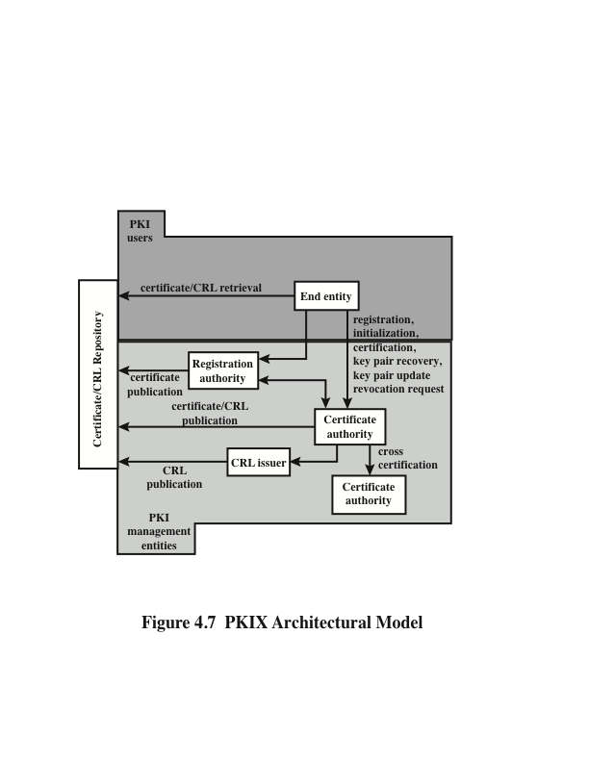
Notes:
RFC 4949 (Internet Security Glossary ) defines public-key infrastructure (PKI) as
the set of hardware, software, people, policies, and procedures needed to create,
manage, store, distribute, and revoke digital certificates based on asymmetric cryptography.
The principal objective for developing a PKI is to enable secure, convenient,
and efficient acquisition of public keys. The Internet Engineering Task Force
(IETF) Public Key Infrastructure X.509 (PKIX) working group has been the driving
force behind setting up a formal (and generic) model based on X.509 that is
suitable for deploying a certificate-based architecture on the Internet. This section
describes the PKIX model.
Figure 4.7 shows the interrelationship among the key elements of the PKIX
model. These elements are
• End entity: A generic term used to denote end users, devices (e.g., servers,
routers), or any other entity that can be identified in the subject field of a public
key certificate. End entities typically consume and/or support PKI-related
services.
• Certification authority (CA): The issuer of certificates and (usually) certificate
revocation lists (CRLs). It may also support a variety of administrative functions,
although these are often delegated to one or more registration authorities.
• Registration authority (RA): An optional component that can assume a number
of administrative functions from the CA. The RA is often associated with the
end entity registration process, but can assist in a number of other areas as well.
• CRL issuer: An optional component that a CA can delegate to publish CRLs.
• Repository: A generic term used to denote any method for storing certificates
and CRLs so that they can be retrieved by end entities.

Slide 134
PKIX Management functions
Functions that potentially need to be supported by management protocols:
Registration
Initialization
Certification
Key pair recovery
Key pair update
Revocation request
Cross certification
Alternative management protocols:
Certificate management protocols (CMP)
Designed to be a flexible protocol able to accommodate a variety of technical, operational, and business models
Certificate management messages over CMS (CMC)
Is built on earlier work and is intended to leverage existing implementations
Notes:
PKIX identifies a number of management functions that potentially need to be supported
by management protocols. These are indicated in Figure 4.7 and include the
following:
• Registration: This is the process whereby a user first makes itself known to
a CA (directly, or through an RA), prior to that CA issuing a certificate or
certificates for that user. Registration begins the process of enrolling in a PKI.
Registration usually involves some off-line or online procedure for mutual authentication.
Typically, the end entity is issued one or more shared secret keys
used for subsequent authentication.
• Initialization: Before a client system can operate securely, it is necessary to
install key materials that have the appropriate relationship with keys stored
elsewhere in the infrastructure. For example, the client needs to be securely
initialized with the public key and other assured information of the trusted
CA(s) to be used in validating certificate paths.
• Certification: This is the process in which a CA issues a certificate for a user’s
public key and returns that certificate to the user’s client system and/or posts
that certificate in a repository.
• Key pair recovery: Key pairs can be used to support digital signature creation
and verification, encryption and decryption, or both. When a key pair is used
for encryption/decryption, it is important to provide a mechanism to recover the
necessary decryption keys when normal access to the keying material is no longer
possible, otherwise it will not be possible to recover the encrypted data. Loss of
access to the decryption key can result from forgotten passwords/PINs, corrupted
disk drives, damage to hardware tokens, and so on. Key pair recovery allows end
entities to restore their encryption/decryption key pair from an authorized key
backup facility (typically, the CA that issued the end entity’s certificate).
• Key pair update: All key pairs need to be updated regularly (i.e., replaced
with a new key pair) and new certificates issued. Update is required when the
certificate lifetime expires and as a result of certificate revocation.
• Revocation request: An authorized person advises a CA of an abnormal situation
requiring certificate revocation. Reasons for revocation include private
key compromise, change in affiliation, and name change.
• Cross-certification: Two CAs exchange information used in establishing
a cross-certificate. A cross-certificate is a certificate issued by one CA to
another CA that contains a CA signature key used for issuing certificates.
The PKIX working group has defined two alternative management protocols
between PKIX entities that support the management functions listed in the preceding
subsection. RFC 2510 defines the certificate management protocols (CMP).
Within CMP, each of the management functions is explicitly identified by specific
protocol exchanges. CMP is designed to be a flexible protocol able to accommodate
a variety of technical, operational, and business models.
RFC 2797 defines certificate management messages over CMS (CMC), where
CMS refers to RFC 2630, cryptographic message syntax. CMC is built on earlier work
and is intended to leverage existing implementations. Although all of the PKIX functions
are supported, the functions do not all map into specific protocol exchanges.

Slide 135
Identity Management
A centralized, automated approach to provide enterprise wide access to resources by employees and other authorized individuals
Focus is defining an identity for each user (human or process), associating attributes with the identity, and enforcing a means by which a user can verify identity
Central concept is the use of single sign-on (SSO) which enables a user to access all network resources after a single authentication
Principal elements of an identity management system:
Authentication
Authorization
Accounting
Provisioning
Workflow automation
Delegated administration
Password synchronization
Self-service password reset
Federation
Notes:
Federated identity management is a relatively new concept dealing with the use of
a common identity management scheme across multiple enterprises and numerous
applications and supporting many thousands, even millions, of users. We begin our
overview with a discussion of the concept of identity management and then examine
federated identity management.
Identity management is a centralized, automated approach to provide enterprise wide
access to resources by employees and other authorized individuals. The focus
of identity management is defining an identity for each user (human or process),
associating attributes with the identity, and enforcing a means by which a user can
verify identity. The central concept of an identity management system is the use
of single sign-on (SSO). SSO enables a user to access all network resources after a
single authentication.
[PELT07] lists the following as the principal elements of an identity management
system.
• Authentication: Confirmation that a user corresponds to the user name
provided.
• Authorization: Granting access to specific services and/or resources based on
the authentication.
• Accounting: A process for logging access and authorization.
• Provisioning: The enrollment of users in the system.
• Workflow automation: Movement of data in a business process.
• Delegated administration: The use of role-based access control to grant
permissions.
• Password synchronization: Creating a process for single sign-on (SSO) or
reduced sign-on (RSO). Single sign-on enables a user to access all network
resources after a single authentication. RSO may involve multiple sign-ons
but requires less user effort than if each resource and service maintained its
own authentication facility.
• Self-service password reset: Enables the user to modify his or her password.
• Federation: A process where authentication and permission will be passed
on from one system to another—usually across multiple enterprises, thereby
reducing the number of authentications needed by the user.
Note that Kerberos contains a number of elements of an identity management
system.

Slide 136
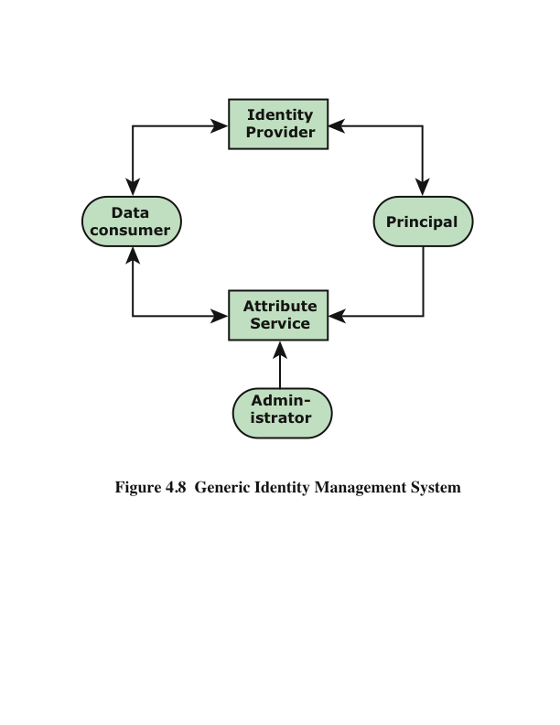
Notes:
Figure 4.8 [LINN06] illustrates entities and data flows in a generic identity
management architecture. A principal is an identity holder. Typically, this is
a human user that seeks access to resources and services on the network. User
devices, agent processes, and server systems may also function as principals.
Principals authenticate themselves to an identity provider . The identity provider
associates authentication information with a principal, as well as attributes and one
or more identifiers.
Increasingly, digital identities incorporate attributes other than simply
an identifier and authentication information (such as passwords and biometric
information). An attribute service manages the creation and maintenance of such
attributes. For example, a user needs to provide a shipping address each time an
order is placed at a new Web merchant, and this information needs to be revised
when the user moves. Identity management enables the user to provide this information
once, so that it is maintained in a single place and released to data consumers
in accordance with authorization and privacy policies. Users may create
some of the attributes to be associated with their digital identity, such as address.
Administrators may also assign attributes to users, such as roles, access permissions,
and employee information.
Data consumers are entities that obtain and employ data maintained and provided
by identity and attribute providers, which are often used to support authorization
decisions and to collect audit information. For example, a database server or
file server is a data consumer that needs a client’s credentials so as to know what
access to provide to that client.

Slide 137
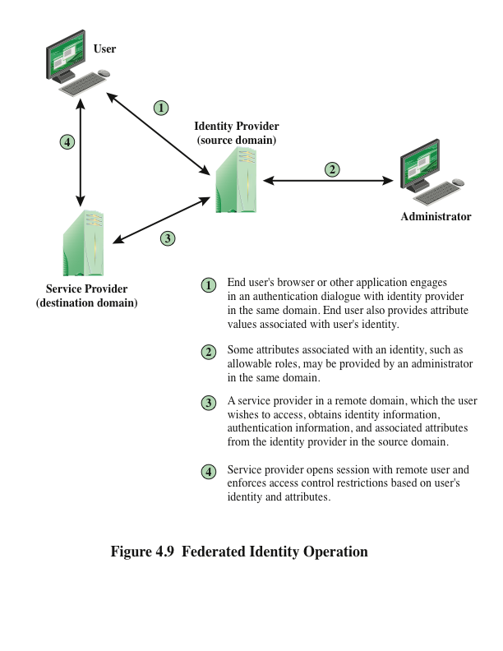
Notes:
Figure 4.9 illustrates entities and data flows in a generic federated identity
management architecture.

Slide 138
Standards
The Extensible Markup Language (XML)
Appear similar to HTML documents that are visible as Web pages, but provide greater functionality
Includes strict definitions of the data type of each field
Provides encoding rules for commands that are used to transfer and update data objects
The Simple Object Access Protocol (SOAP)
Minimal set of conventions for invoking code using XML over HTTP
Enables applications to request services from one another with XML-based requests and receive responses as data formatted with XML
WS-Security
A set of SOAP extensions for implementing message integrity and confidentiality in Web services
Assigns security tokens to each message for use in authentication
Security Assertion Markup Language (SAML)
An XML-based language for the exchange of security information between online business partners
Conveys authentication information in the form of assertions about subjects
Notes:
Federated identity management uses a number of standards as the
building blocks for secure identity exchange across different domains or heterogeneous
systems. In essence, organizations issue some form of security tickets for their
users that can be processed by cooperating partners. Identity federation standards
are thus concerned with defining these tickets in terms of content and format, providing
protocols for exchanging tickets, and performing a number of management
tasks. These tasks include configuring systems to perform attribute transfers and
identity mapping, and performing logging and auditing functions. The key standards
are as follows:
• The Extensible Markup Language (XML): A markup language uses sets of
embedded tags or labels to characterize text elements within a document so as
to indicate their appearance, function, meaning, or context. XML documents
appear similar to HTML (Hypertext Markup Language) documents that are
visible as Web pages, but provide greater functionality. XML includes strict
definitions of the data type of each field, thus supporting database formats
and semantics. XML provides encoding rules for commands that are used to
transfer and update data objects.
• The Simple Object Access Protocol (SOAP): A minimal set of conventions
for invoking code using XML over HTTP. It enables applications to request
services from one another with XML-based requests and receive responses
as data formatted with XML. Thus, XML defines data objects and structures,
and SOAP provides a means of exchanging such data objects and performing
remote procedure calls related to these objects. See [ROS06] for an informative
discussion.
• WS-Security: A set of SOAP extensions for implementing message integrity
and confidentiality in Web services. To provide for secure exchange of SOAP
messages among applications, WS-Security assigns security tokens to each
message for use in authentication.
• Security Assertion Markup Language (SAML): An XML-based language for
the exchange of security information between online business partners. SAML
conveys authentication information in the form of assertions about subjects.
Assertions are statements about the subject issued by an authoritative entity.
The challenge with federated identity management is to integrate multiple
technologies, standards, and services to provide a secure, user-friendly utility. The
key, as in most areas of security and networking, is the reliance on a few mature
standards widely accepted by industry. Federated identity management seems to
have reached this level of maturity.

Slide 139

Notes:
To get some feel for the functionality of identity federation, we look
at three scenarios, taken from [COMP06]. In the first scenario (Figure 4.10a),
Workplace.com contracts with Health.com to provide employee health benefits.
An employee uses a Web interface to sign on to Workplace.com and goes through
an authentication procedure there. This enables the employee to access authorized
services and resources at Workplace.com. When the employee clicks on a
link to access health benefits, her browser is redirected to Health.com. At the same
time, the Workplace.com software passes the user’s identifier to Health.com in a
secure manner. The two organizations are part of a federation that cooperatively
exchanges user identifiers. Health.com maintains user identities for every employee
at Workplace.com and associates with each identity health-benefits information
and access rights. In this example, the linkage between the two companies is based
on account information and user participation is browser based.
Figure 4.10b shows a second type of browser-based scheme. PartsSupplier.
com is a regular supplier of parts to Workplace.com. In this case, a role-based
access control (RBAC) scheme is used for access to information. An engineer of
Workplace.com authenticates at the employee portal at Workplace.com and clicks
on a link to access information at PartsSupplier.com. Because the user is authenticated
in the role of an engineer, he is taken to the technical documentation and
troubleshooting portion of PartSupplier.com’s Web site without having to sign
on. Similarly, an employee in a purchasing role signs on at Workplace.com and is
authorized, in that role, to place purchases at PartSupplier.com without having to
authenticate to PartSupplier.com. For this scenario, PartSupplier.com does not
have identity information for individual employees at Workplace.com. Rather, the
linkage between the two federated partners is in terms of roles.
The scenario illustrated in Figure 4.10c can be referred to as document based
rather than browser based. In this third example, Workplace.com has a purchasing
agreement with PinSupplies.com, and PinSupplies.com has a business relationship
with E-Ship.com. An employee of Workplace.com signs on and is authenticated to
make purchases. The employee goes to a procurement application that provides a
list of Workplace.com’s suppliers and the parts that can be ordered. The user clicks
on the PinSupplies button and is presented with a purchase order Web page (HTML
page). The employee fills out the form and clicks the submit button. The procurement
application generates an XML/SOAP document that it inserts into the envelope
body of an XML-based message. The procurement application then inserts the
user’s credentials in the envelope header of the message, together with Workplace.
com’s organizational identity. The procurement application posts the message to the
PinSupplies.com’s purchasing Web service. This service authenticates the incoming
message and processes the request. The purchasing Web service then sends a SOAP
message its shipping partner to fulfill the order. The message includes a PinSupplies.
com security token in the envelope header and the list of items to be shipped as well
as the end user’s shipping information in the envelope body. The shipping Web
service authenticates the request and processes the shipment order.

Slide 140
Summary
Symmetric key distribution using symmetric encryption
Kerberos
Version 4
Version 5
Key distribution using asymmetric encryption
Public-key certificates
Public-key distribution of secret keys
X.509 certificates
Certificates
X.509 Version 3
Public-key infrastructure
PKIX management functions
PKIX management protocols
Federated identity management
Identity management
Identity federation
Notes:
Chapter 4 summary.

Slide 141
Network Security Essentials
Fifth Edition
by William Stallings
Notes:
Lecture slides prepared for “Network Security Essentials”, 5/e, by William Stallings, Chapter 5 – “Network Access Control and Cloud Security”.

Slide 142
Chapter 5
Network Access Control
and Cloud Security
Notes:
This chapter begins our discussion of network security, focusing on two key topics:
network access control and cloud security. We begin with an overview of network
access control systems, summarizing the principal elements and techniques involved
in such a system. Next, we discuss the Extensible Authentication Protocol and
IEEE 802.1X, two widely implemented standards that are the foundation of many
network access control systems.
The remainder of the chapter deals with cloud security. We begin with an
overview of cloud computing, and follow this with a discussion of cloud security
issues.

Slide 143
“No ticket! Dear me, Watson, this is really very singular. According to my experience it is not possible to reach the platform of a Metropolitan train without exhibiting one’s ticket.”
—The Adventure of the Bruce-Partington Plans,
Sir Arthur Conan Doyle
Notes:
Opening quote.

Slide 144

Network Access Control (NAC)
An umbrella term for managing access to a network
Authenticates users logging into the network and determines what data they can access and actions they can perform
Also examines the health of the user’s computer or mobile device
Notes:
Network access control (NAC) is an umbrella term for managing access to a network.
NAC authenticates users logging into the network and determines what data
they can access and actions they can perform. NAC also examines the health of the
user’s computer or mobile device (the endpoints).

Slide 145
NAC systems deal with three categories of components:
Access requester (AR)
Node that is attempting to access the network and may be any device that is managed by the NAC system, including workstations, servers, printers, cameras, and other IP-enabled devices
Also referred to as supplicants, or clients
Policy server
Determines what access should be granted
Often relies on backend systems
Network access server (NAS)
Functions as an access control point for users in remote locations connecting to an enterprise’s internal network
Also called a media gateway, remote access server (RAS), or policy server
May include its own authentication services or rely on a separate authentication service from the policy server
Notes:
NAC systems deal with three categories of components:
• Access requestor (AR): The AR is the node that is attempting to access the
network and may be any device that is managed by the NAC system, including
workstations, servers, printers, cameras, and other IP-enabled devices. ARs
are also referred to as supplicants , or simply, clients.
• Policy server: Based on the AR’s posture and an enterprise’s defined policy,
the policy server determines what access should be granted. The policy server
often relies on backend systems, including antivirus, patch management, or a
user directory, to help determine the host’s condition.
• Network access server (NAS): The NAS functions as an access control point
for users in remote locations connecting to an enterprise’s internal network.
Also called a media gateway, a remote access server (RAS), or a policy server,
an NAS may include its own authentication services or rely on a separate
authentication service from the policy server.

Slide 146

Notes:
Figure 5.1 is a generic network access diagram. A variety of different ARs
seek access to an enterprise network by applying to some type of NAS. The first
step is generally to authenticate the AR. Authentication typically involves some
sort of secure protocol and the use of cryptographic keys. Authentication may be
performed by the NAS, or the NAS may mediate the authentication process. In the
latter case, authentication takes place between the supplicant and an authentication
server that is part of the policy server or that is accessed by the policy server.
The authentication process serves a number of purposes. It verifies a supplicant’s
claimed identity, which enables the policy server to determine what access
privileges, if any, the AR may have. The authentication exchange may result in the
establishment of session keys to enable future secure communication between the
supplicant and resources on the enterprise network.
Typically, the policy server or a supporting server will perform checks on the
AR to determine if it should be permitted interactive remote access connectivity.
These checks—sometimes called health, suitability, screening, or assessment
checks—require software on the user’s system to verify compliance with certain requirements
from the organization’s secure configuration baseline. For example, the
user’s antimalware software must be up-to-date, the operating system must be fully
patched, and the remote computer must be owned and controlled by the organization.
These checks should be performed before granting the AR access to the enterprise
network. Based on the results of these checks, the organization can determine
whether the remote computer should be permitted to use interactive remote access.
If the user has acceptable authorization credentials but the remote computer does
not pass the health check, the user and remote computer should be denied network
access or have limited access to a quarantine network so that authorized personnel
can fix the security deficiencies. Figure 5.1 indicates that the quarantine portion of
the enterprise network consists of the policy server and related AR suitability servers.
There may also be application servers that do not require the normal security
threshold be met.
Once an AR has been authenticated and cleared for a certain level of access
to the enterprise network, the NAS can enable the AR to interact with resources in
the enterprise network. The NAS may mediate every exchange to enforce a security
policy for this AR, or may use other methods to limit the privileges of the AR.

Slide 147

Network Access Enforcement Methods
The actions that are applied to ARs to regulate access to the enterprise network
Many vendors support multiple enforcement methods simultaneously, allowing the customer to tailor the configuration by using one or a combination of methods
Common NAC enforcement methods:
IEEE 802.1X
Virtual local area networks (VLANs)
Firewall
DHCP management
Notes:
Enforcement methods are the actions that are applied to ARs to regulate access
to the enterprise network. Many vendors support multiple enforcement methods
simultaneously, allowing the customer to tailor the configuration by using one or a
combination of methods. The following are common NAC enforcement methods.
• IEEE 802.1X: This is a link layer protocol that enforces authorization before
a port is assigned an IP address. IEEE 802.1X makes use of the Extensible
Authentication Protocol for the authentication process. Sections 5.2 and
5.3 cover the Extensible Authentication Protocol and IEEE 802.1X,
respectively.
• Virtual local area networks (VLANs): In this approach, the enterprise network,
consisting of an interconnected set of LANs, is segmented logically
into a number of virtual LANs. The NAC system decides to which of the
network’s VLANs it will direct an AR, based on whether the device needs
security remediation, Internet access only, or some level of network access to
enterprise resources. VLANs can be created dynamically and VLAN membership,
of both enterprise servers and ARs, may overlap. That is, an enterprise
server or an AR may belong to more than one VLAN.
• Firewall: A firewall provides a form of NAC by allowing or denying network
traffic between an enterprise host and an external user. Firewalls are discussed
in Chapter 12.
• DHCP management: The Dynamic Host Configuration Protocol (DHCP) is
an Internet protocol that enables dynamic allocation of IP addresses to hosts.
A DHCP server intercepts DHCP requests and assigns IP addresses instead.
Thus, NAC enforcement occurs at the IP layer based on subnet and IP assignment.
A DCHP server is easy to install and configure, but is subject to various
forms of IP spoofing, providing limited security.
There are a number of other enforcement methods available from vendors.
The ones in the preceding list are perhaps the most common, and IEEE 802.1X is by
far the most commonly implemented solution.

Slide 148

Notes:
The Extensible Authentication Protocol (EAP), defined in RFC 3748, acts as a
framework for network access and authentication protocols. EAP provides a set
of protocol messages that can encapsulate various authentication methods to be
used between a client and an authentication server. EAP can operate over a variety
of network and link level facilities, including point-to-point links, LANs, and
other networks, and can accommodate the authentication needs of the various
links and networks. Figure 5.2 illustrates the protocol layers that form the context
for EAP.

Slide 149
Authentication Methods
Extensible Authentication Protocol (EAP) provides a generic transport service for the exchange of authentication information between a client system and an authentication server
The basic EAP transport service is extended by using a specific authentication protocol that is installed in both the EAP client and the authentication server
Commonly supported EAP methods:
EAP Transport Layer Security
EAP Tunneled TLS
EAP Generalized Pre-Shared Key
EAP-IKEv2
Notes:
EAP supports multiple authentication methods. This is what is meant by referring to
EAP as extensible . EAP provides a generic transport service for the exchange of authentication
information between a client system and an authentication server. The
basic EAP transport service is extended by using a specific authentication protocol,
or method, that is installed in both the EAP client and the authentication server.
Numerous methods have been defined to work over EAP. The following are
commonly supported EAP methods:
• EAP-TLS (EAP Transport Layer Security): EAP-TLS (RFC 5216) defines
how the TLS protocol (described in Chapter 6) can be encapsulated in EAP
messages. EAP-TLS uses the handshake protocol in TLS, not its encryption
method. Client and server authenticate each other using digital certificates.
Client generates a pre-master secret key by encrypting a random number with
the server’s public key and sends it to the server. Both client and server use
the pre-master to generate the same secret key.
• EAP-TTLS (EAP Tunneled TLS): EAP-TTLS is like EAP-TLS, except only
the server has a certificate to authenticate itself to the client first. As in EAPTLS,
a secure connection (the “tunnel”) is established with secret keys, but
that connection is used to continue the authentication process by authenticating
the client and possibly the server again using any EAP method or
legacy method such as PAP (Password Authentication Protocol) and CHAP
(Challenge-Handshake Authentication Protocol). EAP-TTLS is defined in
RFC 5281.
• EAP-GPSK (EAP Generalized Pre-Shared Key): EAP-GPSK, defined in
RFC 5433, is an EAP method for mutual authentication and session key derivation
using a Pre-Shared Key (PSK). EAP-GPSK specifies an EAP method
based on pre-shared keys and employs secret key-based cryptographic algorithms.
Hence, this method is efficient in terms of message flows and computational
costs, but requires the existence of pre-shared keys between each
peer and EAP server. The set up of these pairwise secret keys is part of the
peer registration, and thus, must satisfy the system preconditions. It provides
a protected communication channel when mutual authentication is successful
for both parties to communicate over and is designed for authentication
over insecure networks such as IEEE 802.11. EAP-GPSK does not require
any public-key cryptography. The EAP method protocol exchange is done in
a minimum of four messages.
• EAP-IKEv2: It is based on the Internet Key Exchange protocol version 2
(IKEv2), which is described in Chapter 9. It supports mutual authentication
and session key establishment using a variety of methods. EAP-TLS is defined
in RFC 5106.

Slide 150

Notes:
Figure 5.3 indicates a typical arrangement in which EAP is used. The following
components are involved:
• EAP peer: Client computer that is attempting to access a network.
• EAP authenticator: An access point or NAS that requires EAP authentication
prior to granting access to a network.
• Authentication server: A server computer that negotiates the use of a specific
EAP method with an EAP peer, validates the EAP peer’s credentials,
and authorizes access to the network. Typically, the authentication server is a
Remote Authentication Dial-In User Service (RADIUS) server.
The authentication server functions as a backend server that can authenticate
peers as a service to a number of EAP authenticators. The EAP authenticator then
makes the decision of whether to grant access. This is referred to as the EAP pass-through
mode . Less commonly, the authenticator takes over the role of the EAP
server; that is, only two parties are involved in the EAP execution.

Slide 151


Notes:
Figure 5.4 gives an example of an EAP exchange. Not shown in the figure is a
message or signal sent from the EAP peer to the authenticator using some protocol
other than EAP and requesting an EAP exchange to grant network access. One
protocol used for this purpose is IEEE 802.1X, discussed in the next section. The
first pair of EAP Request and Response messages is of Type identity, in which the
authenticator requests the peer’s identity, and the peer returns its claimed identity
in the Response message. This Response is passed through the authenticator to the
authentication server. Subsequent EAP messages are exchanged between the peer
and the authentication server.
Upon receiving the identity Response message from the peer, the server
selects an EAP method and sends the first EAP message with a Type field related
to an authentication method. If the peer supports and accepts the selected EAP
method, it replies with the corresponding Response message of the same type.
Otherwise, the peer sends a NAK, and the EAP server either selects another EAP
method or aborts the EAP execution with a failure message. The selected EAP
method determines the number of Request/Response pairs. During the exchange
the appropriate authentication information, including key material, is exchanged.
The exchange ends when the server determines that authentication has succeeded
or that no further attempt can be made and authentication has failed.

Slide 152

Table 5.1
Terminology Related to IEEE 802.1X
Notes:
IEEE 802.1X Port-Based Network Access Control was designed to provide access control
functions for LANs. Table 5.1 briefly defines key terms used in the IEEE 802.11
standard. The terms supplicant , network access point , and authentication server correspond
to the EAP terms peer , authenticator , and authentication server , respectively.
Until the AS authenticates a supplicant (using an authentication protocol),
the authenticator only passes control and authentication messages between the supplicant
and the AS; the 802.1X control channel is unblocked, but the 802.11 data
channel is blocked. Once a supplicant is authenticated and keys are provided, the
authenticator can forward data from the supplicant, subject to predefined access
control limitations for the supplicant to the network. Under these circumstances,
the data channel is unblocked.

Slide 153

Notes:
As indicated in Figure 5.5, 802.1X uses the concepts of controlled and uncontrolled
ports. Ports are logical entities defined within the authenticator and refer to
physical network connections. Each logical port is mapped to one of these two types
of physical ports. An uncontrolled port allows the exchange of protocol data units
(PDUs) between the supplicant and the AS, regardless of the authentication state
of the supplicant. A controlled port allows the exchange of PDUs between a supplicant
and other systems on the network only if the current state of the supplicant
authorizes such an exchange.
Extensible Authentication Protocol (EAP)
The essential element defined in 802.1X is a protocol known as EAPOL (EAP
over LAN). EAPOL operates at the network layers and makes use of an IEEE 802
LAN, such as Ethernet or Wi-Fi, at the link level. EAPOL enables a supplicant to
communicate with an authenticator and supports the exchange of EAP packets for
authentication.

Slide 154
Table 5.2 Common EAPOL Frame Types
Notes:
The most common EAPOL packets are listed in Table 5.2. When the
supplicant first connects to the LAN, it does not know the MAC address of the
authenticator. Actually it doesn’t know whether there is an authenticator present
at all. By sending an EAPOL-Start packet to a special group-multicast address
reserved for IEEE 802.1X authenticators, a supplicant can determine whether an
authenticator is present and let it know that the supplicant is ready. In many cases,
the authenticator will already be notified that a new device has connected from
some hardware notification. For example, a hub knows that a cable is plugged in
before the device sends any data. In this case the authenticator may preempt the
Start message with its own message. In either case the authenticator sends an EAP Request
Identity message encapsulated in an EAPOL-EAP packet. The EAPOLEAP
is the EAPOL frame type used for transporting EAP packets.
The authenticator uses the EAP-Key packet to send cryptographic keys to the
supplicant once it has decided to admit it to the network. The EAP-Logoff packet
type indicates that the supplicant wishes to be disconnected from the network.

Slide 155

Notes:
The EAPOL packet format includes the following fields:
• Protocol version: version of EAPOL.
• Packet type: indicates start, EAP, key, logoff, etc.
• Packet body length: If the packet includes a body, this field indicates the body
length.
• Packet body: The payload for this EAPOL packet. An example is an EAP packet.
Figure 5.6 shows an example of exchange using EAPOL. In Chapter 7, we examine
the use of EAP and EAPOL in the context of IEEE 802.11 wireless LAN security.

Slide 156
Cloud Computing
NIST defines cloud computing, in NIST SP-800-145 (The NIST Definition of Cloud Computing ), as follows:
“A model for enabling ubiquitous, convenient, on-demand network access to a shared pool of configurable computing resources (e.g., networks, servers, storage, applications, and services) that can be rapidly provisioned and released with minimal management effort or service provider interaction. This cloud model promotes availability and is composed of five essential characteristics, three service models, and four deployment models.”
Notes:
There is an increasingly prominent trend in many organizations to move a
substantial portion of or even all information technology (IT) operations to an
Internet-connected infrastructure known as enterprise cloud computing. This
section provides an overview of cloud computing.
NIST defines cloud computing, in NIST SP-800-145 (The NIST Definition of Cloud
Computing ), as follows:
Cloud computing: A model for enabling ubiquitous, convenient, on-demand network
access to a shared pool of configurable computing resources (e.g., networks,
servers, storage, applications, and services) that can be rapidly provisioned and
released with minimal management effort or service provider interaction. This
cloud model promotes availability and is composed of five essential characteristics,
three service models, and four deployment models.

Slide 157

Notes:
The definition refers to various models and characteristics, whose relationship is
illustrated in Figure 5.7. The essential characteristics of cloud computing include
the following:
• Broad network access: Capabilities are available over the network and accessed
through standard mechanisms that promote use by heterogeneous thin
or thick client platforms (e.g., mobile phones, laptops, and PDAs) as well as
other traditional or cloud-based software services.
• Rapid elasticity: Cloud computing gives you the ability to expand and reduce
resources according to your specific service requirement. For example, you
may need a large number of server resources for the duration of a specific
task. You can then release these resources upon completion of the task.
• Measured service: Cloud systems automatically control and optimize resource
use by leveraging a metering capability at some level of abstraction appropriate
to the type of service (e.g., storage, processing, bandwidth, and active user
accounts). Resource usage can be monitored, controlled, and reported, providing
transparency for both the provider and consumer of the utilized service.
• On-demand self-service: A consumer can unilaterally provision computing
capabilities, such as server time and network storage, as needed automatically
without requiring human interaction with each service provider. Because
the service is on demand, the resources are not permanent parts of your IT
infrastructure.
• Resource pooling: The provider’s computing resources are pooled to serve
multiple consumers using a multi-tenant model, with different physical and
virtual resources dynamically assigned and reassigned according to consumer
demand. There is a degree of location independence in that the customer
generally has no control or knowledge of the exact location of the provided
resources, but may be able to specify location at a higher level of abstraction
(e.g., country, state, or data center). Examples of resources include storage,
processing, memory, network bandwidth, and virtual machines. Even
private clouds tend to pool resources between different parts of the same
organization.
NIST defines three service models , which can be viewed as nested service
alternatives:
• Software as a service (SaaS): The capability provided to the consumer is to
use the provider’s applications running on a cloud infrastructure. The applications
are accessible from various client devices through a thin client interface
such as a Web browser. Instead of obtaining desktop and server licenses
for software products it uses, an enterprise obtains the same functions from
the cloud service. SaaS saves the complexity of software installation, maintenance,
upgrades, and patches. Examples of services at this level are Gmail,
Google’s e-mail service, and Salesforce.com, which helps firms keep track of
their customers.
• Platform as a service (PaaS): The capability provided to the consumer is to
deploy onto the cloud infrastructure consumer-created or acquired applications
created using programming languages and tools supported by the provider.
PaaS often provides middleware-style services such as database and
component services for use by applications. In effect, PaaS is an operating
system in the cloud.
• Infrastructure as a service (IaaS): The capability provided to the consumer is
to provision processing, storage, networks, and other fundamental computing
resources where the consumer is able to deploy and run arbitrary software,
which can include operating systems and applications. IaaS enables customers
to combine basic computing services, such as number crunching and data storage,
to build highly adaptable computer systems.
NIST defines four deployment models :
• Public cloud: The cloud infrastructure is made available to the general public
or a large industry group and is owned by an organization selling cloud services.
The cloud provider is responsible both for the cloud infrastructure and
for the control of data and operations within the cloud.
• Private cloud: The cloud infrastructure is operated solely for an organization.
It may be managed by the organization or a third party and may exist on
premise or off premise. The cloud provider (CP) is responsible only for the
infrastructure and not for the control.
• Community cloud: The cloud infrastructure is shared by several organizations
and supports a specific community that has shared concerns (e.g., mission,
security requirements, policy, and compliance considerations). It may be managed
by the organizations or a third party and may exist on premise or off
premise.
• Hybrid cloud: The cloud infrastructure is a composition of two or more clouds
(private, community, or public) that remain unique entities but are bound together
by standardized or proprietary technology that enables data and application
portability (e.g., cloud bursting for load balancing between clouds).

Slide 158

Notes:
Figure 5.8 illustrates the typical cloud service context. An enterprise maintains
workstations within an enterprise LAN or set of LANs, which are connected
by a router through a network or the Internet to the cloud service provider. The
cloud service provider maintains a massive collection of servers, which it manages
with a variety of network management, redundancy, and security tools. In the figure,
the cloud infrastructure is shown as a collection of blade servers, which is a
common architecture.

Slide 159
Cloud Computing Reference Architecture
NIST SP 500-292 (NIST Cloud Computing Reference Architecture ) establishes a reference architecture, described as follows:
“The NIST cloud computing reference architecture focuses on the requirements of “what” cloud services provide, not a “how to” design solution and implementation. The reference architecture is intended to facilitate the understanding of the operational intricacies in cloud computing. It does not represent the system architecture of a specific cloud computing system; instead it is a tool for describing, discussing, and developing a system-specific architecture using a common framework of reference.”
Notes:
NIST SP 500-292 (NIST Cloud Computing Reference Architecture ) establishes a reference
architecture, described as follows:
The NIST cloud computing reference architecture focuses on the requirements
of “what” cloud services provide, not a “how to” design solution and implementation.
The reference architecture is intended to facilitate the understanding of
the operational intricacies in cloud computing. It does not represent the system
architecture of a specific cloud computing system; instead it is a tool for describing,
discussing, and developing a system-specific architecture using a common
framework of reference.

Slide 160

IaaS (Infrastructure as a Service)
PaaS (Platform as a Service)
SaaS (Software as a Service)
Notes:
NIST developed the reference architecture with the following objectives
in mind:
• to illustrate and understand the various cloud services in the context of an
overall cloud computing conceptual model
• to provide a technical reference for consumers to understand, discuss, categorize,
and compare cloud services
• to facilitate the analysis of candidate standards for security, interoperability,
and portability and reference implementations
The reference architecture, depicted in Figure 5.9, defines five major actors
in terms of the roles and responsibilities:
• Cloud consumer: A person or organization that maintains a business relationship
with, and uses service from, cloud providers.
• Cloud provider: A person, organization, or entity responsible for making a
service available to interested parties.
• Cloud auditor: A party that can conduct independent assessment of cloud services,
information system operations, performance, and security of the cloud
implementation.
• Cloud broker: An entity that manages the use, performance, and delivery of
cloud services, and negotiates relationships between CPs and cloud consumers.
• Cloud carrier: An intermediary that provides connectivity and transport of
cloud services from CPs to cloud consumers.

Slide 161
Cloud Provider
Cloud provider (CP)
Can provide one or more of the cloud services to meet IT and business requirements of cloud consumers
For each of the three service models (SaaS, PaaS, IaaS), the CP provides the storage and processing facilities needed to support that service model, together with a cloud interface for cloud service consumers
For SaaS, the CP deploys, configures, maintains, and updates the operation of the software applications on a cloud infrastructure so that the services are provisioned at the expected service levels to cloud consumers
For PaaS, the CP manages the computing infrastructure for the platform and runs the cloud software that provides the components of the platform, such as runtime software execution stack, databases, and other middleware components
For IaaS, the CP acquires the physical computing resources underlying the service, including the servers, networks, storage, and hosting infrastructure
IaaS (Infrastructure as a Service)
PaaS (Platform as a Service)
SaaS (Software as a Service)
Notes:
The roles of the cloud consumer and provider have already been discussed. To
summarize, a cloud provider can provide one or more of the cloud services to meet
IT and business requirements of cloud consumers . For each of the three service
models (SaaS, PaaS, IaaS), the CP provides the storage and processing facilities
needed to support that service model, together with a cloud interface for cloud service
consumers. For SaaS, the CP deploys, configures, maintains, and updates the
operation of the software applications on a cloud infrastructure so that the services
are provisioned at the expected service levels to cloud consumers. The consumers
of SaaS can be organizations that provide their members with access to software applications,
end users who directly use software applications, or software application
administrators who configure applications for end users.
For PaaS, the CP manages the computing infrastructure for the platform and
runs the cloud software that provides the components of the platform, such as runtime
software execution stack, databases, and other middleware components. Cloud
consumers of PaaS can employ the tools and execution resources provided by CPs to
develop, test, deploy, and manage the applications hosted in a cloud environment.
For IaaS, the CP acquires the physical computing resources underlying the
service, including the servers, networks, storage, and hosting infrastructure. The
IaaS cloud consumer in turn uses these computing resources, such as a virtual computer,
for their fundamental computing needs.

Slide 162
Roles and Responsibilities
Cloud carrier
A networking facility that provides connectivity and transport of cloud services between cloud consumers and CPs
Cloud broker
Useful when cloud services are too complex for a cloud consumer to easily manage
Three areas of support can be offered by a cloud broker:
Service intermediation
Value-added services such as identity management, performance reporting, and enhanced security
Service aggregation
The broker combines multiple cloud services to meet consumer needs not specifically addressed by a single CP, or to optimize performance or minimize cost
Service arbitrage
A broker has the flexibility to choose services from multiple agencies
Cloud auditor
An independent entity that can assure that the CP conforms to a set of standards
Notes:
The cloud carrier is a networking facility that provides connectivity and transport
of cloud services between cloud consumers and CPs. Typically, a CP will set up
service level agreements (SLAs) with a cloud carrier to provide services consistent
with the level of SLAs offered to cloud consumers, and may require the cloud carrier
to provide dedicated and secure connections between cloud consumers and CPs.
A cloud broker is useful when cloud services are too complex for a cloud consumer
to easily manage. Three areas of support can be offered by a cloud broker:
• Service intermediation: These are value-added services, such as identity management,
performance reporting, and enhanced security.
• Service aggregation: The broker combines multiple cloud services to meet
consumer needs not specifically addressed by a single CP, or to optimize performance
or minimize cost.
• Service arbitrage: This is similar to service aggregation except that the services
being aggregated are not fixed. Service arbitrage means a broker has the flexibility
to choose services from multiple agencies. The cloud broker, for example, can
use a credit-scoring service to measure and select an agency with the best score.
A cloud auditor can evaluate the services provided by a CP in terms of security
controls, privacy impact, performance, and so on. The auditor is an independent
entity that can assure that the CP conforms to a set of standards.

Slide 163
Cloud Security Risks and Countermeasures
The Cloud Security Alliance [CSA10] lists the following as the top cloud specific security threats, together with suggested countermeasures:
Abuse and nefarious use of cloud computing
Countermeasures: stricter initial registration and validation processes; enhanced credit card fraud monitoring and coordination; comprehensive introspection of customer network traffic; monitoring public blacklists for one’s own network blocks
Malicious insiders
Countermeasures: enforce strict supply chain management and conduct a comprehensive supplier assessment; specify human resource requirements as part of legal contract; require transparency into overall information security and management practices, as well as compliance reporting; determine security breach notification processes
Notes:
In general terms, security controls in cloud computing are similar to the security
controls in any IT environment. However, because of the operational models and
technologies used to enable cloud service, cloud computing may present risks that
are specific to the cloud environment. The essential concept in this regard is that the
enterprise loses a substantial amount of control over resources, services, and applications
but must maintain accountability for security and privacy policies.
The Cloud Security Alliance [CSA10] lists the following as the top cloud specific
security threats, together with suggested countermeasures:
• Abuse and nefarious use of cloud computing: For many CPs, it is relatively
easy to register and begin using cloud services, some even offering free limited
trial periods. This enables attackers to get inside the cloud to conduct various
attacks, such as spamming, malicious code attacks, and denial of service. PaaS
providers have traditionally suffered most from this kind of attacks; however,
recent evidence shows that hackers have begun to target IaaS vendors as well.
The burden is on the CP to protect against such attacks, but cloud service clients
must monitor activity with respect to their data and resources to detect
any malicious behavior.
Countermeasures include (1) stricter initial registration and validation
processes; (2) enhanced credit card fraud monitoring and coordination;
(3) comprehensive introspection of customer network traffic; and (4) monitoring
public blacklists for one’s own network blocks.
• Malicious insiders: Under the cloud computing paradigm, an organization relinquishes
direct control over many aspects of security and, in doing so, confers
an unprecedented level of trust onto the CP. One grave concern is the risk
of malicious insider activity. Cloud architectures necessitate certain roles that
are extremely high risk. Examples include CP system administrators and managed
security service providers.
Countermeasures include the following: (1) enforce strict supply chain
management and conduct a comprehensive supplier assessment; (2) specify
human resource requirements as part of legal contract; (3) require transparency
into overall information security and management practices, as well
as compliance reporting; and (4) determine security breach notification
processes.

Slide 164
Risks and Countermeasures (continued)
Insecure interfaces and APIs
Countermeasures: analyzing the security model of CP interfaces; ensuring that strong authentication and access controls are implemented in concert with encryption machines; understanding the dependency chain associated with the API
Shared technology issues
Countermeasures: implement security best practices for installation/configuration; monitor environment for unauthorized changes/activity; promote strong authentication and access control for administrative access and operations; enforce SLAs for patching and vulnerability remediation; conduct vulnerability scanning and configuration audits
Data loss or leakage
Countermeasures: implement strong API access control; encrypt and protect integrity of data in transit; analyze data protection at both design and run time; implement strong key generation, storage and management, and destruction practices
Notes:
• Insecure interfaces and APIs: CPs expose a set of software interfaces or APIs
that customers use to manage and interact with cloud services. The security
and availability of general cloud services are dependent upon the security of
these basic APIs. From authentication and access control to encryption and
activity monitoring, these interfaces must be designed to protect against both
accidental and malicious attempts to circumvent policy.
Countermeasures include (1) analyzing the security model of CP
interfaces; (2) ensuring that strong authentication and access controls are
implemented in concert with encrypted transmission; and (3) understanding
the dependency chain associated with the API.
• Shared technology issues: IaaS vendors deliver their services in a scalable way
by sharing infrastructure. Often, the underlying components that make up this
infrastructure (CPU caches, GPUs, etc.) were not designed to offer strong
isolation properties for a multi-tenant architecture. CPs typically approach
this risk by the use of isolated virtual machines for individual clients. This approach
is still vulnerable to attack, by both insiders and outsiders, and so can
only be a part of an overall security strategy.
Countermeasures include the following: (1) implement security best
practices for installation/configuration; (2) monitor environment for unauthorized
changes/activity; (3) promote strong authentication and access control
for administrative access and operations; (4) enforce SLAs for patching
and vulnerability remediation; and (5) conduct vulnerability scanning and
configuration audits.
• Data loss or leakage: For many clients, the most devastating impact from a
security breach is the loss or leakage of data. We address this issue in the next
subsection.
Countermeasures include the following: (1) implement strong API access
control; (2) encrypt and protect integrity of data in transit; (3) analyze
data protection at both design and run time; and (4) implement strong key
generation, storage and management, and destruction practices.

Slide 165
Risks and Countermeasures (continued)
Account or service hijacking
Countermeasures: prohibit the sharing of account credentials between users and services; leverage strong two-factor authentication techniques where possible; employ proactive monitoring to detect unauthorized activity; understand CP security policies and SLAs
Unknown risk profile
Countermeasures: disclosure of applicable logs and data; partial/full disclosure of infrastructure details; monitoring and alerting on necessary information
Notes:
• Account or service hijacking: Account or service hijacking, usually with stolen
credentials, remains a top threat. With stolen credentials, attackers can
often access critical areas of deployed cloud computing services, allowing
them to compromise the confidentiality, integrity, and availability of those
services.
Countermeasures include the following: (1) prohibit the sharing of
account credentials between users and services; (2) leverage strong two-factor
authentication techniques where possible; (3) employ proactive monitoring
to detect unauthorized activity; and (4) understand CP security policies
and SLAs.
• Unknown risk profile: In using cloud infrastructures, the client necessarily
cedes control to the CP on a number of issues that may affect security. Thus
the client must pay attention to and clearly define the roles and responsibilities
involved for managing risks. For example, employees may deploy applications
and data resources at the CP without observing the normal policies and
procedures for privacy, security, and oversight.
Countermeasures include (1) disclosure of applicable logs and data; (2)
partial/full disclosure of infrastructure details (e.g., patch levels and firewalls);
and (3) monitoring and alerting on necessary information.
Similar lists have been developed by the European Network and Information
Security Agency [ENIS09] and NIST [JANS11].

Slide 166

Table 5.3
NIST Guidelines on Security and Privacy Issues
and Recommendations
(page 1 of 2)
(Table can be found on
Pages 154 – 155 in textbook)
Notes:
As can be seen from the previous section, there are numerous aspects to cloud
security and numerous approaches to providing cloud security measures. A further
example is seen in the NIST guidelines for cloud security, specified in SP-800-14 and
listed in Table 5.3. Thus, the topic of cloud security is well beyond the scope of this
chapter. In this section, we focus on one specific element of cloud security.

Slide 167
Table 5.3
NIST Guidelines on Security and Privacy Issues
and Recommendations
(page 2 of 2)
(Table can be found on
Pages 154 – 155 in textbook)
Notes:
Table 5.3 NIST Guidelines on Security and Privacy Issues and Recommendations
(page 2 of 2)

Slide 168
Data Protection in the Cloud
The threat of data compromise increases in the cloud
Database environments used in cloud computing can vary significantly
Multi-instance model
Provides a unique DBMS running on a virtual machine instance for each cloud subscriber
This gives the subscriber complete control over role definition, user authorization, and other administrative tasks related to security
Multi-tenant model
Provides a predefined environment for the cloud subscriber that is shared with other tenants, typically through tagging data with a subscriber identifier
Tagging gives the appearance of exclusive use of the instance, but relies on the CP to establish and maintain a sound secure database environment
Notes:
There are many ways to compromise data. Deletion or alteration of records
without a backup of the original content is an obvious example. Unlinking a record
from a larger context may render it unrecoverable, as can storage on unreliable
media. Loss of an encoding key may result in effective destruction. Finally, unauthorized
parties must be prevented from gaining access to sensitive data.
The threat of data compromise increases in the cloud, due to the number of
and interactions between risks and challenges that are either unique to the cloud or
more dangerous because of the architectural or operational characteristics of the
cloud environment.
Database environments used in cloud computing can vary significantly. Some
providers support a multi-instance model , which provides a unique DBMS running
on a virtual machine instance for each cloud subscriber. This gives the subscriber
complete control over role definition, user authorization, and other administrative
tasks related to security. Other providers support a multi-tenant model , which provides
a predefined environment for the cloud subscriber that is shared with other
tenants, typically through tagging data with a subscriber identifier. Tagging gives
the appearance of exclusive use of the instance, but relies on the CP to establish and
maintain a sound secure database environment.

Slide 169

Data Protection in the Cloud
Data must be secured while at rest, in transit, and in use, and access to the data must be controlled
The client can employ encryption to protect data in transit, though this involves key management responsibilities for the CP
For data at rest the ideal security measure is for the client to encrypt the database and only store encrypted data in the cloud, with the CP having no access to the encryption key
A straightforward solution to the security problem in this context is to encrypt the entire database and not provide the encryption/decryption keys to the service provider
The user has little ability to access individual data items based on searches or indexing on key parameters
The user would have to download entire tables from the database, decrypt the tables, and work with the results
To provide more flexibility it must be possible to work with the database in its encrypted form
Notes:
Data must be secured while at rest, in transit, and in use, and access to the
data must be controlled. The client can employ encryption to protect data in transit,
though this involves key management responsibilities for the CP. The client can
enforce access control techniques but, again, the CP is involved to some extent depending
on the service model used.
For data at rest, the ideal security measure is for the client to encrypt the database
and only store encrypted data in the cloud, with the CP having no access to the
encryption key. So long as the key remains secure, the CP has no ability to read the
data, although corruption and other denial-of-service attacks remain a risk.
A straightforward solution to the security problem in this context is to encrypt
the entire database and not provide the encryption/decryption keys to the
service provider. This solution by itself is inflexible. The user has little ability to
access individual data items based on searches or indexing on key parameters, but
rather would have to download entire tables from the database, decrypt the tables,
and work with the results. To provide more flexibility, it must be possible to work
with the database in its encrypted form.

Slide 170

Notes:
An example of such an approach, depicted in Figure 5.10, is reported in
[DAMI05] and [DAMI03]. A similar approach is described in [HACI02]. Four entities
are involved:
• Data owner: An organization that produces data to be made available for controlled
release, either within the organization or to external users.
• User: Human entity that presents requests (queries) to the system. The user
could be an employee of the organization who is granted access to the database
via the server, or a user external to the organization who, after authentication,
is granted access.
• Client: Frontend that transforms user queries into queries on the encrypted
data stored on the server.
• Server: An organization that receives the encrypted data from a data owner
and makes them available for distribution to clients. The server could in fact
be owned by the data owner but, more typically, is a facility owned and maintained
by an external provider. For our discussion, the server is a cloud server.

Slide 171
Cloud Security as a Service (SecaaS)
The Cloud Security Alliance defines SecaaS as the provision of security applications and services via the cloud either to cloud-based infrastructure and software or from the cloud to the customers’ on-premise systems
The Cloud Security Alliance has identified the following SecaaS categories of service:
Identity and access management
Data loss prevention
Web security
E-mail security
Security assessments
Intrusion management
Security information and event management
Encryption
Business continuity and disaster recovery
Network security
Notes:
The term security as a service (SecaaS) has generally meant a package of security
services offered by a service provider that offloads much of the security responsibility
from an enterprise to the security service provider. Among the services typically
provided are authentication, antivirus, antimalware/-spyware, intrusion detection,
and security event management. In the context of cloud computing, cloud security
as a service, designated SecaaS, is a segment of the SaaS offering of a CP.
The Cloud Security Alliance defines SecaaS as the provision of security applications
and services via the cloud either to cloud-based infrastructure and software
or from the cloud to the customers’ on-premise systems [CSA11b]. The Cloud
Security Alliance has identified the following SecaaS categories of service:
• Identity and access management
• Data loss prevention

Slide 172

Notes:
In this section, we examine these categories with a focus on security of the
cloud-based infrastructure and services (Figure 5.11).
Identity and access management (IAM) includes people, processes, and systems
that are used to manage access to enterprise resources by assuring that the
identity of an entity is verified, and then granting the correct level of access based
on this assured identity. One aspect of identity management is identity provisioning,
which has to do with providing access to identified users and subsequently
deprovisioning, or deny access, to users when the client enterprise designates such
users as no longer having access to enterprise resources in the cloud. Another aspect
of identity management is for the cloud to participate in the federated identity
management scheme (see Chapter 4) scheme used by the client enterprise. Among
other requirements, the cloud service provider (CSP) must be able to exchange
identity attributes with the enterprise’s chosen identity provider.
The access management portion of IAM involves authentication and access
control services. For example, the CSP must be able to authenticate users in a
trustworthy manner. The access control requirements in SPI environments include
establishing trusted user profile and policy information, using it to control access
within the cloud service, and doing this in an auditable way.
Data loss prevention (DLP) is the monitoring, protecting, and verifying the
security of data at rest, in motion, and in use. Much of DLP can be implemented by
the cloud client, such as discussed in Section 5.6. The CSP can also provide DLP
services, such as implementing rules about what functions can be performed on data
in various contexts.
Web security is real-time protection offered either on premise through software/
appliance installation or via the cloud by proxying or redirecting Web traffic
to the CP. This provides an added layer of protection on top of things like antiviruses
to prevent malware from entering the enterprise via activities such as Web
browsing. In addition to protecting against malware, a cloud-based Web security
service might include usage policy enforcement, data backup, traffic control, and
Web access control.
A CSP may provide a Web-based e-mail service, for which security measures
are needed. E-mail security provides control over inbound and outbound e-mail,
protecting the organization from phishing, malicious attachments, enforcing corporate
polices such as acceptable use and spam prevention. The CSP may also incorporate
digital signatures on all e-mail clients and provide optional e-mail encryption.
Security assessments are third-part audits of cloud services. While this service
is outside the province of the CSP, the CSP can provide tools and access points to
facilitate various assessment activities.
Intrusion management encompasses intrusion detection, prevention, and response.
The core of this service is the implementation of intrusion detection systems
(IDSs) and intrusion prevention systems (IPSs) at entry points to the cloud and on
servers in the cloud. An IDS is a set of automated tools designed to detect unauthorized
access to a host system. We discuss this in Chapter 1. An IPS incorporates IDS
functionality but also includes mechanisms designed to block traffic from intruders.
Security information and event management (SIEM) aggregates (via push or
pull mechanisms) log and event data from virtual and real networks, applications,
and systems. This information is then correlated and analyzed to provide real-time
reporting and alerting on information/events that may require intervention or other
type of response. The CSP typically provides an integrated service that can put together
information from a variety of sources both within the cloud and within the
client enterprise network.
Encryption is a pervasive service that can be provided for data at rest in the
cloud, e-mail traffic, client-specific network management information, and identity
information. Encryption services provided by the CSP involve a range of complex
issues, including key management, how to implement virtual private network (VPN)
services in the cloud, application encryption, and data content access.
Business continuity and disaster recovery comprise measures and mechanisms
to ensure operational resiliency in the event of any service interruptions. This is an
area where the CSP, because of economies of scale, can offer obvious benefits to a
cloud service client [WOOD10]. The CSP can provide backup at multiple locations,
with reliable failover and disaster recovery facilities. This service must include a
flexible infrastructure, redundancy of functions and hardware, monitored operations,
geographically distributed data centers, and network survivability.
Network security consists of security services that allocate access, distribute,
monitor, and protect the underlying resource services. Services include perimeter and
server firewalls and denial-of-service protection. Many of the other services listed in
this section, including intrusion management, identity and access management, data
loss protection, and Web security, also contribute to the network security service.

Slide 173
Summary
Network access control
Elements of a network access control system
Network access enforcement methods
Extensible authentication protocol
Authentication methods
EAP exchanges
Cloud security as a service
IEEE 802.1X port-based network access control
Cloud computing
Elements
Reference architecture
Cloud security risks and countermeasures
Data protection in the cloud
Notes:
Chapter 5 summary.

Slide 174
Network Security Essentials
Fifth Edition
by William Stallings
Notes:
Lecture slides prepared for “Network Security Essentials”, 5/e, by William Stallings, Chapter 6 -- “Transport-Level Security”.

Slide 175
Chapter 6
Transport-Level Security
Notes:
The topic of Web security is a broad one and can easily fill a book. In this chapter,
we begin with a discussion of the general requirements for Web security and then focus
on three standardized schemes that are becoming increasingly important as part of Web
commerce and that focus on security at the transport layer: SSL/TLS, HTTPS, and SSH.

Slide 176
We cannot enter into alliance with neighboring princes until we are acquainted with their designs.
—The Art of War, Sun Tzu
Notes:
Virtually all businesses, most government agencies, and many individuals now have
Web sites. The number of individuals and companies with Internet access is expanding
rapidly and all of these have graphical Web browsers. As a result, businesses are enthusiastic
about setting up facilities on the Web for electronic commerce. But the reality
is that the Internet and the Web are extremely vulnerable to compromises of various
sorts. As businesses wake up to this reality, the demand for secure Web services grows.

Slide 177
Web Security Considerations
The World Wide Web is fundamentally a client/server application running over the Internet and TCP/IP intranets
The following characteristics of Web usage suggest the need for tailored security tools:
Web servers are relatively easy to configure and manage
Web content is increasingly easy to develop
The underlying software is extraordinarily complex
May hide many potential security flaws
A Web server can be exploited as a launching pad into the corporation’s or agency’s entire computer complex
Casual and untrained (in security matters) users are common clients for Web-based services
Such users are not necessarily aware of the security risks that exist and do not have the tools or knowledge to take effective countermeasures
Notes:
The World Wide Web is fundamentally a client/server application running over the
Internet and TCP/IP intranets. As such, the security tools and approaches discussed
so far in this book are relevant to the issue of Web security. However, the following
characteristics of Web usage suggest the need for tailored security tools:
• Although Web browsers are very easy to use, Web servers are relatively easy
to configure and manage, and Web content is increasingly easy to develop, the
underlying software is extraordinarily complex. This complex software may
hide many potential security flaws. The short history of the Web is filled with
examples of new and upgraded systems, properly installed, that are vulnerable
to a variety of security attacks.
• A Web server can be exploited as a launching pad into the corporation’s or
agency’s entire computer complex. Once the Web server is subverted, an attacker
may be able to gain access to data and systems not part of the Web
itself but connected to the server at the local site.
• Casual and untrained (in security matters) users are common clients for Web-based
services. Such users are not necessarily aware of the security risks that
exist and do not have the tools or knowledge to take effective countermeasures.

Slide 178
Table 6.1 A Comparison of Threats on the Web
Notes:
Table 6.1 provides a summary of the types of security threats faced when using
the Web. One way to group these threats is in terms of passive and active attacks.
Passive attacks include eavesdropping on network traffic between browser and
server and gaining access to information on a Web site that is supposed to be restricted.
Active attacks include impersonating another user, altering messages in
transit between client and server, and altering information on a Web site.
Another way to classify Web security threats is in terms of the location of the
threat: Web server, Web browser, and network traffic between browser and server.
Issues of server and browser security fall into the category of computer system security;
Part Six of this book addresses the issue of system security in general but is also
applicable to Web system security. Issues of traffic security fall into the category of
network security and are addressed in this chapter.

Slide 179

Notes:
A number of approaches to providing Web security are possible. The various approaches
that have been considered are similar in the services they provide and, to
some extent, in the mechanisms that they use, but they differ with respect to their
scope of applicability and their relative location within the TCP/IP protocol stack.
Figure 6.1 illustrates this difference. One way to provide Web security is
to use IP security (IPsec) (Figure 6.1a). The advantage of using IPsec is that it is
transparent to end users and applications and provides a general-purpose solution.
Furthermore, IPsec includes a filtering capability so that only selected traffic need
incur the overhead of IPsec processing.
Another relatively general-purpose solution is to implement security just
above TCP (Figure 6.1b). The foremost example of this approach is the Secure
Sockets Layer (SSL) and the follow-on Internet standard known as Transport
Layer Security (TLS). At this level, there are two implementation choices. For full
generality, SSL (or TLS) could be provided as part of the underlying protocol suite
and therefore be transparent to applications. Alternatively, SSL can be embedded
in specific packages. For example, Netscape and Microsoft Explorer browsers come
equipped with SSL, and most Web servers have implemented the protocol.
Application-specific security services are embedded within the particular
application. Figure 6.1c shows examples of this architecture. The advantage of this
approach is that the service can be tailored to the specific needs of a given application.

Slide 180
Secure Sockets Layer (SSL)
One of the most widely used security services
A general purpose service implemented as a set of protocols that rely on TCP
Could be provided as part of the underlying protocol suite and therefore be transparent to applications
Can be embedded in specific packages
Notes:
One of the most widely used security services is the Secure Sockets Layer (SSL) and
the follow-on Internet standard known as Transport Layer Security (TLS), the latter
defined in RFC 5246. SSL is a general-purpose service implemented as a set of
protocols that rely on TCP. At this level, there are two implementation choices. For
full generality, SSL (or TLS) could be provided as part of the underlying protocol
suite and therefore be transparent to applications. Alternatively, SSL can be embedded
in specific packages. For example, most browsers come equipped with SSL,
and most Web servers have implemented the protocol.
This section is devoted to a discussion of SSLv3, and next section describes the
principal differences between SSLv3 and TLS.

Slide 181

Notes:
SSL is designed to make use of TCP to provide a reliable end-to-end secure service.
SSL is not a single protocol but rather two layers of protocols, as illustrated in
Figure 6.2.
The SSL Record Protocol provides basic security services to various higher layer
protocols. In particular, the Hypertext Transfer Protocol (HTTP), which
provides the transfer service for Web client/server interaction, can operate on top
of SSL. Three higher-layer protocols are defined as part of SSL: the Handshake
Protocol, The Change Cipher Spec Protocol, and the Alert Protocol. These
SSL-specific protocols are used in the management of SSL exchanges and are
examined later in this section.

Slide 182
SSL Architecture
Two important SSL concepts are:
SSL connection
A transport that provides a suitable type of service
For SSL such connections are peer-to-peer relationships
Connections are transient
Every connection is associated with one session
SSL session
An association between a client and a server
Created by the Handshake Protocol
Define a set of cryptographic security parameters which can be shared among multiple connections
Are used to avoid the expensive negotiation of new security parameters for each connection
Notes:
Two important SSL concepts are the SSL session and the SSL connection,
which are defined in the specification as follows.
• Connection: A connection is a transport (in the OSI layering model definition)
that provides a suitable type of service. For SSL, such connections are
peer-to-peer relationships. The connections are transient. Every connection is
associated with one session.
• Session: An SSL session is an association between a client and a server.
Sessions are created by the Handshake Protocol. Sessions define a set of cryptographic
security parameters which can be shared among multiple connections.
Sessions are used to avoid the expensive negotiation of new security
parameters for each connection.
Between any pair of parties (applications such as HTTP on client and
server), there may be multiple secure connections. In theory, there may also be
multiple simultaneous sessions between parties, but this feature is not used in
practice.
There are a number of states associated with each session. Once a session is established,
there is a current operating state for both read and write (i.e., receive and
send). In addition, during the Handshake Protocol, pending read and write states
are created. Upon successful conclusion of the Handshake Protocol, the pending
states become the current states.
The Open Systems Interconnection model (OSI model) is a conceptual model that characterizes and standardizes the communication functions of a telecommunication or computing system without regard to their underlying internal structure and technology.
The seven Open Systems Interconnection layers are:
Layer 7: The application layer. ...
Layer 6: The presentation layer. ...
Layer 5: The session layer. ...
Layer 4: The transport layer. ...
Layer 3: The network layer. ...
Layer 2: The data-link layer. ...
Layer 1: The physical layer.

Slide 183
A session state is defined by the following parameters:
Session identifier
An arbitrary byte sequence chosen by the server to identify an active or resumable session state
Peer certificate
An X509.v3 certificate of the peer; this element of the state may be null
Compression method
The algorithm used to compress data prior to encryption
Cipher spec
Specifies the bulk data encryption algorithm and a hash algorithm used for MAC calculation; also defines cryptographic attributes such as the hash_size
Master secret
48-byte secret shared between the client and the server
Is resumable
A flag indicating whether the session can be used to initiate new connections
Notes:
A session state is defined by the following parameters.
• Session identifier: An arbitrary byte sequence chosen by the server to identify
an active or resumable session state.
• Peer certificate: An X509.v3 certificate of the peer. This element of the state
may be null.
• Compression method: The algorithm used to compress data prior to
encryption.
• Cipher spec: Specifies the bulk data encryption algorithm (such as null, AES,
etc.) and a hash algorithm (such as MD5 or SHA-1) used for MAC calcula tion.
It also defines cryptographic attributes such as the hash_size.
• Master secret: 48-byte secret shared between the client and the server.
• Is resumable: A flag indicating whether the session can be used to initiate new
connections.

Slide 184
A connection state is defined by the following parameters:
Server and client random
Byte sequences that are chosen by the server and client for each connection
Server write MAC secret
The secret key used in MAC operations on data sent by the server
Client write MAC secret
The secret key used in MAC operations on data sent by the client
Server write key
The secret encryption key for data encrypted by the server and decrypted by the client
Client write key
The symmetric encryption key for data encrypted by the client and decrypted by the server
Initialization vectors
When a block cipher in CBC mode is used, an initialization vector (IV) is maintained for each key
Sequence numbers
Each party maintains separate sequence numbers for transmitted and received messages for each connection
This field is first initialized by the SSL Handshake Protocol
The final ciphertext block from each record is preserved for use as the IV with the following record
When a party sends or receives a change cipher spec message, the appropriate sequence number is set to zero
Sequence numbers may not exceed 2⁶⁴ - 1
Notes:
A connection state is defined by the following parameters.
• Server and client random: Byte sequences that are chosen by the server and
client for each connection.
• Server write MAC secret: The secret key used in MAC operations on data
sent by the server.
• Client write MAC secret: The secret key used in MAC operations on data sent
by the client.
• Server write key: The secret encryption key for data encrypted by the server
and decrypted by the client.
• Client write key: The symmetric encryption key for data encrypted by the client
and decrypted by the server.
• Initialization vectors: When a block cipher in CBC mode is used, an initialization
vector (IV) is maintained for each key. This field is first initialized by
the SSL Handshake Protocol. Thereafter, the final ciphertext block from each
record is preserved for use as the IV with the following record.
• Sequence numbers: Each party maintains separate sequence numbers for
transmitted and received messages for each connection. When a party sends
or receives a change cipher spec message, the appropriate sequence number is
set to zero. Sequence numbers may not exceed 2⁶⁴ - 1.

Slide 185
SSL Record Protocol
The SSL Record Protocol provides two services for SSL connections
Confidentiality
The Handshake Protocol defines a shared secret key that is used for conventional encryption of SSL payloads
Message integrity
The Handshake Protocol also defines a shared secret key that is used to form a Message Authentication Code (MAC)
Notes:
SSL Record Protocol defines two services for SSL connections:
• Confidentiality: The Handshake Protocol defines a shared secret key that is used for conventional encryption of SSL payloads. The message is compressed before being concatenated with the Message Authentication Code (MAC) and encrypted, with a range of ciphers being supported as shown.
• Message Integrity: The Handshake Protocol also defines a shared secret key that is used to form a message authentication code (MAC), which is similar to HMAC

Slide 186

Notes:
Figure 6.3 indicates the overall operation of the SSL Record Protocol. The
Record Protocol takes an application message to be transmitted, fragments the data
into manageable blocks, optionally compresses the data, applies a MAC, encrypts,
adds a header, and transmits the resulting unit in a TCP segment. Received data
are decrypted, verified, decompressed, and reassembled before being delivered to
higher-level users.
The first step is fragmentation. Each upper-layer message is fragmented into
blocks of 2¹⁴ bytes (16384 bytes) or less. Next, compression is optionally applied.
Compression must be lossless and may not increase the content length by more than
1024 bytes. In SSLv3 (as well as the current version of TLS), no compression algorithm
is specified, so the default compression algorithm is null.
The next step in processing is to compute a message authentication code over
the compressed data. For this purpose, a shared secret key is used.
Next, the compressed message plus the MAC are encrypted using symmetric
encryption. Encryption may not increase the content length by more than 1024
bytes, so that the total length may not exceed 2¹⁴ + 2048.
For stream encryption, the compressed message plus the MAC are encrypted.
Note that the MAC is computed before encryption takes place and that the MAC is
then encrypted along with the plaintext or compressed plaintext.
For block encryption, padding may be added after the MAC prior to encryption.
The padding is in the form of a number of padding bytes followed by a onebyte
indication of the length of the padding. The total amount of padding is the
smallest amount such that the total size of the data to be encrypted (plaintext plus
MAC plus padding) is a multiple of the cipher’s block length. An example is a plaintext
(or compressed text if compression is used) of 58 bytes, with a MAC of 20 bytes
(using SHA-1), that is encrypted using a block length of 8 bytes (e.g., DES). With
the padding-length byte, this yields a total of 79 bytes. To make the total an integer
multiple of 8, one byte of padding is added.

Slide 187

Notes:
The final step of SSL Record Protocol processing is to prepare a header consisting
of the following fields:
• Content Type (8 bits): The higher-layer protocol used to process the enclosed
fragment.
• Major Version (8 bits): Indicates major version of SSL in use. For SSLv3, the
value is 3.
• Minor Version (8 bits): Indicates minor version in use. For SSLv3, the value
is 0.
• Compressed Length (16 bits): The length in bytes of the plaintext fragment
(or compressed fragment if compression is used). The maximum value is
2¹⁴ + 2048.
The content types that have been defined are change_cipher_spec ,
alert , handshake , and application_data . The first three are the SSL-specific
protocols, discussed next. Note that no distinction is made among the various applications
(e.g., HTTP) that might use SSL; the content of the data created by such
applications is opaque to SSL.
Figure 6.4 illustrates the SSL record format.

Slide 188

Notes:
The Change Cipher Spec Protocol is one of the three SSL-specific protocols that
use the SSL Record Protocol, and it is the simplest. This protocol consists of a single
message (Figure 6.5a), which consists of a single byte with the value 1. The sole
purpose of this message is to cause the pending state to be copied into the current
state, which updates the cipher suite to be used on this connection.
The Alert Protocol is used to convey SSL-related alerts to the peer entity. As with
other applications that use SSL, alert messages are compressed and encrypted, as
specified by the current state.
Each message in this protocol consists of two bytes (Figure 6.5b). The first
byte takes the value warning (1) or fatal (2) to convey the severity of the message.
If the level is fatal, SSL immediately terminates the connection. Other connections
on the same session may continue, but no new connections on this session
may be established. The second byte contains a code that indicates the specific
alert.
The most complex part of SSL is the Handshake Protocol. This protocol allows
the server and client to authenticate each other and to negotiate an encryption and
MAC algorithm and cryptographic keys to be used to protect data sent in an SSL
record. The Handshake Protocol is used before any application data is transmitted.
The Handshake Protocol consists of a series of messages exchanged by client
and server. All of these have the format shown in Figure 6.5c.

Slide 189

Table 6.2 SSL Handshake Protocol Message Types
Notes:
Each message has
three fields:
• Type (1 byte): Indicates one of ten messages. Table 6.2 lists the defined
message types.
• Length (3 bytes): The length of the message in bytes.
• Content (# 0 bytes): The parameters associated with this message; these are
listed in Table 6.2.

Slide 190

Notes:
Figure 6.6 shows the initial exchange needed to establish a logical connection
between client and server. The exchange can be viewed as having four phases.

Slide 191
Cryptographic Computations
Two further items are of interest:
The creation of a shared master secret by means of the key exchange
The shared master secret is a one-time 48-byte value generated for this session by means of secure key exchange
The generation of cryptographic parameters from the master secret
CipherSpecs require a client write MAC secret, a server write MAC secret, a client write key, a server write key, a client write IV, and a server write IV which are generated from the master secret in that order
These parameters are generated from the master secret by hashing the master secret into a sequence of secure bytes of sufficient length for all needed parameters
Notes:
Two further items are of interest: (1) the creation of a shared master secret by means
of the key exchange and (2) the generation of cryptographic parameters from the
master secret.
The shared master secret is a one-time 48-byte value
(384 bits) generated for this session by means of secure key exchange. The creation
is in two stages. First, a pre_master_secret is exchanged. Second, the master_
secret is calculated by both parties. For pre_master_secret exchange, there
are two possibilities.
• RSA: A 48-byte pre_master_secret is generated by the client, encrypted
with the server’s public RSA key, and sent to the server. The server decrypts
the ciphertext using its private key to recover the pre_master_secret.
• Diffie-Hellman: Both client and server generate a Diffie-Hellman public key.
After these are exchanged, each side performs

Slide 192
Transport Layer Security (TLS)
Differences include:
Version number
Message Authentication Code
Pseudorandom function
Alert keys
Cipher suites
Client certificate types
Certificate_verify and Finished Messages
Cryptographic computations
Padding
An IETF standardization initiative whose goal is to produce an Internet standard version of SSL
Is defined as a Proposed Internet Standard in RFC 5246
RFC 5246 is very similar to SSLv3
Notes:
TLS is an IETF standardization initiative whose goal is to produce an Internet standard
version of SSL. TLS is defined as a Proposed Internet Standard in RFC 5246.
RFC 5246 is very similar to SSLv3. In this section, we highlight the differences.
Version Number
The TLS Record Format is the same as that of the SSL Record Format (Figure 6.4),
and the fields in the header have the same meanings. The one difference is in version
values. For the current version of TLS, the major version is 3 and the minor version is 3.
Message Authentication Code
There are two differences between the SSLv3 and TLS MAC schemes: the actual
algorithm and the scope of the MAC calculation. TLS makes use of the HMAC
algorithm defined in RFC 2104.
The MAC calculation covers all of the fields covered by the SSLv3 calculation,
plus the field TLSCompressed.version , which is the version of the protocol
being employed.
Pseudorandom Function
TLS makes use of a pseudorandom function referred to as PRF to expand secrets
into blocks of data for purposes of key generation or validation. The objective is to
make use of a relatively small shared secret value but to generate longer blocks of
data in a way that is secure from the kinds of attacks made on hash functions and
MACs.
TLS supports all of the alert codes defined in SSLv3 with the exception of
no_certificate . A number of additional codes are defined in TLS.
Cipher Suites
There are several small differences between the cipher suites available under SSLv3
and under TLS:
• Key Exchange: TLS supports all of the key exchange techniques of SSLv3
with the exception of Fortezza.
• Symmetric Encryption Algorithms: TLS includes all of the symmetric encryption
algorithms found in SSLv3, with the exception of Fortezza.
Client Certificate Types
TLS defines the following certificate types to be requested in a certificate_
request message: rsa_sign, dss_sign, rsa_fixed_dh, and dss_fixed_dh.
These are all defined in SSLv3. In addition, SSLv3 includes rsa_ephemeral_dh,
dss_ephemeral_dh, and fortezza_kea. Ephemeral Diffie-Hellman involves
signing the Diffie-Hellman parameters with either RSA or DSS. For TLS, the rsa_
sign and dss_sign types are used for that function; a separate signing type is
not needed to sign Diffie-Hellman parameters. TLS does not include the Fortezza
scheme.
certificate_verify and Finished Messages
In the TLS certificate_verify message, the MD5 and SHA-1 hashes are calculated
only over handshake_messages. Recall that for SSLv3, the hash calculation
also included the master secret and pads. These extra fields were felt to add no
additional security.
As with the finished message in SSLv3, the finished message in TLS is a hash
based on the shared master_secret, the previous handshake messages, and a
label that identifies client or server. The calculation is somewhat different.
Cryptographic Computations
The pre_master_secret for TLS is calculated in the same way as in SSLv3. As
in SSLv3, the master_secret in TLS is calculated as a hash function of the pre_
master_secret and the two hello random numbers.
As with SSLv3, the key_block is a function
of the master_secret and the client and server random numbers, but for
TLS, the actual algorithm is different.
Padding
In SSL, the padding added prior to encryption of user data is the minimum amount
required so that the total size of the data to be encrypted is a multiple of the cipher’s
block length. In TLS, the padding can be any amount that results in a total that is a
multiple of the cipher’s block length, up to a maximum of 255 bytes. For example,
if the plaintext (or compressed text if compression is used) plus MAC plus padding.
length byte is 79 bytes long, then the padding length (in bytes) can be 1, 9, 17, and so
on, up to 249. A variable padding length may be used to frustrate attacks based on
an analysis of the lengths of exchanged messages.

Slide 193

Notes:
The PRF is based on the data expansion function (Figure 6.7)

Slide 194

HTTPS (HTTP over SSL)
Refers to the combination of HTTP and SSL to implement secure communication between a Web browser and a Web server
The HTTPS capability is built into all modern Web browsers
A user of a Web browser will see URL addresses that begin with https:// rather than http://
If HTTPS is specified, port 443 is used, which invokes SSL
Documented in RFC 2818, HTTP Over TLS
There is no fundamental change in using HTTP over either SSL or TLS and both implementations are referred to as HTTPS
When HTTPS is used, the following elements of the communication are encrypted:
URL of the requested document
Contents of the document
Contents of browser forms
Cookies sent from browser to server and from server to browser
Contents of HTTP header
Notes:
HTTPS (HTTP over SSL) refers to the combination of HTTP and SSL to implement
secure communication between a Web browser and a Web server.
The HTTPS capability is built into all modern Web browsers. Its use depends
on the Web server supporting HTTPS communication. For example, some
search engines do not support HTTPS. Google provides HTTPS as an option:
https://google.com.
The principal difference seen by a user of a Web browser is that URL (uniform
resource locator) addresses begin with https:// rather than http://. A normal
HTTP connection uses port 80. If HTTPS is specified, port 443 is used, which
invokes SSL.
When HTTPS is used, the following elements of the communication are
encrypted:
• URL of the requested document
• Contents of the document
• Contents of browser forms (filled in by browser user)
• Cookies sent from browser to server and from server to browser
• Contents of HTTP header
HTTPS is documented in RFC 2818, HTTP Over TLS . There is no fundamental
change in using HTTP over either SSL or TLS, and both implementations are
referred to as HTTPS.

Slide 195
Connection Initiation
For HTTPS, the agent acting as the HTTP client also acts as the TLS client
The client initiates a connection to the server on the appropriate port and then sends the TLS ClientHello to begin the TLS handshake
When the TLS handshake has finished, the client may then initiate the first HTTP request
All HTTP data is to be sent as TLS application data
There are three levels of awareness of a connection in HTTPS:
At the HTTP level, an HTTP client requests a connection to an HTTP server by sending a connection request to the next lowest layer
Typically the next lowest layer is TCP, but it may also be TLS/SSL
At the level of TLS, a session is established between a TLS client and a TLS server
This session can support one or more connections at any time
A TLS request to establish a connection begins with the establishment of a TCP connection between the TCP entity on the client side and the TCP entity on the server side
Notes:
For HTTPS, the agent acting as the HTTP client also acts as the TLS client. The
client initiates a connection to the server on the appropriate port and then sends
the TLS ClientHello to begin the TLS handshake. When the TLS handshake has
finished, the client may then initiate the first HTTP request. All HTTP data is to be
sent as TLS application data. Normal HTTP behavior, including retained connections,
should be followed.
There are three levels of awareness of a connection in HTTPS. At the HTTP
level, an HTTP client requests a connection to an HTTP server by sending a connection
request to the next lowest layer. Typically, the next lowest layer is TCP,
but it also may be TLS/SSL. At the level of TLS, a session is established between a
TLS client and a TLS server. This session can support one or more connections at
any time. As we have seen, a TLS request to establish a connection begins with the
establishment of a TCP connection between the TCP entity on the client side and
the TCP entity on the server side.

Slide 196
Connection Closure
An HTTP client or server can indicate the closing of a connection by including the line Connection: close in an HTTP record
The closure of an HTTPS connection requires that TLS close the connection with the peer TLS entity on the remote side, which will involve closing the underlying TCP connection
TLS implementations must initiate an exchange of closure alerts before closing a connection
A TLS implementation may, after sending a closure alert, close the connection without waiting for the peer to send its closure alert, generating an “incomplete close”
An unannounced TCP closure could be evidence of some sort of attack so the HTTPS client should issue some sort of security warning when this occurs
Notes:
An HTTP client or server can indicate the closing of a connection by including the
following line in an HTTP record: Connection: close . This indicates that the
connection will be closed after this record is delivered.
The closure of an HTTPS connection requires that TLS close the connection
with the peer TLS entity on the remote side, which will involve closing the underlying
TCP connection. At the TLS level, the proper way to close a connection is for
each side to use the TLS alert protocol to send a close_notify alert. TLS implementations
must initiate an exchange of closure alerts before closing a connection.
A TLS implementation may, after sending a closure alert, close the connection
without waiting for the peer to send its closure alert, generating an “incomplete
close”. Note that an implementation that does this may choose to reuse the session.
This should only be done when the application knows (typically through detecting
HTTP message boundaries) that it has received all the message data that it
cares about.
HTTP clients also must be able to cope with a situation in which the underlying
TCP connection is terminated without a prior close_notify alert and
without a Connection: close indicator. Such a situation could be due to a
programming error on the server or a communication error that causes the TCP
connection to drop. However, the unannounced TCP closure could be evidence of
some sort of attack. So the HTTPS client should issue some sort of security warning
when this occurs.

Slide 197

Secure Shell (SSH)
A protocol for secure network communications designed to be relatively simple and inexpensive to implement
The initial version, SSH1 was focused on providing a secure remote logon facility to replace TELNET and other remote logon schemes that provided no security
SSH also provides a more general client/server capability and can be used for such network functions as file transfer and e-mail
SSH2 fixes a number of security flaws in the original scheme
Is documented as a proposed standard in IETF RFCs 4250 through 4256
SSH client and server applications are widely available for most operating systems
Has become the method of choice for remote login and X tunneling
Is rapidly becoming one of the most pervasive applications for encryption technology outside of embedded systems
Notes:
Secure Shell (SSH) is a protocol for secure network communications designed
to be relatively simple and inexpensive to implement. The initial version, SSH1
was focused on providing a secure remote logon facility to replace TELNET and
other remote logon schemes that provided no security. SSH also provides a more
general client/server capability and can be used for such network functions as file
transfer and e-mail. A new version, SSH2, fixes a number of security flaws in the
original scheme. SSH2 is documented as a proposed standard in IETF RFCs 4250
through 4256.
SSH client and server applications are widely available for most operating systems.
It has become the method of choice for remote login and X tunneling and is
rapidly becoming one of the most pervasive applications for encryption technology
outside of embedded systems.

Slide 198

Notes:
SSH is organized as three protocols that typically run on top of TCP
(Figure 6.8):
• Transport Layer Protocol: Provides server authentication, data confidentiality,
and data integrity with forward secrecy (i.e., if a key is compromised during
one session, the knowledge does not affect the security of earlier sessions).
The transport layer may optionally provide compression.
• User Authentication Protocol: Authenticates the user to the server.
• Connection Protocol: Multiplexes multiple logical communications channels
over a single, underlying SSH connection.

Slide 199
Transport Layer Protocol
Server authentication occurs at the transport layer, based on the server possessing a public/private key pair
A server may have multiple host keys using multiple different asymmetric encryption algorithms
Multiple hosts may share the same host key
The server host key is used during key exchange to authenticate the identity of the host
RFC 4251 dictates two alternative trust models:
The client has a local database that associates each host name with the corresponding public host key
The host name-to-key association is certified by a trusted certification authority (CA); the client only knows the CA root key and can verify the validity of all host keys certified by accepted CAs
Notes:
Server authentication occurs at the transport layer, based on the server
possessing a public/private key pair. A server may have multiple host keys using
multiple different asymmetric encryption algorithms. Multiple hosts may share the
same host key. In any case, the server host key is used during key exchange to authenticate
the identity of the host. For this to be possible, the client must have a
prior knowledge of the server’s public host key. RFC 4251 dictates two alternative
trust models that can be used:
1. The client has a local database that associates each host name (as typed by
the user) with the corresponding public host key. This method requires no
centrally administered infrastructure and no third-party coordination. The
downside is that the database of name-to-key associations may become burdensome
to maintain.
The host name-to-key association is certified by a trusted certification authority
(CA). The client only knows the CA root key and can verify the validity
of all host keys certified by accepted CAs. This alternative eases the maintenance
problem, since ideally, only a single CA key needs to be securely stored
on the client. On the other hand, each host key must be appropriately certified
by a central authority before authorization is possible.

Slide 200

Notes:
Figure 6.9 illustrates the sequence of events in the SSH
Transport Layer Protocol. First, the client establishes a TCP connection to the
server. This is done via the TCP protocol and is not part of the Transport Layer
Protocol. Once the connection is established, the client and server exchange data,
referred to as packets, in the data field of a TCP segment.

Slide 201

Notes:
Each packet is in the following
format (Figure 6.10).
• Packet length: Length of the packet in bytes, not including the packet length
and MAC fields.
• Padding length: Length of the random padding field.
• Payload: Useful contents of the packet. Prior to algorithm negotiation, this
field is uncompressed. If compression is negotiated, then in subsequent packets,
this field is compressed.
• Random padding: Once an encryption algorithm has been negotiated, this
field is added. It contains random bytes of padding so that that total length of
the packet (excluding the MAC field) is a multiple of the cipher block size, or
8 bytes for a stream cipher.
• Message authentication code (MAC): If message authentication has been negotiated,
this field contains the MAC value. The MAC value is computed over
the entire packet plus a sequence number, excluding the MAC field. The sequence
number is an implicit 32-bit packet sequence that is initialized to zero
for the first packet and incremented for every packet. The sequence number is
not included in the packet sent over the TCP connection.
Once an encryption algorithm has been negotiated, the entire packet (excluding
the MAC field) is encrypted after the MAC value is calculated.
The SSH Transport Layer packet exchange consists of a sequence of steps
(Figure 6.9).

Slide 202

Table 6.3
SSH
Transport
Layer
Cryptographic
Algorithms
* = Required
** = Recommended
Notes:
Table 6.3
shows the allowable options for encryption, MAC, and compression. For each category,
the algorithm chosen is the first algorithm on the client’s list that is also supported
by the server.

Slide 203
Authentication Methods
Publickey
The client sends a message to the server that contains the client’s public key, with the message signed by the client’s private key
When the server receives this message, it checks whether the supplied key is acceptable for authentication and, if so, it checks whether the signature is correct
Password
The client sends a message containing a plaintext password, which is protected by encryption by the Transport Layer Protocol
Hostbased
Authentication is performed on the client’s host rather than the client itself
This method works by having the client send a signature created with the private key of the client host
Rather than directly verifying the user’s identity, the SSH server verifies the identity of the client host
Notes:
The server may require one or more of the following
authentication methods.
• publickey: The details of this method depend on the public-key algorithm
chosen. In essence, the client sends a message to the server that contains the
client’s public key, with the message signed by the client’s private key. When
the server receives this message, it checks whether the supplied key is acceptable
for authentication and, if so, it checks whether the signature is correct.
• password: The client sends a message containing a plaintext password,
which is protected by encryption by the Transport Layer Protocol.
• hostbased: Authentication is performed on the client’s host rather than the
client itself. Thus, a host that supports multiple clients would provide authentication
for all its clients. This method works by having the client send a signature
created with the private key of the client host. Thus, rather than directly
verifying the user’s identity, the SSH server verifies the identity of the client
host—and then believes the host when it says the user has already authenticated
on the client side.

Slide 204
Connection Protocol
The SSH Connection Protocol runs on top of the SSH Transport Layer Protocol and assumes that a secure authentication connection is in use
The secure authentication connection, referred to as a tunnel, is used by the Connection Protocol to multiplex a number of logical channels
Channel mechanism
All types of communication using SSH are supported using separate channels
Either side may open a channel
For each channel, each side associates a unique channel number
Channels are flow controlled using a window mechanism
No data may be sent to a channel until a message is received to indicate that window space is available
The life of a channel progresses through three stages: opening a channel, data transfer, and closing a channel
Notes:
The SSH Connection Protocol runs on top of the SSH Transport Layer Protocol
and assumes that a secure authentication connection is in use. That secure authentication
connection, referred to as a tunnel, is used by the Connection Protocol to
multiplex a number of logical channels.
All types of communication using SSH, such as a terminal
session, are supported using separate channels. Either side may open a channel. For
each channel, each side associates a unique channel number, which need not be the
same on both ends. Channels are flow controlled using a window mechanism. No
data may be sent to a channel until a message is received to indicate that window
space is available.
The life of a channel progresses through three stages: opening a channel, data
transfer, and closing a channel.

Slide 205

Notes:
Figure 6.11 provides an example of Connection Protocol Message
Exchange.

Slide 206
Channel Types
Four channel types are recognized in the SSH Connection Protocol specification
The remote execution of a program
The program may be a shell, an application such as file transfer or e-mail, a system command, or some built-in subsystem
Once a session channel is opened, subsequent requests are used to start the remote program
X11
X allows applications to run on a network server but to be displayed on a desktop machine
Forwarded-tcpip
Remote port forwarding
Direct-tcpip
Local port forwarding
Session
Refers to the X Window System, a computer software system and network protocol that provides a graphical user interface (GUI) for networked computers
Notes:
Four channel types are recognized in the SSH Connection Protocol
specification.
• session: The remote execution of a program. The program may be a shell, an
application such as file transfer or e-mail, a system command, or some built-in
subsystem. Once a session channel is opened, subsequent requests are used to
start the remote program.
• x11: This refers to the X Window System, a computer software system and
network protocol that provides a graphical user interface (GUI) for networked
computers. X allows applications to run on a network server but to be
displayed on a desktop machine.
• forwarded-tcpip: This is remote port forwarding, as explained in the next
subsection.
• direct-tcpip: This is local port forwarding, as explained in the next subsection.

Slide 207
Port Forwarding
One of the most useful features of SSH
Provides the ability to convert any insecure TCP connection into a secure SSH connection (also referred to as SSH tunneling)
Incoming TCP traffic is delivered to the appropriate application on the basis of the port number (a port is an identifier of a user of TCP)
An application may employ multiple port numbers
Notes:
One of the most useful features of SSH is port forwarding. In essence,
port forwarding provides the ability to convert any insecure TCP connection
into a secure SSH connection. This is also referred to as SSH tunneling. We need to
know what a port is in this context. A port is an identifier of a user of TCP. So, any
application that runs on top of TCP has a port number. Incoming TCP traffic is delivered
to the appropriate application on the basis of the port number. An application
may employ multiple port numbers. For example, for the Simple Mail Transfer
Protocol (smtp), the server side generally listens on port 25, so an incoming SMTP
request uses TCP and addresses the data to destination port 25. TCP recognizes that
this is the SMTP server address and routes the data to the SMTP server application.

Slide 208

Notes:
Figure 6.12 illustrates the basic concept behind port forwarding. We have a
client application that is identified by port number x and a server application identified
by port number y . At some point, the client application invokes the local TCP
entity and requests a connection to the remote server on port y . The local TCP
entity negotiates a TCP connection with the remote TCP entity, such that the connection
links local port x to remote port y .
To secure this connection, SSH is configured so that the SSH Transport Layer
Protocol establishes a TCP connection between the SSH client and server entities,
with TCP port numbers a and b , respectively. A secure SSH tunnel is established over
this TCP connection. Traffic from the client at port x is redirected to the local SSH
entity and travels through the tunnel where the remote SSH entity delivers the data to
the server application on port y . Traffic in the other direction is similarly redirected.
SSH supports two types of port forwarding: local forwarding and remote forwarding.
Local forwarding allows the client to set up a “hijacker” process. This will
intercept selected application-level traffic and redirect it from an unsecured TCP
connection to a secure SSH tunnel. SSH is configured to listen on selected ports.
SSH grabs all traffic using a selected port and sends it through an SSH tunnel. On
the other end, the SSH server sends the incoming traffic to the destination port dictated
by the client application.
With remote forwarding, the user’s SSH client acts on the server’s behalf. The
client receives traffic with a given destination port number, places the traffic on the
correct port and sends it to the destination the user chooses. A typical example of
remote forwarding is the following. You wish to access a server at work from your
home computer. Because the work server is behind a firewall, it will not accept an
SSH request from your home computer. However, from work you can set up an
SSH tunnel using remote forwarding.

Slide 209
Summary
Transport layer security
Version number
Message authentication code
Pseudorandom function
Alert codes
Cipher suites
Client certificate types
Certificate_verify and finished messages
Cryptographic computations
Padding
Secure shell (SSH)
Transport layer protocol
User authentication protocol
Communication protocol
Web security considerations
Web security threats
Web traffic security approaches
Secure sockets layer
SSL architecture
SSL record protocol
Change cipher spec protocol
Alert protocol
Handshake protocol
Cryptographic computations
HTTPS
Connection initiation
Connection closure
Notes:
Chapter 6 summary.

Slide 210





Block Cipher 1-2
https://www.youtube.com/watch?v=-Gk9kaFoBxU
Notes:
Four channel types are recognized in the SSH Connection Protocol
specification.
• session: The remote execution of a program. The program may be a shell, an
application such as file transfer or e-mail, a system command, or some built-in
subsystem. Once a session channel is opened, subsequent requests are used to
start the remote program.
• x11: This refers to the X Window System, a computer software system and
network protocol that provides a graphical user interface (GUI) for networked
computers. X allows applications to run on a network server but to be
displayed on a desktop machine.
• forwarded-tcpip: This is remote port forwarding, as explained in the next
subsection.
• direct-tcpip: This is local port forwarding, as explained in the next subsection.

Slide 211



Block Cipher 2-2
https://www.youtube.com/watch?v=-Gk9kaFoBxU
Notes:
Four channel types are recognized in the SSH Connection Protocol
specification.
• session: The remote execution of a program. The program may be a shell, an
application such as file transfer or e-mail, a system command, or some built-in
subsystem. Once a session channel is opened, subsequent requests are used to
start the remote program.
• x11: This refers to the X Window System, a computer software system and
network protocol that provides a graphical user interface (GUI) for networked
computers. X allows applications to run on a network server but to be
displayed on a desktop machine.
• forwarded-tcpip: This is remote port forwarding, as explained in the next
subsection.
• direct-tcpip: This is local port forwarding, as explained in the next subsection.

Slide 212
Figure 3.2 illustrates three ways in which the message can be authenticated.
The message digest can be encrypted using conventional encryption (part a); if
it is assumed that only the sender and receiver share the encryption key, then
authenticity is assured. The message digest can be encrypted using public-key
encryption (part b); this is explained in Section 3.5. The public-key approach
has two advantages: (1) It provides a digital signature as well as message
authentication. (2) It does not require the distribution of keys to communicating
parties.
These two approaches also have an advantage over approaches that encrypt
the entire message in that less computation is required. Nevertheless, there has
been interest in developing a technique that avoids encryption altogether.
Figure 3.2c shows a technique that uses a hash function but no encryption for
message authentication. Because the secret value itself is
not sent, it is not possible for an attacker to modify an intercepted message. As long
as the secret value remains secret, it is also not possible for an attacker to generate
a false message.
A variation on the third technique, called HMAC, is the one adopted for
IP security (described in Chapter 9); it also has been specified for SNMPv3
(Chapter 13).

Slide 213
In fact, symmetric encryption alone is not a suitable tool for data authentication.
To give one simple example, in the ECB mode of encryption, if an attacker
reorders the blocks of ciphertext, then each block will still decrypt successfully.
However, the reordering may alter the meaning of the overall data sequence.
Although sequence numbers may be used at some level (e.g., each IP packet), it is
typically not the case that a separate sequence number will be associated with each
b -bit block of plaintext. Thus, block reordering is a threat.
(Chapter 13). 1) One authentication technique involves the use
of a secret key to generate a small block of data, known as a message authentication
code (MAC) , that is appended to the message. 2) An alternative to the message authentication code is the one-way hash function. Message digest is to ensure the authenticity of the message content. The purpose of a hash function is to produce a “fingerprint” of a file, message, or
other block of data. To be useful for message authentication, a hash function H
must have the following properties:
1. H can be applied to a block of data of any size.
2. H produces a fixed-length output.
3. H(x ) is relatively easy to compute for any given x , making both hardware and
software implementations practical.
A hash function that satisfies the first five properties in the preceding list is
referred to as a weak hash function. If the sixth property is also satisfied, then it is
referred to as a strong hash function. The sixth property, collision resistant, protects
against a sophisticated class of attack known as the birthday attack. See p78

Slide 214
As with symmetric encryption, there are two approaches to attacking a secure hash
function: cryptanalysis and brute-force attack. As with symmetric encryption algorithms,
cryptanalysis of a hash function involves exploiting logical weaknesses in the
algorithm.
The strength of a hash function against brute-force attacks depends solely on
the length of the hash code produced by the algorithm.
If collision resistance is required (and this is desirable for a general-purpose
secure hash code), then the value 2^{n/2} determines the strength of the hash code
against brute-force attacks. Van Oorschot and Wiener [VANO94] presented a
design for a $10 million collision search machine for MD5, which has a 128-bit
hash length, that could find a collision in 24 days. Thus, a 128-bit code may be
viewed as inadequate. The next step up, if a hash code is treated as a sequence
of 32 bits, is a 160-bit hash length. With a hash length of 160 bits, the same
search machine would require over four thousand years to find a collision. With
today’s technology, the time would be much shorter, so that 160 bits now
appears suspect.

Slide 215
(Note to p81) In recent years, the most widely used hash function has been the Secure Hash Algorithm (SHA). Indeed, because virtually every other widely used hash function
had been found to have substantial cryptanalytic weaknesses, SHA was more or
less the last remaining standardized hash algorithm by 2005. SHA was developed
by the National Institute of Standards and Technology (NIST) and published as a
federal information processing standard (FIPS 180) in 1993. When weaknesses were
discovered in SHA (now known as SHA-0), a revised version was issued as FIPS
180-1 in 1995 and is referred to as SHA-1 . The actual standards document is entitled
“Secure Hash Standard.” SHA is based on the hash function MD4, and its design
closely models MD4. SHA-1 produces a hash value of 160 bits.
In 2005, NIST announced the intention to phase out approval of SHA-1 and
move to a reliance on SHA-2 by 2010. In 2002, NIST produced a revised
version of the standard, FIPS 180-2, that defined three new versions of SHA with
hash value lengths of 256, 384, and 512 bits known as SHA-256, SHA-384, and
SHA-512, respectively. Collectively, these hash algorithms are known as SHA-2 .
These new versions have the same underlying structure and use the same types of
modular arithmetic and logical binary operations as SHA-1. A revised document
was issued as FIP PUB 180-3 in 2008, which added a 224-bit version (Table 3.1).
SHA-1 and SHA-2 are also specified in RFC 6234, which essentially duplicates the
material in FIPS 180-3 but adds a C code implementation.

Slide 216
(Note to p92) Public-key encryption, first publicly proposed by Diffie and Hellman in 1976
[DIFF76], is the first truly revolutionary advance in encryption in literally thousands
of years. Public-key algorithms are based on mathematical functions rather than on simple operations on bit patterns, such as are used in symmetric encryption
algorithms. More important, public-key cryptography is asymmetric, involving the
use of two separate keys—in contrast to the symmetric conventional encryption,
which uses only one key. The use of two keys has profound consequences in the
areas of confidentiality, key distribution, and authentication.
Before proceeding, we should first mention several common misconceptions
concerning public-key encryption. One is that public-key encryption is more
secure from cryptanalysis than conventional encryption. In fact, the security of any
encryption scheme depends on (1) the length of the key and (2) the computational
work involved in breaking a cipher. There is nothing in principle about either conventional or public-key encryption that makes one superior to another from the
point of view of resisting cryptanalysis. A second misconception is that public-key
encryption is a general-purpose technique that has made conventional encryption
obsolete. On the contrary, because of the computational overhead of current public-
key encryption schemes, there seems no foreseeable likelihood that conventional
encryption will be abandoned. Finally, there is a feeling that key distribution
is trivial when using public-key encryption, compared to the rather cumbersome
handshaking involved with key distribution centers for conventional encryption.
In fact, some form of protocol is needed, often involving a central agent, and the
procedures involved are no simpler or any more efficient than those required for
conventional encryption.

Slide 217







Primitive Root (PR) example
where * is the PR of 7

